Slide 1
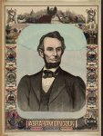
Abraham Lincoln
Zack Laws

Slide 2
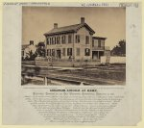
1860
Photo shows the house where Abraham Lincoln lived in Springfield, Illinois, with presidential candidate Abraham Lincoln standing on the terrace, with his sons Willie and Tad.
http://www.loc.gov/pictures/item/2009630661/

Slide 3
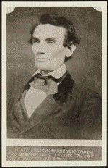
May 10, 1854 Tazewell County, Illinois
Dunham v. Bale
Robert Dunham, as administrator of James Dunham's estate, retained Lincoln and sued James Bale and Jacob Bale in an action of trove. Dunham dismissed his suit against the Bales. Lincoln and his co-counsel received $10 for their legal services.
http://hdl.loc.gov/loc.rbc/lprbscsm.scsm1575

Slide 4
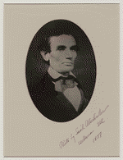
May 31, 185
Smith v. Campbell
Campbell sued Smith in an action of slander and requested $2,000 in damages. Campbell, the state's attorney, claimed that Smith publicly accused him of drunkenness. Smith pleaded not guilty, but the jury found for Campbell and awarded $450. Smith appealed to the Illinois Supreme Court on the grounds that the verdict contradicted the evidence. The court dismissed the appeal after Smith failed to file the court record on time. Lincoln represented Campbell in the trial and the appeal.
http://hdl.loc.gov/loc.rbc/lprbscsm.scsm1553

Slide 5
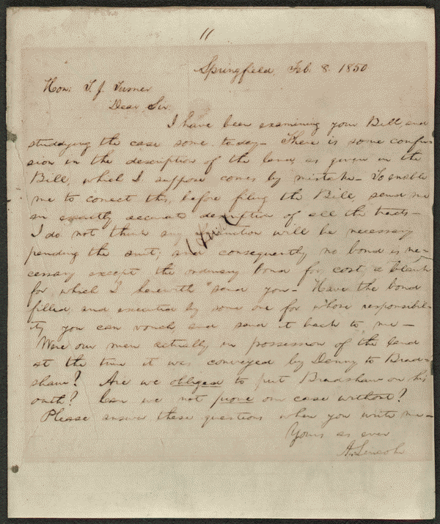
September 16, 1851 Tazewell County, Illinois
Harris v. Shaw
In 1835, Harris donated twenty acres of land in Tremont, Illinois, to Tazewell County for the erection of the county courthouse. In 1849, the legislature authorized the removal of the county seat to Pekin, Illinois, and specified that the Tremont courthouse be used for education. Harris retained Lincoln and sued to recover the property from the school trustees, but the circuit court ruled for the trustees. Harris appealed to the Illinois Supreme Court, and Lincoln argued that the land had been given on the condition that it be used as the county seat. The supreme court rejected Lincoln's argument and affirmed the judgment. Justice Trumbull ruled that Harris had given the land unconditionally, but had "the land been granted upon condition that it should be used for a particular purpose, it would unquestionably have reverted to the donor when it ceased to be thus used."
http://hdl.loc.gov/loc.rbc/lprbscsm.scsm1525

Slide 6
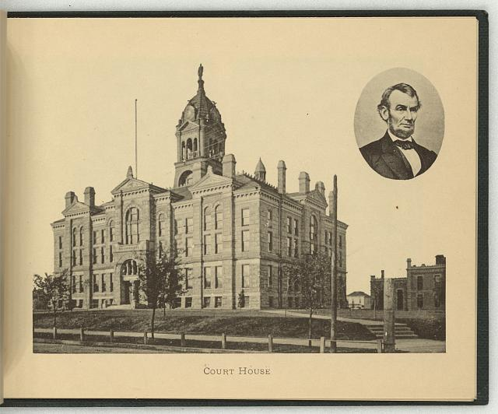
1897
Court house
Print showing exterior view of the courthouse in Lincoln, Nebraska; includes a bust portrait of Abraham Lincoln, facing right, in oval, in upper right corner.
http://www.loc.gov/pictures/item/2009630142/

Slide 7
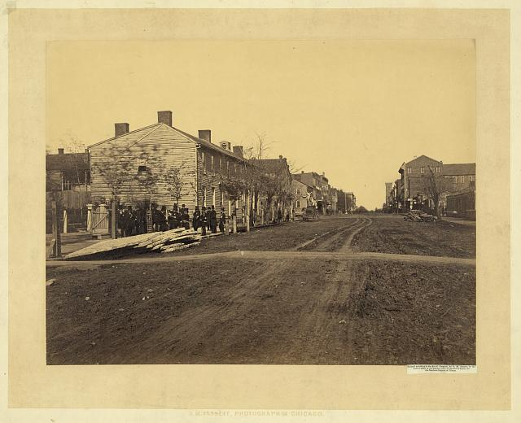
1865
Lincoln, birthplace
Photograph shows men wearing suits and top hats standing on the side of the road at the end of a row of buildings at or near the site of the Globe Tavern in Springfield, Illinois.
http://www.loc.gov/pictures/item/2008680255/

Slide 8
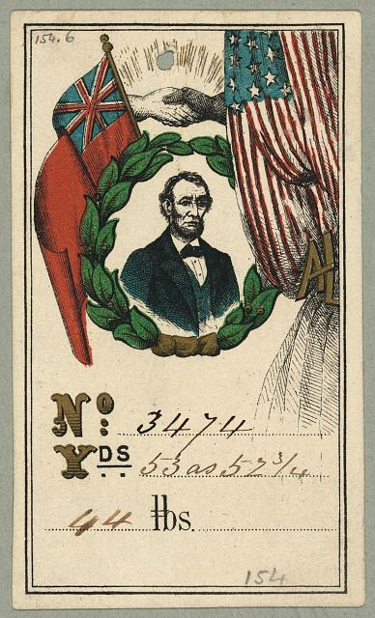
1890
Fabric tag showing head-and-shoulders portrait of Abraham Lincoln, facing right, within a wreath, beneath two hands grasped in a handshake, flanked by British and American flags.
http://www.loc.gov/pictures/item/2009630138/

Slide 9
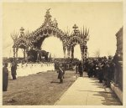
1865
Funeral of Abraham Lincoln
Photographs show funeral of Abraham Lincoln. Decorated hearse, funeral train with military guards, former home of the President, funeral procession entering Chicago courthouse, groups of spectators, etc.
http://www.loc.gov/pictures/item/2005688778/

