Slide 1
You and the Law Abraham Lincoln Lawyer
Tyler Kauffman
11/19/12

Slide 2
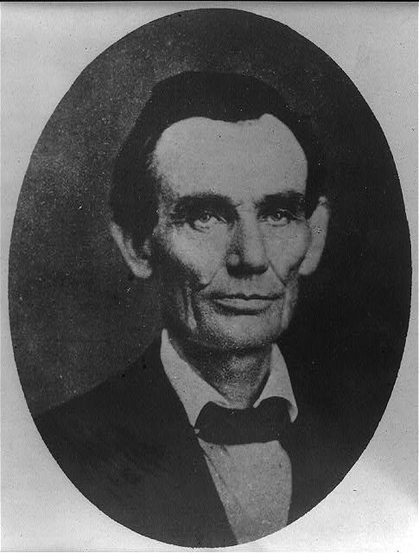
Abraham Lincoln travelin lawyer
Published:1857 May 27
Photographer: Joslin, Amon T
Portrait of Abraham Lincoln
http://www.loc.gov/pictures/item/2008678328/

Slide 3
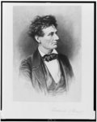
Lincoln the Lawyer
Published between 1865-19010
Portrait of Lincoln
http://www.loc.gov/pictures/item/98517810/

Slide 4
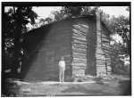
Lincoln Courthouse
Location: Macon Illinois
Building made: 1832
Courthouse Lincoln was in.

Slide 5
Montgomery Courthouse
Location: Montgomery Courthouse
Published: 1859

Slide 6
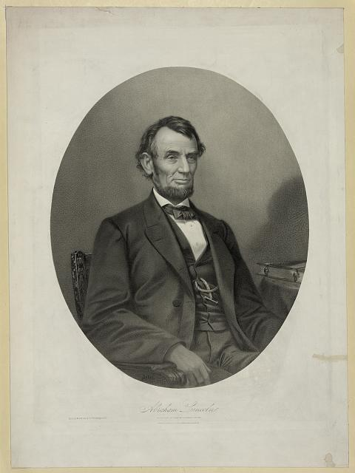
Lincoln Portrait
Abraham Lincoln in 1865 and after his lawyer days.
http://www.loc.gov/pictures/item/2006677686/

Slide 7
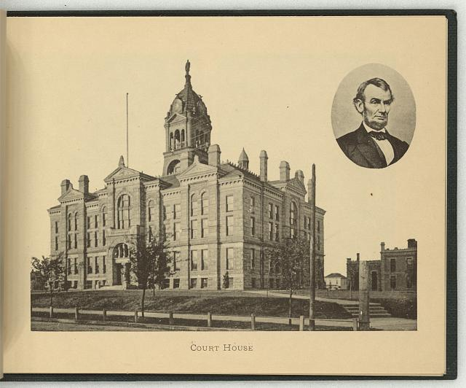
Lincoln and Courthouse
Abraham Lincoln and a courthouse in Lincoln, Nebraska.
Published in 1897
http://www.loc.gov/pictures/item/2009630142/

Slide 8
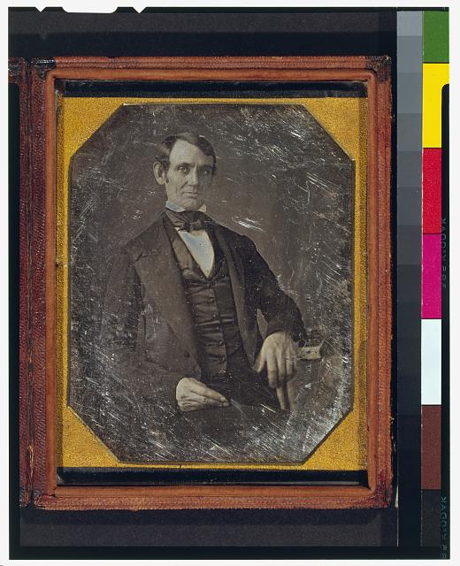
Young Lincoln
Published 1846 or 47
Young Picture of Abraham
One of the few pictures of him without a bread.

Slide 9
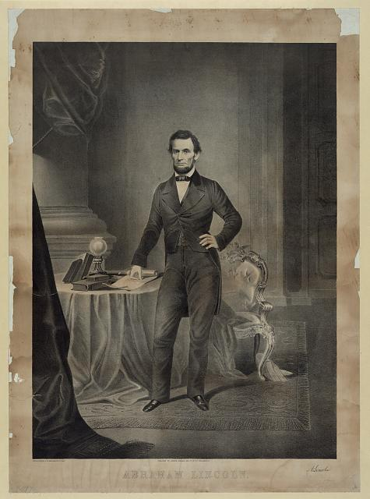
Abraham Lincoln President
Lincoln when he first became president. Published around start of Presidency. http://www.loc.gov/pictures/resource/pga.03364/

Slide 10
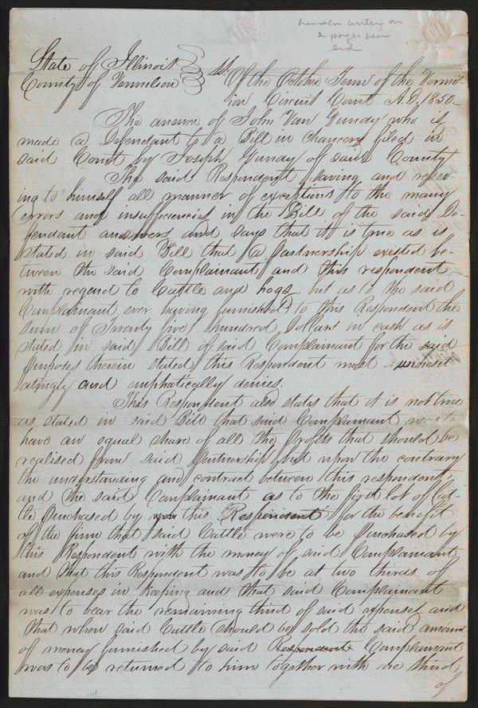
Gundy Vs Gundy
Gundy Family split apart there hog business and Joseph sued John.
Joseph won 415 dollars.
http://memory.loc.gov/cgi-bin/query/h?ammem/scsmbib:@field%28DOCID+@lit%28scsm001444%29%29

Slide 11
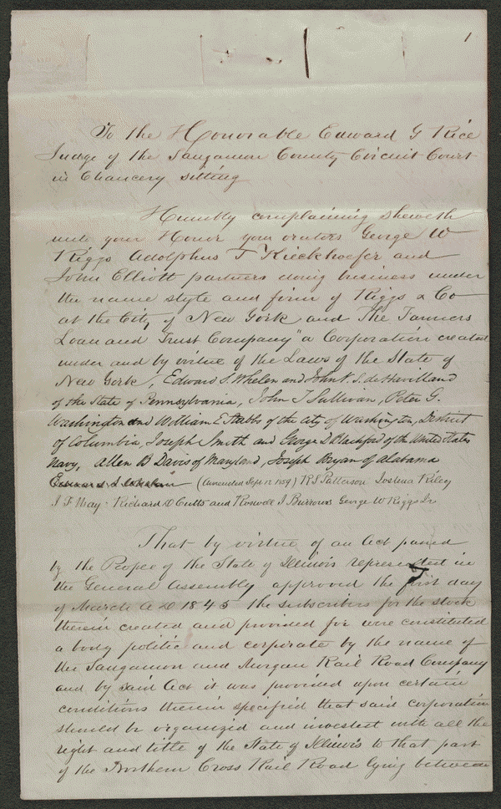
Farmer’s Loan and Trust Co. vs. Great Western Railroad Company
Railroad borrowed million dollars and Bonds and the Railroad failed to pay it.
http://memory.loc.gov/cgi-bin/query/h?ammem/scsmbib:@field%28DOCID+@lit%28scsm001592%29%29

Slide 12
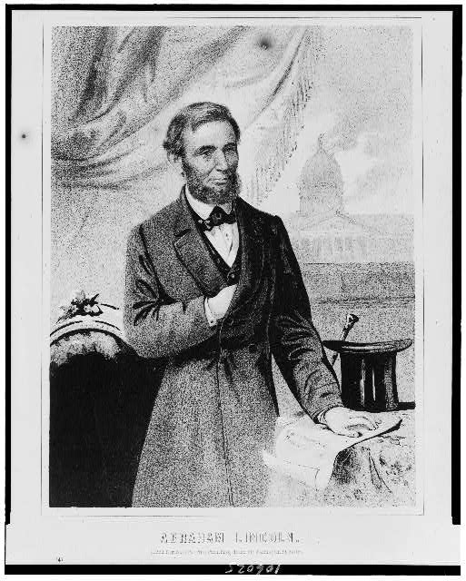
Abraham Lincoln just after being a lawyer
http://www.loc.gov/pictures/resource/cph.3c06025/

