Slide 1
Lincoln
Trevor Addis

Slide 2
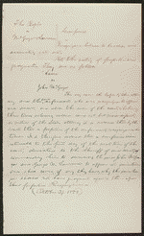
Attorney's Notes in People v. McGregor & Lawrence
http://hdl.loc.gov/loc.rbc/lprbscsm.scsm1488
Created/Published
October 29, 1858 Illinois
Summary: The state's attorney indicted McGregor for forgery. Lawrence signed as a surety on McGregor's recognizance bond. McGregor failed to appear, and the court ruled that McGregor had forfeited the recognizance. The state's attorney sued McGregor and Lawrence to recover the $100 penalty on the bond. Lawrence retained Lincoln and claimed that there was a variance between the record of judgment and the writ of scire facias. The court quashed the writ of scire facias and continued the case. The resolution of the case is unknown.

Slide 3
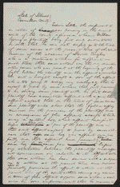
Affidavit in Young v. Littler
Created/Published
May, 1850 Vermilion County, Illinois
Summary: Young sued Littler for $1,000 for assault and battery. The fight occurred on Young's property after Littler claimed that a hog belonged to him. Littler, represented by Lincoln, pleaded self-defense and claimed that Young had tried to assault him with a gun and a club. Young died, and his attorney abated the case.
http://hdl.loc.gov/loc.rbc/lprbscsm.scsm1440

Slide 4
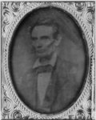
Photo shows Abraham Lincoln in an image that was widely reproduced on presidential campaign ribbins in 1860. Lincoln reportedly liked the photograph and often signed prints for admirers. (Source: Ostendorf, p. 29)
[probably 1858, copied later]
http://www.loc.gov/pictures/item/2009630654/

Slide 5
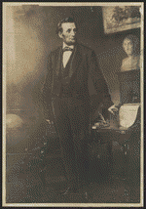
http://hdl.loc.gov/loc.rbc/lprbscsm.scsm0646
Full-length portrait. The original was "begun in Washington in the fall of 1864 and completed the following spring at Frankfort-on-Main." Wilson, R. R. Lincoln in portraiture, New York, 1935.

Slide 6
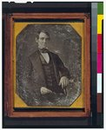
[Springfield, Ill., 1846 or 1847]
This daguerreotype is the earliest-known photograph of Abraham Lincoln, taken at age 37 when he was a frontier lawyer in Springfield and Congressman-elect from Illinois. (Source: Ostendorf, p. 4)
http://www.loc.gov/pictures/item/2004664400/

Slide 7
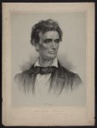
Print showing Abraham Lincoln, head-and-shoulders portrait, facing right.
Boston : Thayer & Eldridge, Publishers for N.E. States, c1860 (Boston : J.H. Bufford's Lith. 313 Washington St.)
http://www.loc.gov/pictures/item/2006680102/

Slide 8
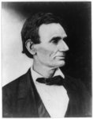
http://www.loc.gov/pictures/item/2009630674/
Reproduction of photo of Lincoln made from a negative taken in Springfield, Illinois, by Alexander Hesler on June 3, 1860. One of several poses from that day. "Wrote Lincoln's law partner, William H. Herndon, 'There is the peculiar curve of the lower lip, the lone mole on the right cheek, and a pose of the head so essentially Lincolnian; no other artist has ever caught it.'" (Source: Ostendorf, p. 46)
[c1899 and c1909, from a photo taken in 1860]

Slide 9
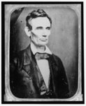
Photo shows Abraham Lincoln in an image that was widely reproduced on presidential campaign ribbons in 1860. Lincoln reportedly liked the photograph and often signed prints for admirers. (Source: Ostendorf, p. 29)
[probably 1858, copied later]
http://www.loc.gov/pictures/item/2009630652/

Slide 10
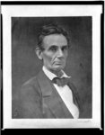
[1859 Oct. 4, printed later]
http://www.loc.gov/pictures/item/2009630657/

Slide 11
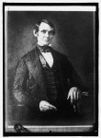
1847.
http://www.loc.gov/pictures/item/npc2008000116/

Slide 12
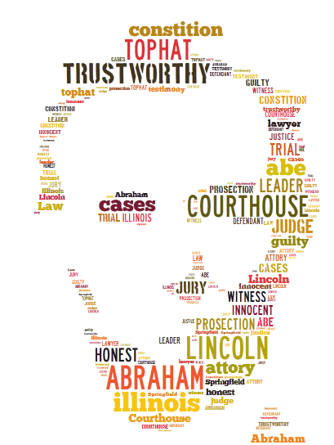
tagxedo

