Slide 1
Abraham Lincoln
By:Tiarra Scott

Slide 2
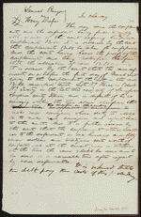
Item Title
Decree in Runyon v. Dresser, [Law papers].
Author/Creator
Author: Lincoln, Abraham
Created/Published
November 23, 1843 Sangamon County, Illinois
Notes
Appears to be in Lincoln's hand.
Summary: Runyon worked for Dresser for 162 days but received no pay. Runyon and Dresser agreed that Dresser would give Runyon one lot in Springfield, Illinois, as payment. The parties sought arbitration to assign values to the lot and the labor. The arbitrators estimated the value of the lot at $441.66, and the value of the labor at $284.37. The arbitrators ruled that Runyon could pay the balance due of $157.29 by performing carpentry work for Dresser. Dresser refused to accept Runyon's labor and to convey the lot to him. Runyon retained Logan and Lincoln and sued Dresser in a chancery action of specific performance to order Dresser to convey the land and to accept Runyon's labor. Dresser failed to appear, and the court ruled for Runyon.
http://hdl.loc.gov/loc.rbc/lprbscsm.scsm1415

Slide 3
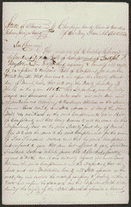
Item Title
Answer in Taylor v. Cherry, [Law papers].
Author/Creator
Author: Lincoln, Abraham Author: Cherry, Charles
Created/Published
May 22, 1855 Champaign County, Illinois
Summary: Taylor wanted to buy a mill dam and mill along the Sangamon River from Cherry and offered him $1,700. Cherry wanted $3,000. After a flood destroyed the mill and mill dam, Cherry accepted the $1,700 offer. Taylor, who did not know of the destruction, gave Cherry three promissory notes. After Taylor discovered what had happened, he sued Cherry for an injunction to stop him from assigning the notes to other people. Cherry apparently retained Lincoln. Taylor later dismissed the case.
Digital ID - http://hdl.loc.gov/loc.rbc/lprbscsm.scsm1450

Slide 4
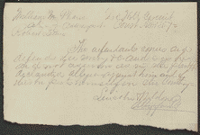
Item Title
Plea in Lewis v. Phares, [Law papers].
Author/Creator
Author: Lincoln, Abraham Author: Neldon?
Created/Published
March 09, 1857 DeWitt County, Illinois
Notes
Summary: Lewis appealed a $100 JP judgment and sued Phares for $1,000 in damages for failing to tend a wheat crop. Lewis had agreed to pay Phares $260 for sowing and harrowing 160 acres of wheat. He paid Phares $160 but refused to pay a $100 promissory note for the balance, claiming that Phares harrowed the wheat so poorly that the land produced only half the expected yield. The court agreed to consolidate the two cases, but Lewis then agreed to a nonsuit in the consolidated case.
Digital ID - http://hdl.loc.gov/loc.rbc/lprbscsm.scsm1474

Slide 5
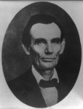
Title: [Abraham Lincoln while a traveling lawyer, taken in Danville, Illinois
Creator(s): Joslin, Amon T., photographer
Date Created/Published: 1857 May 27 [printed later]
Notes:
Illus. in: The Photographs of Abraham Lincoln / Frederick Hill Meserve. New York, Privately printed, 1911, p. 43.
Original photograph: The original ambrotype is at the Illinois State Historical Library.
Ostendorf, no. 3
Meserve, no. 2
Published in: Lincoln's photographs: a complete album / by Lloyd Ostendorf. Dayton, OH: Rockywood Press, 1998, p. 8-9.
Bookmark This Record: http://www.loc.gov/pictures/item/2008678328/

Slide 6
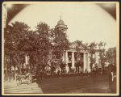
Title: The Coles County Court House in Charleston, Ills., in which Lincoln often practiced law and before which he made a short speech in the evening after his fourth joint debate with Douglas, Sept. 18, 1858
Date Created/Published: [between 1860 and 1898?]
Summary: Photograph showing courthouse with people and horse-drawn wagons in front.
Bookmark This Record: http://www.loc.gov/pictures/item/2008680974/

Slide 7
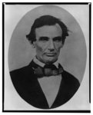
Title: [Abraham Lincoln, head-and-shoulders portrait, facing slightly left, taken in Pittsfield, Illinois, two weeks before the final Lincoln-Douglas debate in Lincoln's unsuccessful bid for the Senate, October 1, 1858]
Creator(s): Jackson, Calvin, fl. 1858-1882, photographer
Date Created/Published: [printed between 1900 and 1911]
Bookmark This Record: http://www.loc.gov/pictures/item/98504517/

Slide 8
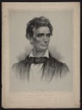
Title: Abraham Lincoln from a portrait taken from life by Charles A. Barry, Springfield, Illinois, June 1860 / on stone by J.E. Baker ; J.H. Bufford's Lith. 313 Washington St. Boston.
Creator(s): J.H. Bufford's Lith.,
Related Names: Baker, Joseph E., ca. 1837-1914 , artist Barry, Charles A., 1830-1892 , copyright claimant
Date Created/Published: Boston : Thayer & Eldridge, Publishers for N.E. States, c1860 (Boston : J.H. Bufford's Lith. 313 Washington St.)
Summary: Print showing Abraham Lincoln, head-and-shoulders portrait, facing right.
Bookmark This Record: http://www.loc.gov/pictures/item/2006680102/

Slide 9
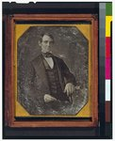
Title: [Abraham Lincoln, Congressman-elect from Illinois. Three-quarter length portrait, seated, facing front]
Creator(s): Shepherd, Nicholas H., photographer
Date Created/Published: [Springfield, Ill., 1846 or 1847]
Medium: 1 photograph : quarter plate daguerreotype ; plate 4 1/4 x 3 1/4 in.
Summary: This daguerreotype is the earliest-known photograph of Abraham Lincoln, taken at age 37 when he was a frontier lawyer in Springfield and Congressman-elect from Illinois. (Source: Ostendorf, p. 4)
Bookmark This Record: http://www.loc.gov/pictures/item/2004664400/

Slide 10
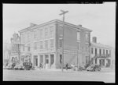
Title: The Posey Building of Shawneetown, Illinois, in which Abraham Lincoln and Robert Ingersoll had law offices
Creator(s): Lee, Russell, 1903-1986, photographer
Date Created/Published: 1937 Apr.
Bookmark This Record: http://www.loc.gov/pictures/item/fsa1998022486/PP/

Slide 11
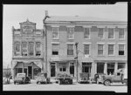
Title: An old grocery building and the Posey Building where Abraham Lincoln and Robert Ingersoll had law offices. Shawneetown, Illinois
Creator(s): Lee, Russell, 1903-1986, photographer
Date Created/Published: 1937 Apr.
Bookmark This Record: http://www.loc.gov/pictures/item/fsa1998022487/PP/

Slide 12
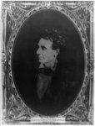
Title: [Abraham Lincoln, immediately prior to Senate nomination, Chicago, Illinois]
Creator(s): Hesler, Alexander, 1823-1895, photographer
Date Created/Published: [1857 February 28, printed later]
Medium: 1 photographic print : gelatin silver.
Summary: Abraham Lincoln, head-and-shoulders portrait, facing right. According to Ostendorf, this portrait by Hessler was copied during Lincoln's campaign and further distributed.
Bookmark This Record: http://www.loc.gov/pictures/item/2008678332/

Slide 13
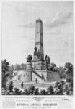
Title: National Lincoln Monument, Oak Ridge Cemetery, Springfield, Illinois
Date Created/Published: c1876.
Bookmark This Record: http://www.loc.gov/pictures/item/96508433/

Slide 14
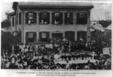
Title: [Abraham Lincoln at his home in Springfield, Illinois, with a large crowd of people gathered outside after a Republican rally, August 8, 1860]
Creator(s): Shaw, William, photographer
Date Created/Published: [between 1900 and 1930]
Bookmark This Record: http://www.loc.gov/pictures/item/2009630655/

