Slide 1
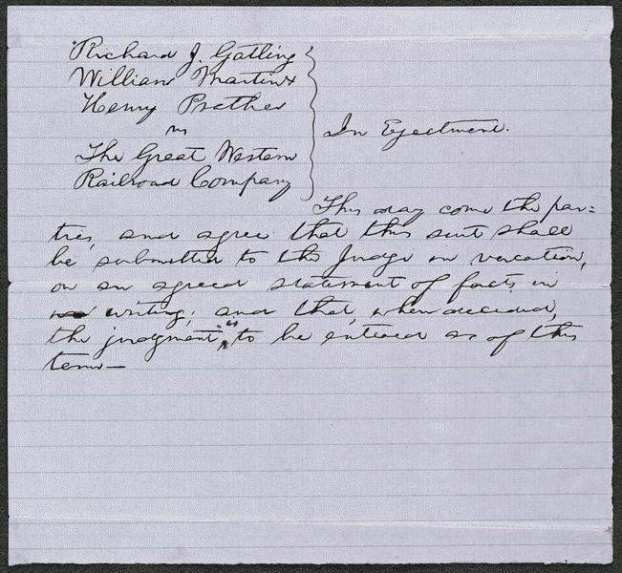
Title: Order in Gatling et al. vs. Great Western Railroad
Summary: Gatling Martin, and Prather found Lincoln and sued the Great Western Railroad for unlawful detention of the five acres of their land. The railroads depot built the property, and had burned. Gatling requested $500 in damages. He dismissed the suit. But later invented the rapid fire. “Gatling Gun”
Published in October 1880.
Digital ID
lprbscsm scsm1457 http://hdl.loc.gov/loc.rbc/lprbscsm.scsm1457
.

Slide 2
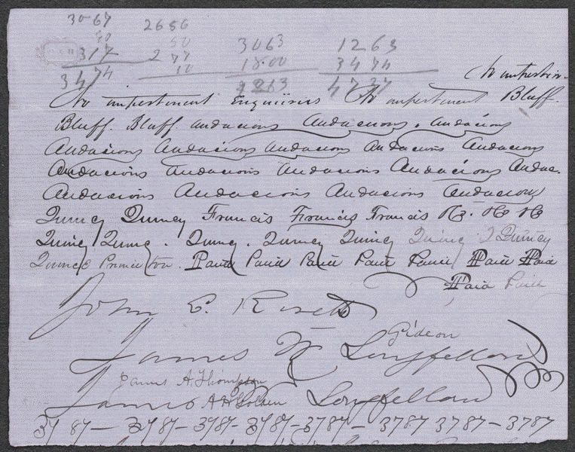
Title: Bill of Exceptions in Gray v. Gray et al.
Summary: Mary Gray sued Franklin Gray after a divorce. Franklin had failed to show and Mary got rewarded to $5,000 in alimony. Five years later Mary found Lincoln and Herndon and filed a writ of error in Illinois supreme court to reverse the divorce decree since Franklin died. Defendants moved to dismiss the writ stating that the supreme court had no original jurisdiction in the subject. The supreme court overruled the motion. But dismissed the suit after Mary failed to join on the plea.
Published: September 1, 1851 in Sangamon County, IL.
Created by: Riseth, John b.
And Longfellow James.
Digital ID
lprbscsm scsm1529 http://hdl.loc.gov/loc.rbc/lprbscsm.scsm1529

Slide 3
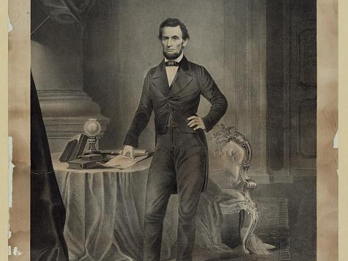
Abraham Lincoln/ Herline and Hensel, lith, 632 Chestnut St., Phila.
.
Published: between 1860-1865
Bookmark This Record: http://www.loc.gov/pictures/item/2006677676/

Slide 4
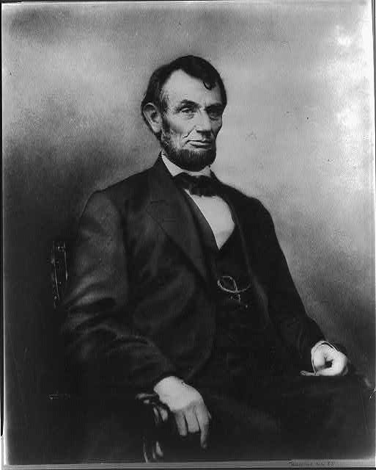
Abraham Lincoln: five dollar bill portrait.
Portrait used for the engraved bust of the Lincoln that appeared on the United States five dollar bill for many years from 1914 to 2007
Was published around the 1860’s
Bookmark This Record: http://www.loc.gov/pictures/item/96524282/

Slide 5
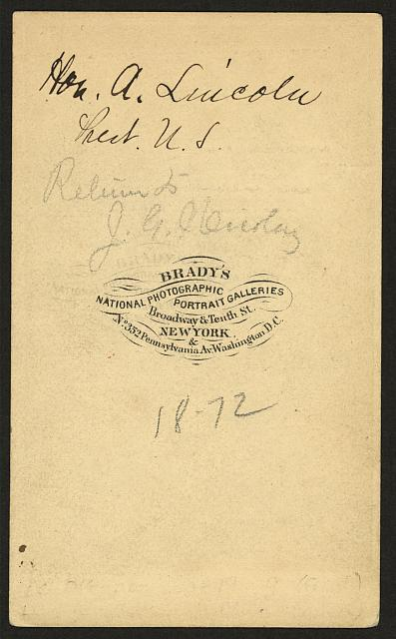
Abraham Lincoln, and His signature/emblem of the Brady’s National Photographic Portrait Galleries, in New York
Photograph showing of Lincoln, head and shoulders. Taken January 8, 1864.
Bookmark This Record: http://www.loc.gov/pictures/item/2008680390/

Slide 6
Campaign button of Abraham Lincoln.
Political campaign button for 1864 presidential election showing portrait of Abraham Lincoln, facing left (Anthony Berger photo Feb. 9, 1864); metal casing with pin fastener attached.
Bookmark This Record: http://www.loc.gov/pictures/item/2008680236/

Slide 7
Wordal

