Slide 1
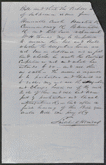
McDaniel Vs. Thomas
Item Title
Bill of Complaint in McDaniel v. Thomas, [Law papers].
Author/Creator
Author: Lincoln, Abraham Author: Herndon, William Henry
Created/Published
April, 1859 Sangamon County, Illinois
Notes
Summary: McDaniel sold 117 acres of land to Thomas for $3,000. Thomas paid $300 down and gave McDaniel three promissory notes for the balance. After Thomas failed to pay the notes, McDaniel retained Lincoln and Herndon and sued Thomas to enforce the sale of the land. McDaniel asked the court to permit him to complete the contract by giving Thomas a deed, to allow a vendor's lien, to sell enough of the land to pay the notes, and to order Thomas to pay rent for using the property. The parties later reached a settlement, and McDaniel dismissed the case and paid the costs.
Digital ID
lprbscsm scsm1496 http://hdl.loc.gov/loc.rbc/lprbscsm.scsm1496

Slide 2
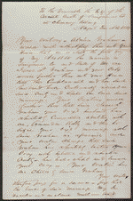
Graham Vs. Graham
Item Title
Bill for Divorce in Graham v. Graham, [Law papers].
Author/Creator
Author: Lincoln, Abraham Author: Herndon, William Henry
Created/Published
August 02, 1859 Sangamon County, Illinois
Notes
Summary: Almira Graham retained Lincoln and Herndon and sued James Graham for divorce on the grounds of cruelty and adultery with Amanda Kelly. She also requested custody of their one child. Almira Graham claimed that James Graham beat her causing bruises on her body. Amanda Kelly testified that she had had a bastard child and that James Graham was the father. A constable arrested Graham for bastardy and testified that Graham "stated that he did not know whether he was the father ... but that he had a chance to be." Other testimony showed James Graham to be a drunkard. James Graham failed to appear, and the court ruled for Almira Graham and granted the divorce.
Digital ID
lprbscsm scsm1497 http://hdl.loc.gov/loc.rbc/lprbscsm.scsm1497

Slide 3
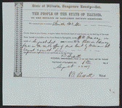
McAtee Vs. Envert
Item Title
Summons in McAtee et al. v. Enyert, [Law papers].
Author/Creator
Author: Herndon, William Henry Author: Lincoln, Abraham
Created/Published
August 01, 1849 Springfield, Illinois
Notes
Summary: Enyart retained Lincoln and Herndon and sued McAtee to set aside a land sale. Enyart charged that McAtee used terror and intoxication to persuade him to sell ninety acres of land, valued at $1,000, to McAtee for $350. The court ruled for Enyart, voided the deed, and ordered McAtee to re-convey the property to Enyart. McAtee appealed to the Illinois Supreme Court, which affirmed the judgment. Chief Justice Treat stated that, as a general rule, the courts did not set aside land conveyances because of an inadequate price. A chancery court "will not rescind an executed contract merely because the consideration was inadequate." However, Treat reasoned, "fraud, mistake, or undue influence" were proper grounds for annulling a land sale. Treat believed that McAtee exercised "fraudulent practices" and "undue influence" through terror and intoxication to obtain Enyart's land. Treat recounted that McAtee pressured Enyart to sell the land and to flee the area to avoid imprisonment. The state's attorney had indicted Enyart for stealing a pair of shoes, but Enyart had paid bail. At that point, Treat stated, McAtee took advantage of Enyart's youth and weak mind, plied him with liquor, pressured him to sell at the unfair price, and even offered to plan an escape route. "Finally," Treat wrote, "under the combined influence of intoxication and fear," Enyart sold the land. Treat concluded: "It is very evident that but for these expedients the purchase could not have been effected....Barely competent at any time to transact business discreetly, and peculiarly disqualified on that occasion by intoxication and terror, he [Enyart] was completely in the power of the defendant." Treat voided the deed because of McAtee's "improper influences" and "fraudulent practices," not because of the inadequate price.
Digital ID
lprbscsm scsm1435 http://hdl.loc.gov/loc.rbc/lprbscsm.scsm1435

Slide 4
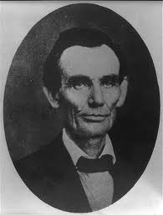
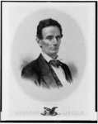
Lincoln the lawyer
Title: [Abraham Lincoln while a traveling lawyer, taken in Danville, Illinois
Creator(s): Joslin Amon, photographer
Date Created/Published: 1857 May 27 [printed later
Title: Abraham Lincoln / lith. & published by Edw. Mendel.
Creator(s): Mendel, Ed, lithographer
Date Created/Published: Chicago : Edw. Mendel, [between 1850 and 1900?]

Slide 5
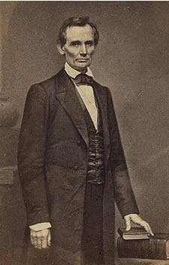
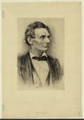
Abraham Lincoln holding James Wadeworth’s family pictures.
Library of Congress Manuscript division
Title: Portrait of Lincoln
Date Created/Published: [between 1900 and 1950]
Medium: 1 print : etching.
Summary: Print shows Abraham Lincoln, head-and-shoulders portrait, facing right.

Slide 6
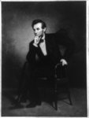
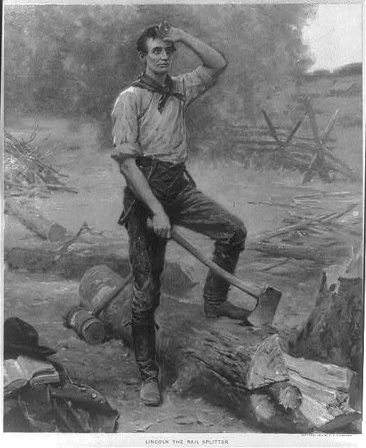
Title: [Abraham Lincoln, full-length portrait, seated, facing left, with hand under chin] / G.P.A. Healy, 1887.
Creator(s): Healy, G. P. A. (George Peter Alexander), 1813-1894, artist
Date Created/Published: [between 1920 and 1950]
Title: Lincoln the rail splitter
Date Created/Published: c1909.
Medium: 1 photomechanical print : color.
Summary: Abraham Lincoln standing over log, holding axe, with left hand raised to his brow.

Slide 7
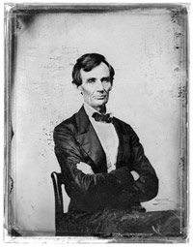
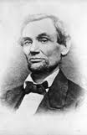
Abraham Lincoln sits for a portrait in an ambrotype by Preston Butler, Aug. 13, 1859. Prints and Photographs Division.
Abraham Lincoln gets a portrait taken in Chicago, Il, while working as a traveling lawyer.

Slide 8
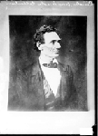
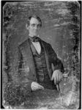
Contributor:Chicago Daily News, IncSite:American Memory-culturalOriginal Format:Photo, Print, DrawingDate:1909
Title: [Abraham Lincoln, Congressman-elect from Illinois. Three-quarter length portrait, seated, facing front]
Creator(s): Shepherd, Nicholas H., photographer
Date Created/Published: [Springfield, Ill., 1846 or 1847]
Medium: 1 photograph : quarter plate daguerreotype ; plate 4 1/4 x 3 1/4 in.
Summary: This daguerreotype is the earliest-known photograph of Abraham Lincoln, taken at age 37 when he was a frontier lawyer in Springfield and Congressman-elect from Illinois. (Source: Ostendorf, p. 4)

Slide 9
Wordle

