Slide 1
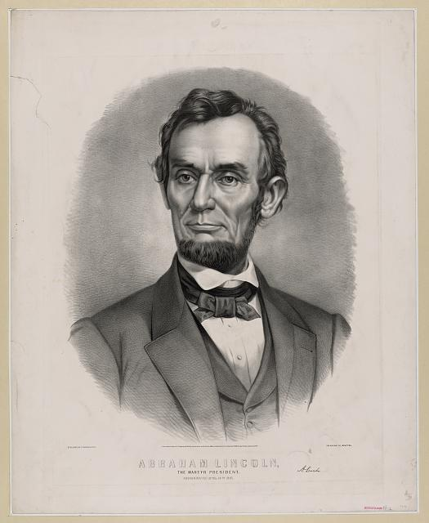
Lincoln as a lawyer
http://www.loc.gov/pictures/resource/pga.03167/

Slide 2
Wordle

Slide 3
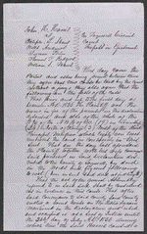
Harris -vs.- Shaw
1835, Harris donated twenty acres of land in Tremont, Illinois, to Tazewell County for the erection of the county courthouse.
In 1849, the legislature authorized the removal of the county seat to Pekin, Illinois, and specified that the Tremont courthouse be used for education.
Harris retained Lincoln and sued to recover the property from the school trustees, but the circuit court ruled for the trustees.

Slide 4
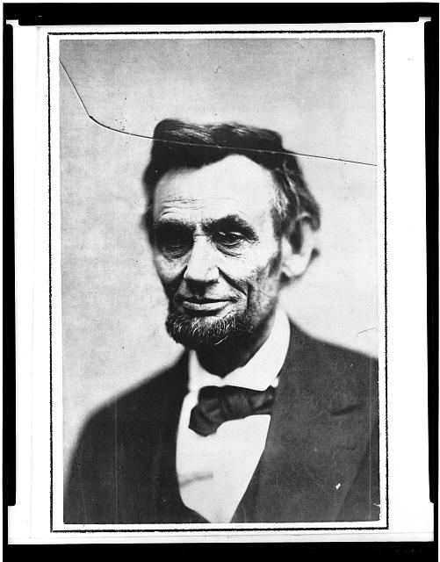
Harris -vs.- Shaw
Harris appealed to the Illinois Supreme Court, and Lincoln argued that the land had been given on the condition that it be used as the county seat.
The supreme court rejected Lincoln's argument and affirmed the judgment.
Justice Trumbull ruled that Harris had given the land unconditionally, but had "the land been granted upon condition that it should be used for a particular purpose, it would unquestionably have reverted to the donor when it ceased to be thus used."
http://www.loc.gov/pictures/resource/cph.3a11366/

Slide 5
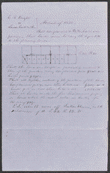
Knight -vs.-Carter
Knight retained Lincoln and sued the heirs of Washington Carter to settle a partnership.
Carter and Knight had been partners in selling land and livestock and in farming.
The court appointed three commissioners to partition the estate's 615 acres.
http://memory.loc.gov/service/rbc/lprbscsm/scsm1555/001r.jpg

Slide 6
Knight -vs.-Carter
The commissioners assigned dower to Carter's widow, Susan Boardman.
He also gave Knight one-half of the land; and partitioned the remaining land in equal shares for Carter's three minor heirs.

Slide 7
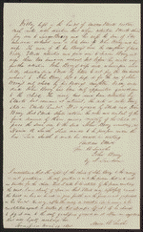
Kelly -vs.-Elliot
When William Kelly left Sangamon County, Illinois, he left enough money with Elliott to give $200 to each of Kelly's children.
Before Elliott gave $200 to Adaih Berry, she died. John Berry, Adaih's husband, requested that Elliott give the money in the form of a promissory note to John Berry's daughter Maria Berry.
Elliott refused, then several years later, William Kelly died and Elliott became the administrator of his estate.
John Berry again requested the note, but Elliott again refused.
http://memory.loc.gov/cgi-bin/ampage?collId=lprbscsm&fileName=scsm1421/lprbscsmscsm1421.db&recNum=0&itemLink=D?scsmbib:16:./temp/~ammem_Eh4N::

Slide 8
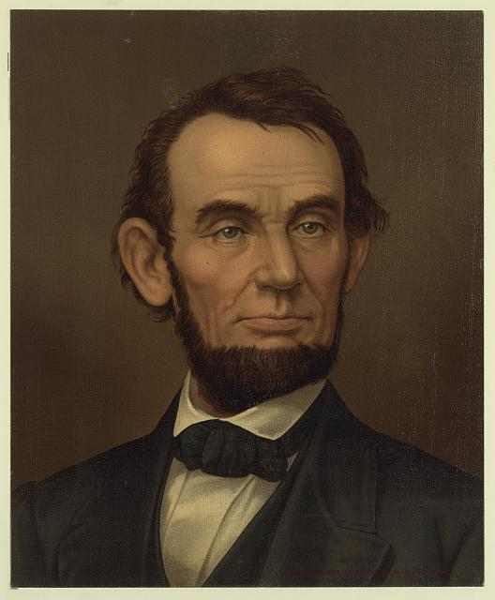
Kelly -vs.-Elliot
Berry sued Elliott and the makers of the note to pay the note over to Berry.
Elliott retained Lincoln and Herndon and argued that after Adaih Berry died, William Kelly asked Elliott not to convey the note to John Berry but to hold the note until Maria Berry reached adulthood.
In addition, Lincoln continued, an arbitrator had already decided the issue for Elliott.
The court heard the arguments and dismissed the bill, thus deciding for Elliott.
http://www.loc.gov/pictures/resource/ppmsca.19241/

Slide 9
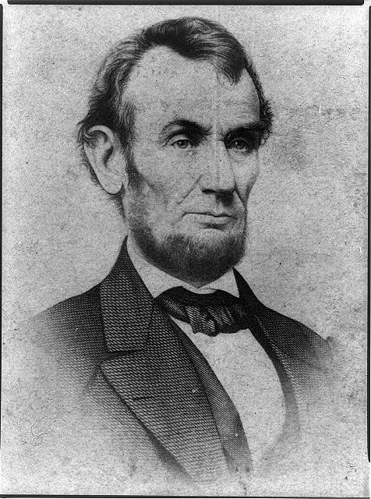
http://www.loc.gov/pictures/resource/cph.3a15821/

Slide 10
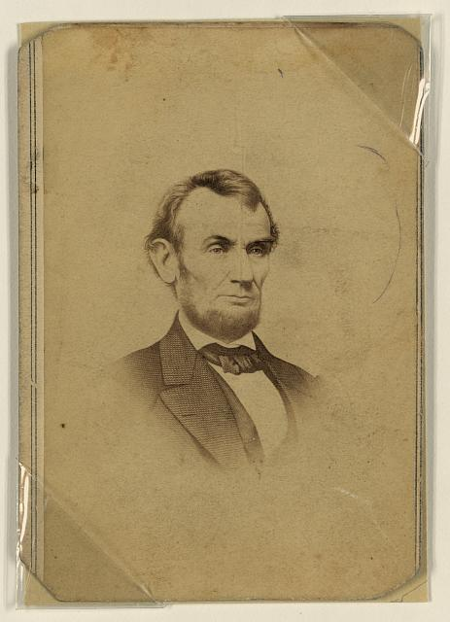
http://www.loc.gov/pictures/resource/ppmsca.23729/

Slide 11
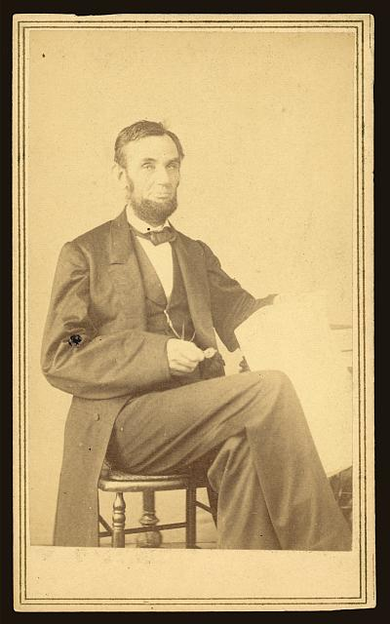
http://www.loc.gov/pictures/resource/ppmsca.19207/

Slide 12
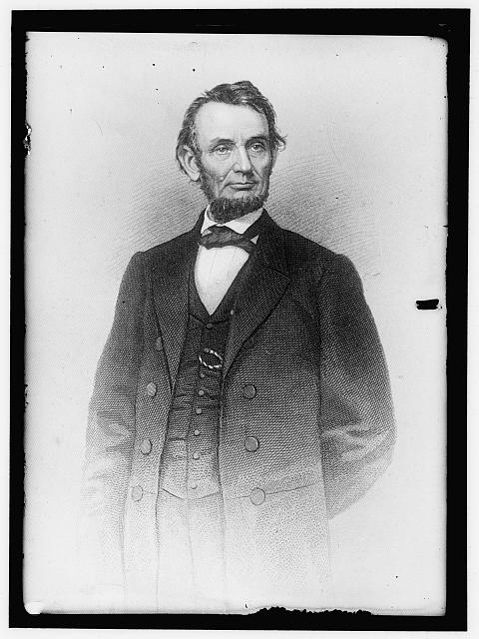
http://www.loc.gov/pictures/resource/hec.10970/

Slide 13
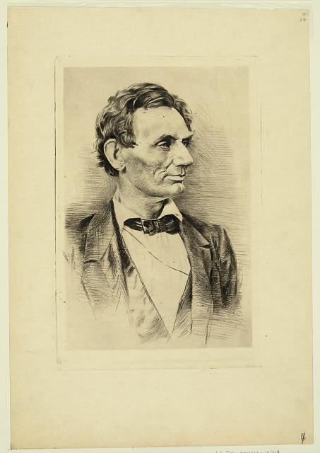
http://www.loc.gov/pictures/resource/ppmsca.19248/

