Slide 1
Lincoln
Samson Callear

Slide 2
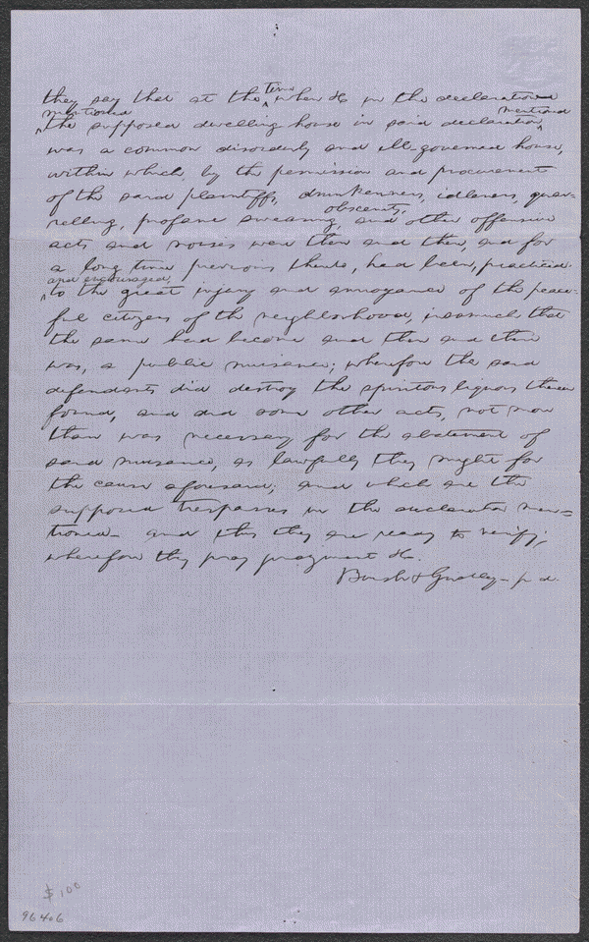
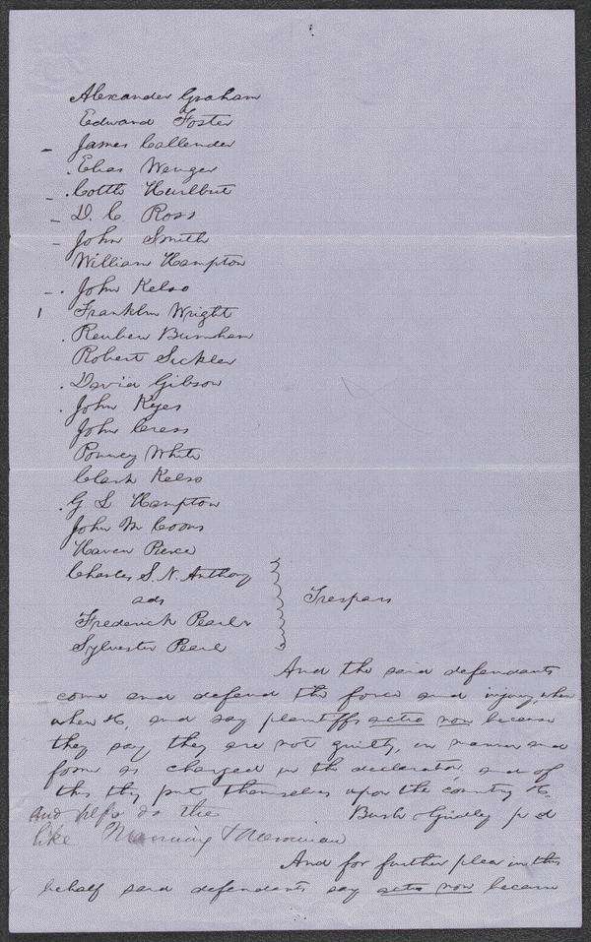
Pearl v. Pearl
http://hdl.loc.gov/loc.rbc/lprbscsm.scsm1571
Summary: Graham and twenty other men broke into a grocery store owned by Frederick Pearl and Sylvester Pearl and destroyed everything, including large amounts of liquor. Pearl and Pearl sued them in an action of trespass and requested $5,000 in damages. Graham retained Lincoln and pleaded not guilty because the grocery was actually a disorderly house where "drunkenness, idleness, quarrelling, profane swearing, obscenity, and other offensive acts" occurred. Graham and the other defendants claimed that they were peaceful citizens who became annoyed at the public nuisance and destroyed the liquor to stop the problem. Pearl and Pearl motioned for a change of venue, and the case moved to the Woodford County Circuit Court. Once in Woodford County, Lincoln motioned the court to change the venue again, and the case returned to the Tazewell County Circuit Court. Pearl and Pearl decided not to prosecute four defendants. The jury found eleven defendants not guilty, six defendants guilty, and awarded Pearl and Pearl $50 in damages. Lincoln received $25 for defending this suit and the criminal suit (People v. Sickler et al.).

Slide 3
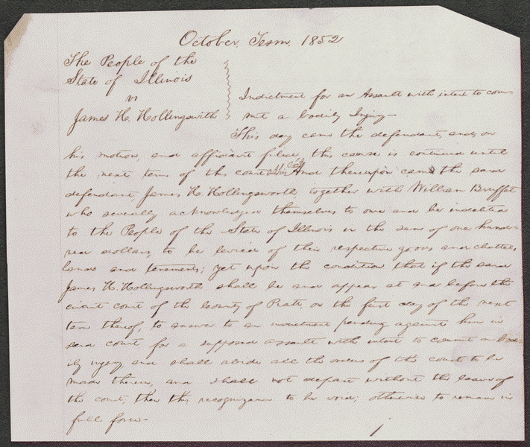
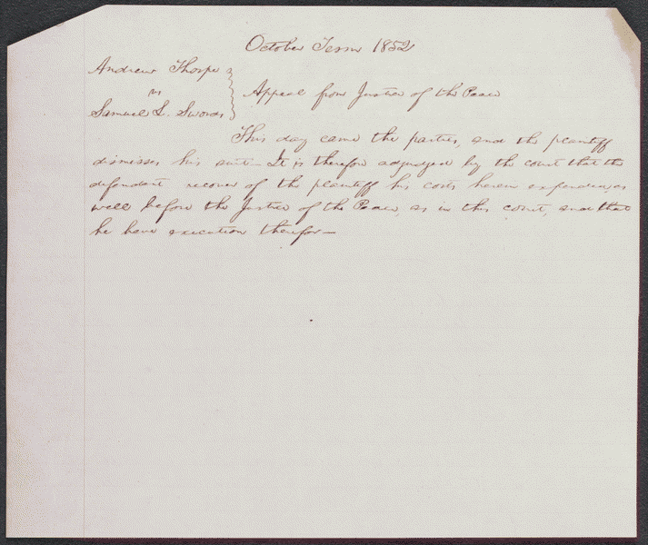
Order in People v. Hollingsworth
http://hdl.loc.gov/loc.rbc/lprbscsm.scsm1540
Summary: Hollingsworth asked Deborah Ater to care for his sick wife at his home while he was away. Jacob Ater insisted that Deborah Ater leave town with him, and when she refused, Jacob Ater assaulted her. Hollingsworth intervened, he and Jacob Ater began to fight, and Deborah Ater fled to another house. Hollingsworth again asked Deborah Ater to care for his wife, and as they were returning to Hollingsworth's house, Jacob Ater approached them "in a menacing attitude." Hollingsworth aimed a pistol at Ater and pulled the trigger, but the pistol did not fire. The state's attorney indicted Hollingsworth for assault with intent to commit bodily injury, and Hollingsworth retained Lincoln. The parties reached an agreement in which the state's attorney would cease prosecution and Hollingsworth would pay all costs, and the court dismissed the case. Thorp sued Swords in the JP court to recover a debt of $48.77. The jury found for Thorp and awarded $36.17. Swords appealed the judgment to the circuit court. Thorp failed to prosecute his case, and the court ordered a non suit. Lincoln represented one of the parties in the case

Slide 4
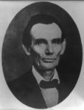
Abraham Lincoln while a traveling lawyer, taken in Danville, Illinois
Creator(s): Joslin, Amon T., photographer
Date Created/Published: 1857 May 27 [printed later]
http://www.loc.gov/pictures/item/2008678328/

Slide 5
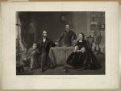
Lincoln and his family
painted by S.B. Waugh ; engraved by William Sartain.
Creator(s): Sartain, William, 1843-1924, engraver
Related Names: Waugh, Samuel Bell , artist Bradley & Company , publisher
Date Created/Published: Philadelphia : Published by Bradley & Co. 66 N. Fourth St., c1866 ( Printed by Irwin & Sartain)
http://www.loc.gov/pictures/item/2003666395/

Slide 6
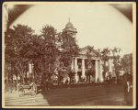
The Coles County Court House in Charleston, Ills., in which Lincoln often practiced law and before which he made a short speech in the evening after his fourth joint debate with Douglas, Sept. 18, 1858
Date Created/Published: [between 1860 and 1898?]
Medium: 1 photographic print : albumen.
Summary: Photograph showing courthouse with people and horse-drawn wagons in front.
http://www.loc.gov/pictures/item/2008680974/

Slide 7
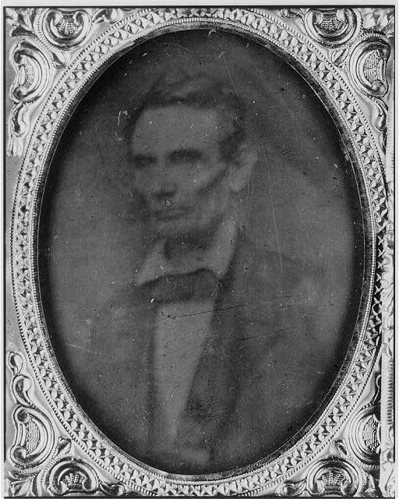
Abraham Lincoln, half-length portrait, facing left
Date Created/Published: [probably 1858, copied later]
Summary: Photo shows Abraham Lincoln in an image that was widely reproduced on presidential campaign ribbins in 1860. Lincoln reportedly liked the photograph and often signed prints for admirers. (Source: Ostendorf, p. 29)
http://www.loc.gov/pictures/item/2009630654/

Slide 8
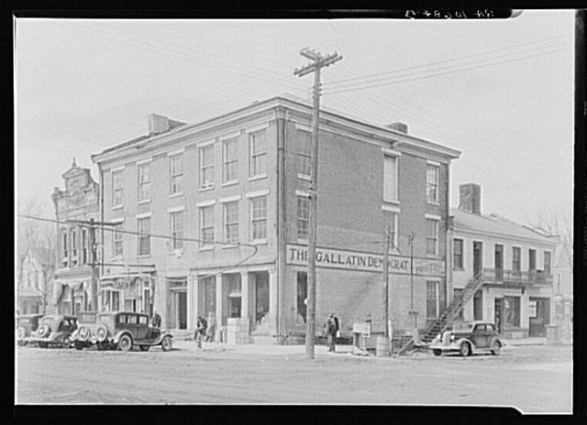
The Posey Building of Shawneetown, Illinois, in which Abraham Lincoln and Robert Ingersoll had law offices
Creator(s): Lee, Russell, 1903-1986, photographer
Date Created/Published: 1937 Apr.
http://www.loc.gov/pictures/item/fsa1998022486/PP/

Slide 9
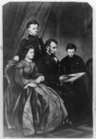
Lincoln Family
Date Created/Published: [no date recorded on caption card]
Medium: 1 print : lithograph.
Summary: Abraham Lincoln seated, full lgth., facing right; looking at book and surrounded by his wife and 2 sons.
http://www.loc.gov/pictures/item/2003675038/

Slide 10
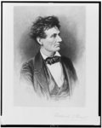
Lincoln the lawyer
Frederick T. Stuart.
Creator(s): Stuart, Frederick T., 1837-1913, etcher
Date Created/Published: [between 1865 and 1910(?)]
Medium: 1 print : etching.
Summary: Abraham Lincoln, head-and-shoulders portrait, facing right.
http://www.loc.gov/pictures/item/98517810/

Slide 11
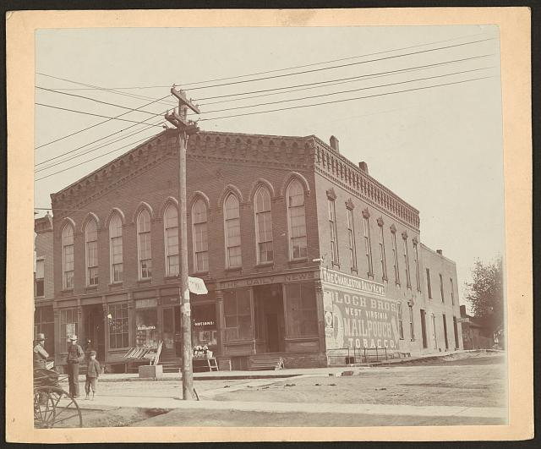
The town-hall , Charleston, Ills., where Lincoln addressed the people of the town when he paid his last visit to his stepmother in February 1861
Date Created/Published: [ca. 1900?]
Medium: 1 photographic print : albumen.
Summary: Photograph showing brick building occupied at the time of depiction by The Charleston Daily News, W. S. Williams Notions, Hop Sing Laundry, and a printing office.
http://www.loc.gov/pictures/item/2008680973/

Slide 12
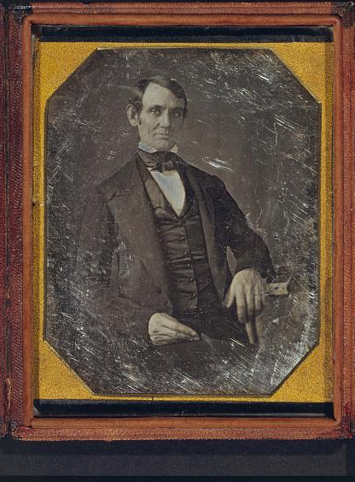
Abraham Lincoln, Congressman-elect from Illinois. Three-quarter length portrait, seated, facing front
Creator(s): Shepherd, Nicholas H., photographer
Date Created/Published: [Springfield, Ill., 1846 or 1847]
Medium: 1 photograph : quarter plate daguerreotype ; plate 4 1/4 x 3 1/4 in.
Summary: This daguerreotype is the earliest-known photograph of Abraham Lincoln, taken at age 37 when he was a frontier lawyer in Springfield and Congressman-elect from Illinois. (Source: Ostendorf, p. 4)
http://www.loc.gov/pictures/item/2004664400/

Slide 13
Lincoln at Home
Creator(s): Whipple, John Adams, 1822-1891, photographer
Date Created/Published: [1860, c1865]
Medium: 1 photographic print : albumen.
Summary: Photo shows the house where Abraham Lincoln lived in Springfield, Illinois, with presidential candidate Abraham Lincoln standing on the terrace, with his sons Willie and Tad. (Source: Ostendorf, p. 56-9.)
http://www.loc.gov/pictures/item/2009630661/

Slide 14
Wordle

