Slide 1
Abraham Lincoln
By Ryan Christiansen

Slide 2
Kellog V. Crain
Summary: Kellogg and Lewis Crain dissolved their business partnership, but Crain owed Kellogg $16,000 to pay off the business's debts. Crain died before paying, and Kellogg sued James Crain, who served as surety for Lewis Crain, in an action of debt for $16,000. The court granted a change of venue to Peoria County, but the court there remanded the case back to Tazewell County. Kellogg retained Lincoln but failed to appear, and the court dismissed the case. Kellogg motioned to reinstate the case because he was ill and could not attend court. The court set aside the dismissal and ruled for Kellogg for $16,000.
Created/Published
January 23, 1836
http://hdl.loc.gov/loc.rbc/lprbscsm.scsm1374

Slide 3
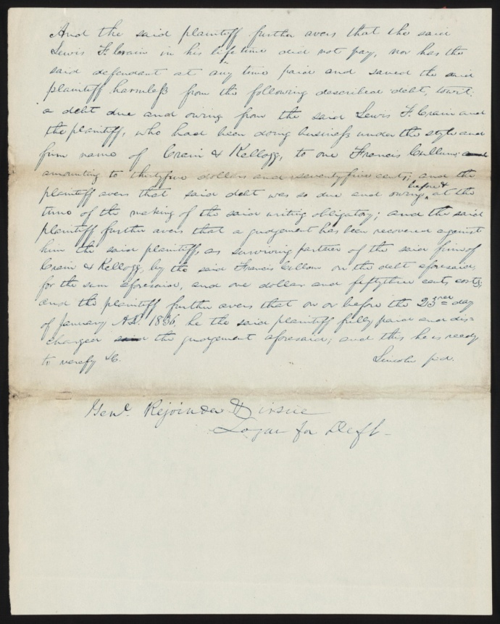

Slide 4
Campbell V. Smith
Summary: Campbell sued Smith in an action of slander and requested $2,000 in damages. Campbell, the state's attorney, claimed that Smith publicly accused him of drunkenness, neglect of duty, and collusion by purposefully drawing defective indictments through which grocery owners might escape punishment for unlawfully selling liquor in quantities of less than one quart. Smith pleaded not guilty, but the jury found for Campbell and awarded $450. Smith appealed to the Illinois Supreme Court on the grounds that the verdict contradicted the evidence. The court dismissed the appeal after Smith failed to file the court record on time. Lincoln represented Campbell in the trial and the appeal.
http://hdl.loc.gov/loc.rbc/lprbscsm.scsm1553
Created/Published
May 31, 1853

Slide 5
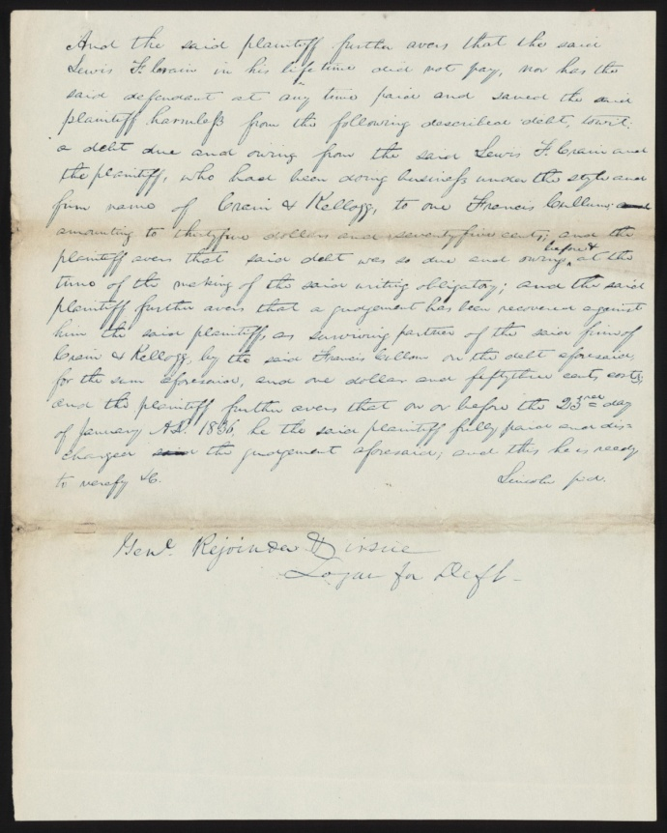

Slide 6
Demurrer, Plea in Smith v. Campbell, [Law papers].
Created/Published
May 31, 1853 Vermilion County, Illinois
http://hdl.loc.gov/loc.rbc/lprbscsm.scsm1554

Slide 7
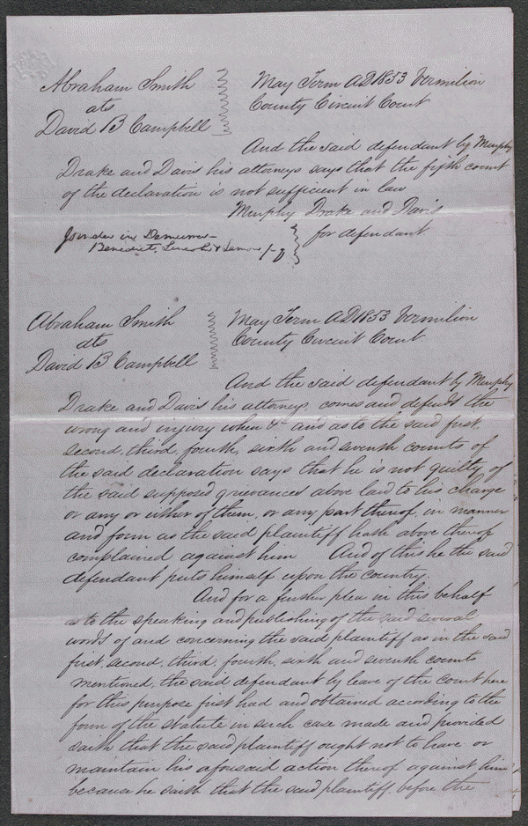

Slide 8
Abraham Lincoln, Congressman-elect from Illinois. Three-quarter length portrait, seated, facing front
Summary: This daguerreotype is the earliest-known photograph of Abraham Lincoln, taken at age 37 when he was a frontier lawyer in Springfield and Congressman-elect from Illinois. (Source: Ostendorf, p. 4)
Date Created/Published: [Springfield, Ill., 1846 or 1847]
http://hdl.loc.gov/loc.pnp/cph.3g02439

Slide 9
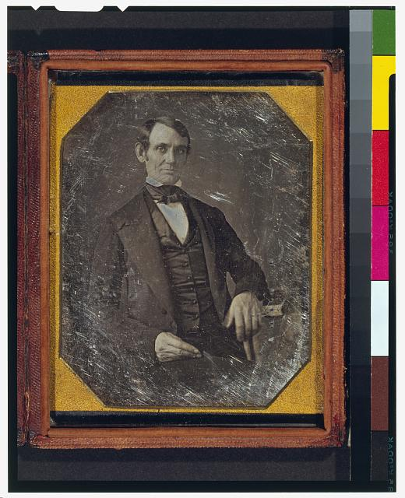

Slide 10
Abraham Lincoln / lith. & published by Edw. Mendel.
Summary: Head-and-shoulders portrait, facing right.
Date Created/Published: Chicago : Edw. Mendel, 1850
http://hdl.loc.gov/loc.pnp/cph.3c02366

Slide 11
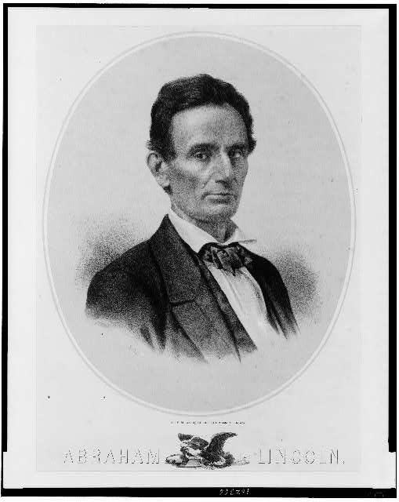

Slide 12
Print of the "lost ambertype" of Lincoln
Notes
Written in pencil on back: This is the photograph from the original ambertype owned by the Latham family of Lincoln, Illinois. It was posed for by Mr. Lincoln at the time the city of Lincoln was named for him. The photographer is unknown and is called the lost ambrotype. [Signed] Gillespie, 7/5/35.
Created/Published
c1853
http://hdl.loc.gov/loc.rbc/lprbscsm.scsm0987

Slide 13
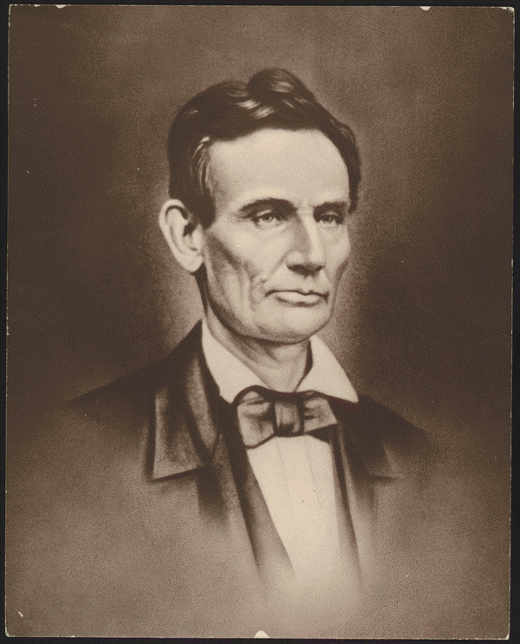

Slide 14
Abraham Lincoln while campaigning for the U.S. Senate, taken in Chicago, Illinois
Notes:
Title devised by Library staff.
Original photograph: The original daguerreotype is at the Chicago Historical Society.
Ostendorf, no. 6
Meserve, no. 3
Published in: Lincoln's photographs: a complete album / by Lloyd Ostendorf. Dayton, OH: Rockywood Press, 1998, p. 18-19.
Date Created/Published: 1854 Oct. 27 [printed later]
http://hdl.loc.gov/loc.pnp/cph.3a13087

Slide 15
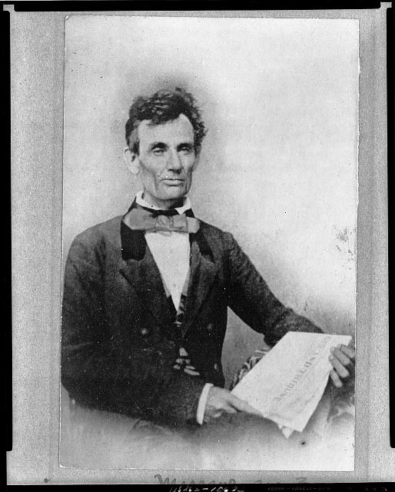

Slide 16
Old Cass County Courthouse, Beardstown, Cass County, IL
1937 VIEW FROM WEST
http://www.loc.gov/pictures/item/il0264.photos.064142p/

Slide 17
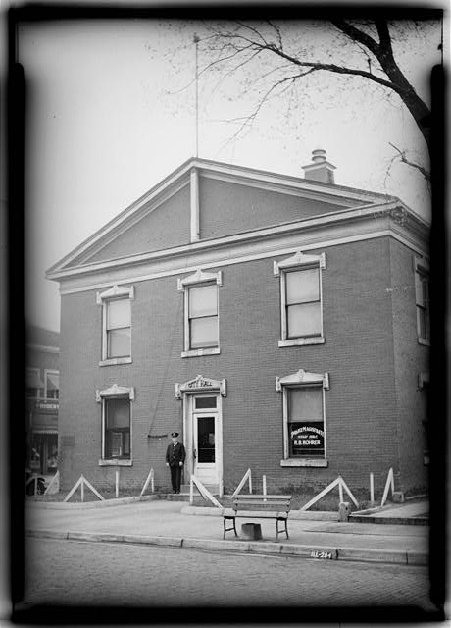

Slide 18
Anson Conger Goodyear Collection of Lincoln images
Summary: Thought to be the last beardless portrait of Lincoln, this photo was "made for the portrait painter, John Henry Brown, noted for his miniatures in ivory. ... 'There are so many hard lines in his face,' wrote Brown in his diary, 'that it becomes a mask to the inner man. His true character only shines out when in an animated conversation, or when telling an amusing tale. ... He is said to be a homely man; I do not think so.'" (Source: Ostendorf, p. 62)
Date Created/Published: [Springfield, Ill., 1860 Aug. 13]
http://hdl.loc.gov/loc.pnp/cph.3a10370

Slide 19
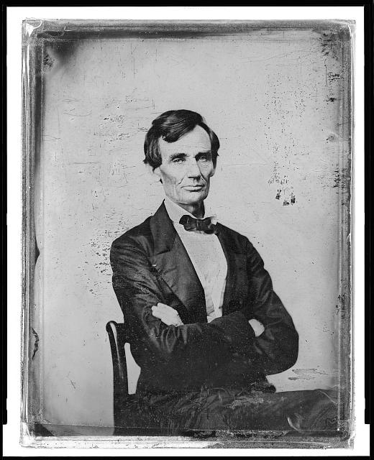

Slide 20
Abraham Lincoln while a traveling lawyer, taken in Danville, Illinois
Notes:
Illus. in: The Photographs of Abraham Lincoln / Frederick Hill Meserve. New York, Privately printed, 1911, p. 43.
Original photograph: The original ambrotype is at the Illinois State Historical Library.
Ostendorf, no. 3
Meserve, no. 2
Published in: Lincoln's photographs: a complete album / by Lloyd Ostendorf. Dayton, OH: Rockywood Press, 1998, p. 8-9.
Date Created/Published: 1857 May 27 [printed later]
http://hdl.loc.gov/loc.pnp/cph.3a18603

Slide 21
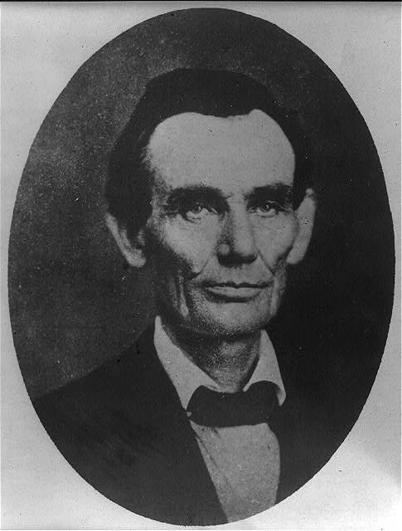

Slide 22
Abraham Lincoln posed in a borrowed coat, in Urbana, Illinois
Notes:
Original photograph: an ambrotype now known through copy prints.
Library copy is reversed.
Ostendorf, no. 4
Meserve, no. 5
Published in: Lincoln's photographs: a complete album / by Lloyd Ostendorf. Dayton, OH: Rockywood Press, 1998, p. 10-11.
Date Created/Published: 1858 April 25 [printed later]
http://hdl.loc.gov/loc.pnp/cph.3a52063

Slide 23
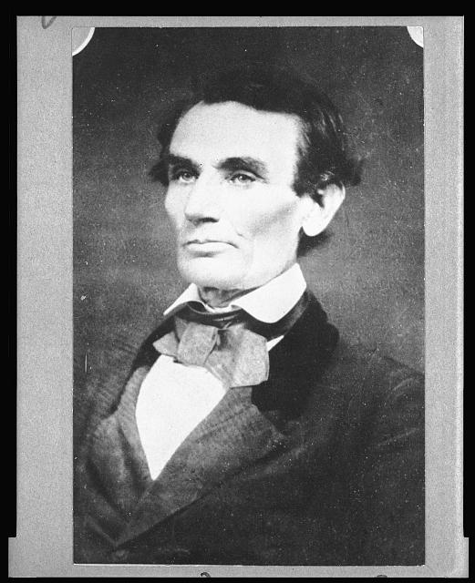

Slide 24
Abraham Lincoln, half-length portrait, facing right
Summary: Photo shows Abraham Lincoln in an image that was widely reproduced on presidential campaign ribbins in 1860. Lincoln reportedly liked the photograph and often signed prints for admirers. (Source: Ostendorf, p. 29)
Date Created/Published: [probably 1858, printed later]
http://hdl.loc.gov/loc.pnp/cph.3a09457

Slide 25
