Slide 1
Abe Lincoln Project
By: Nick Schindler

Slide 2
Illinois v. Overholt & Squier
Created/Published;January 29, 1857 Christian County, Illinois
Notes:Autograph document. Lawyer Lincoln issues a receipt for "fifty dollars, in full of my fee, both in Circuit and Supreme Court, in the case with Overhold & Squier.
Summary: Overholt and Squier contracted with three judges from Christian County, Illinois, to construct a courthouse. The $15,000 contract was to be paid in installments upon completion of specific projects. Overholt completed the foundation, but Judge Vandeveer refused to pay because the job failed to meet agreed specifications. Overholt and Squier halted construction and sued in the Christian County Circuit Court to recover the anticipated profits. The court granted a change of venue to the Macon County Circuit Court. The jury found for Overholt and Squier and awarded $657.87. The Christian County officials, who had retained Lincoln, appealed to the Illinois Supreme Court, which reversed and remanded the appeal. The court ruled that Overholt and Squier could not sue for anticipated profits unless they were prevented from completing construction, which did not happen. Lincoln received a $50 fee for his work in the trial and the appeal.
Digital ID:http://hdl.loc.gov/loc.rbc/lprbscsm.scsm1473

Slide 3
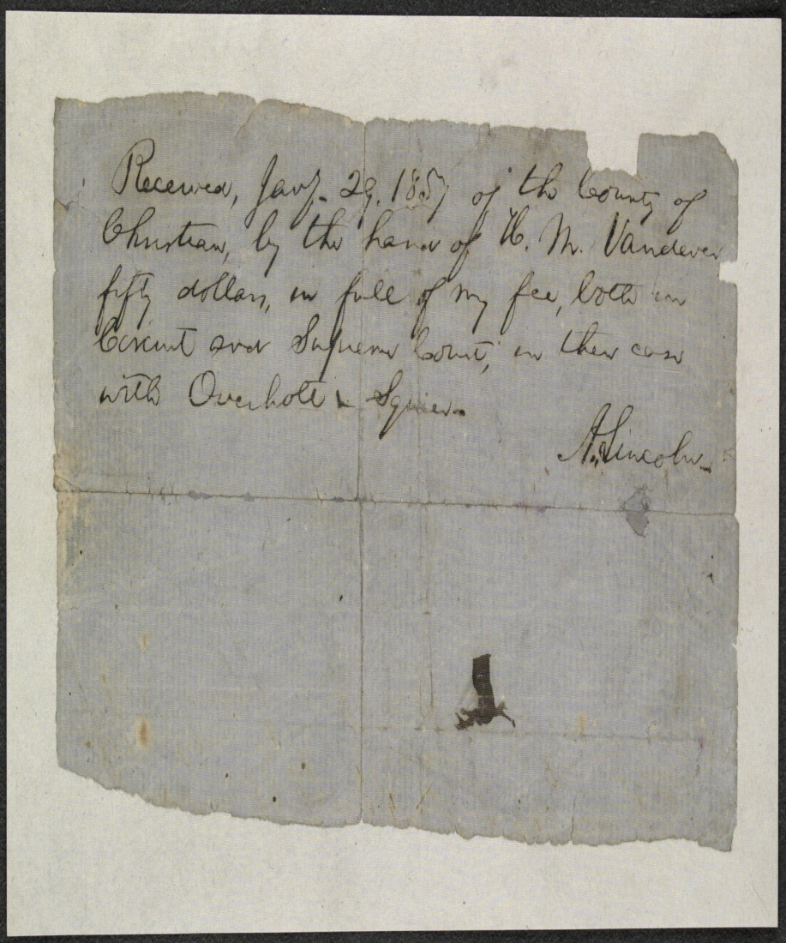
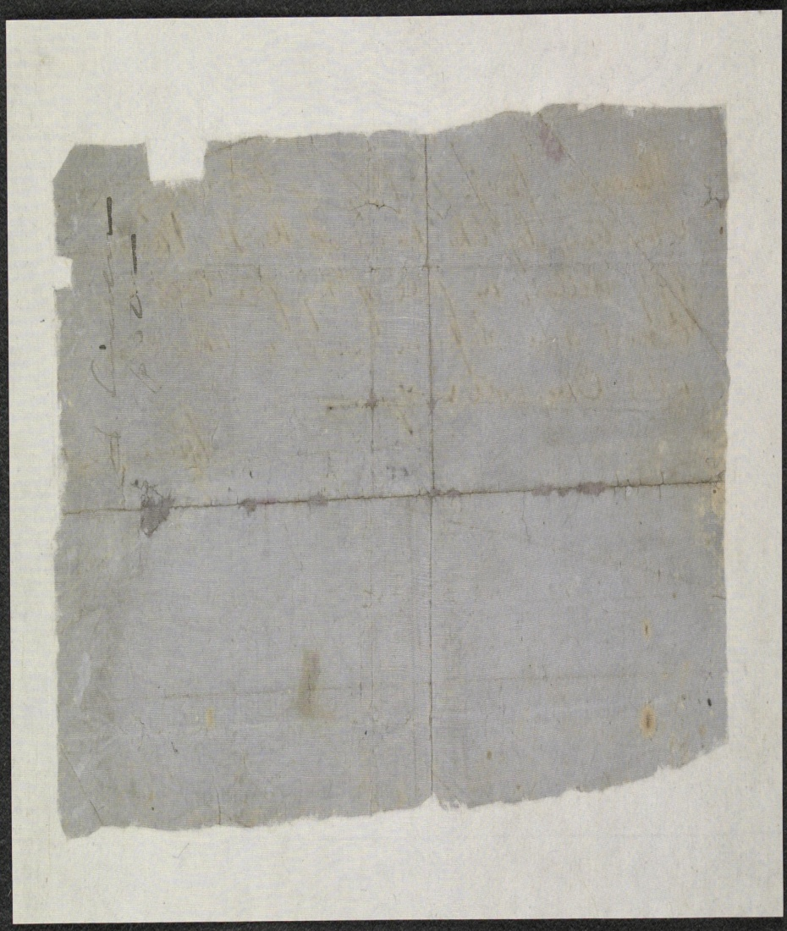

Slide 4
Demurrer in Allen v. Illinois Central Railroad
Created/Published:Spring, 1859
Summary: Allen sued the Illinois Central Railroad and requested $300 in damages. The railroad retained Lincoln, who demurred to Allen's declaration. The court sustained the demurrer and dismissed the case.
Digital ID http://hdl.loc.gov/loc.rbc/lprbscsm.scsm1495

Slide 5
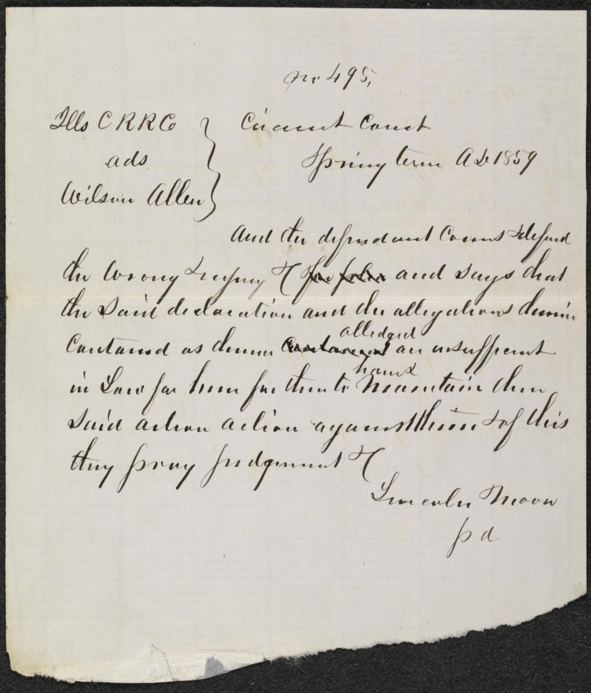
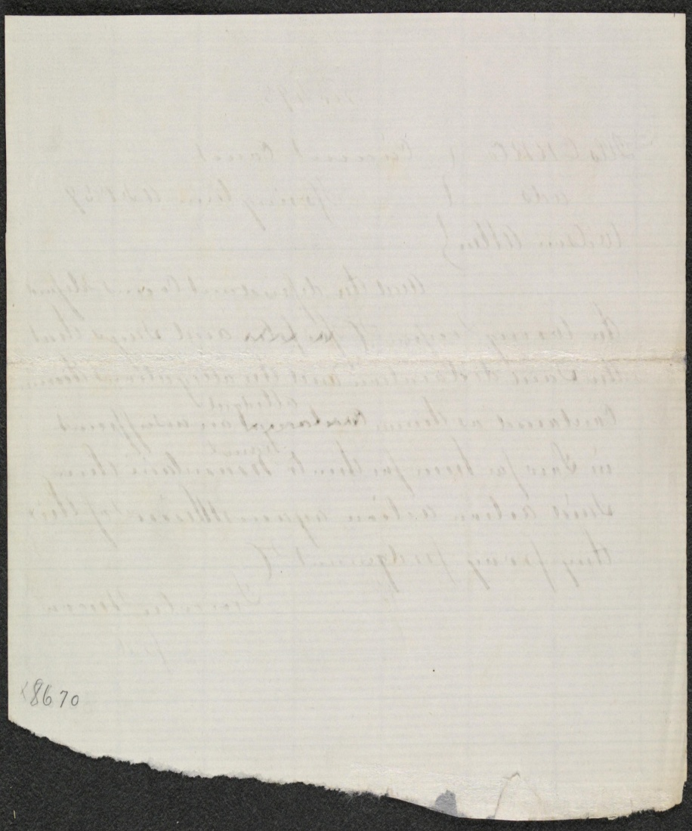

Slide 6
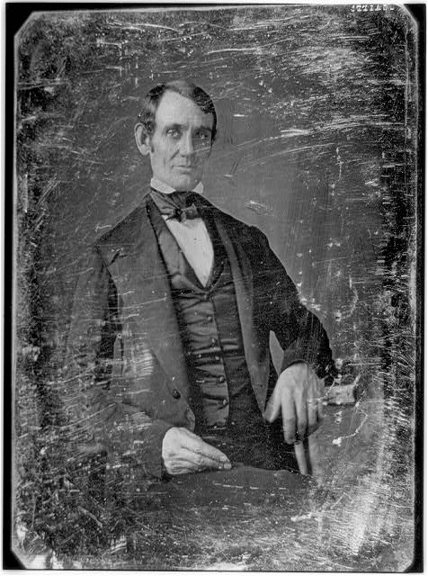
Abraham Lincoln, Congressman
Date Created/Published: [Springfield, Ill., 1846 or 1847]
Summary: This daguerreotype is the earliest-known photograph of Abraham Lincoln, taken at age 37 when he was a frontier lawyer in Springfield and Congressman-elect from Illinois.
Creator(s): Shepherd, Nicholas H., photographer
Bookmark This Record: http://www.loc.gov/pictures/item/2004664400

Slide 7
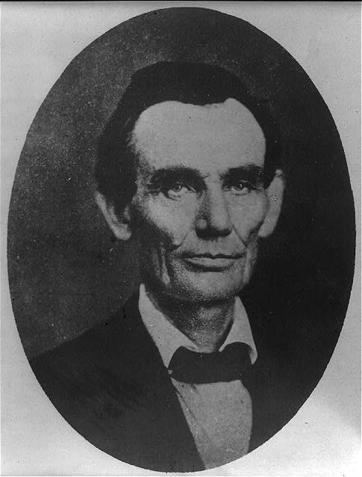
Abraham Lincoln while a traveling lawyer
Date Created/Published: 1857 May 27
Creator(s): Joslin Amon T. Photographer
Bookmark This Record: http://www.loc.gov/pictures/item/2008678328

Slide 8
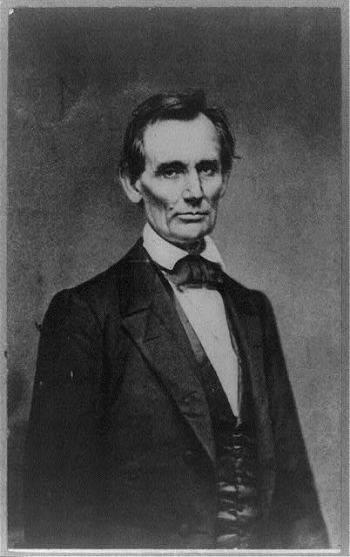
Abraham Lincoln, candidate for U.S. president
Date Created/Published: 1860
Bookmark This Record: http://www.loc.gov/pictures/item/2009630664/

Slide 9
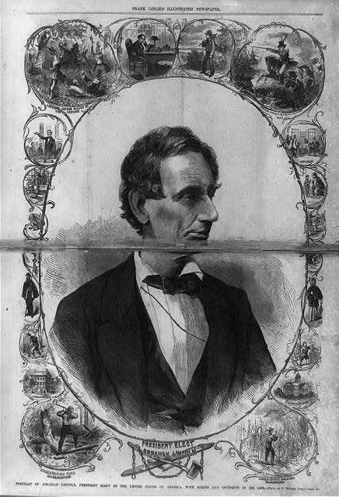
Abraham Lincoln Portrait of Abraham Lincoln
Date Created/Published: 1861 March 9
Bookmark This Record: http://www.loc.gov/pictures/item/2003674537/

Slide 10
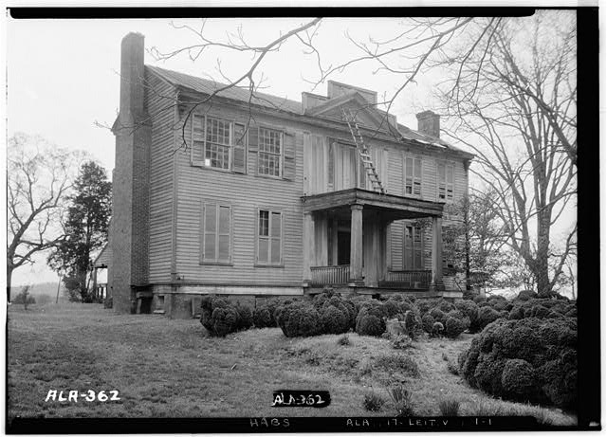
Abraham Ricks House
Creator: Historic buildings survey
Date Created/Published: Documentation compiled after 1933
Bookmark This Record: http://www.loc.gov/pictures/item/al0077

Slide 11
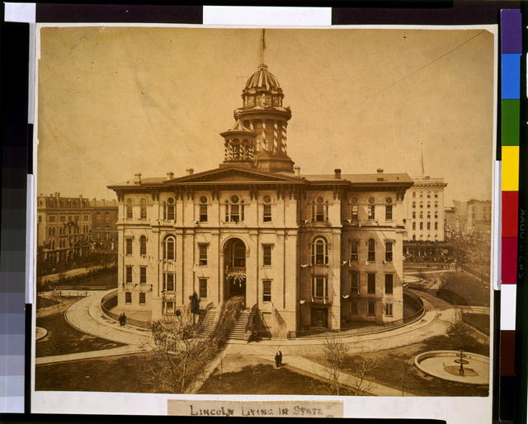
Lincoln lying in state
Date Created/Published: [1865]
Creator(s): Fassett, Samuel Montague, photographer
Summary: Funeral procession entering(?) Cook County Courthouse in Chicago where President Abraham Lincoln's body lay in State

Slide 12
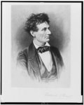
Lincoln the lawyer
Date Created/Published: [between 1865 and 1910
Creator(s): Stuart, Frederick T., 1837-1913, etcher
Summary: Abraham Lincoln, head-and-shoulders portrait, facing right
Bookmark This Record: http://www.loc.gov/pictures/item/98517810

Slide 13
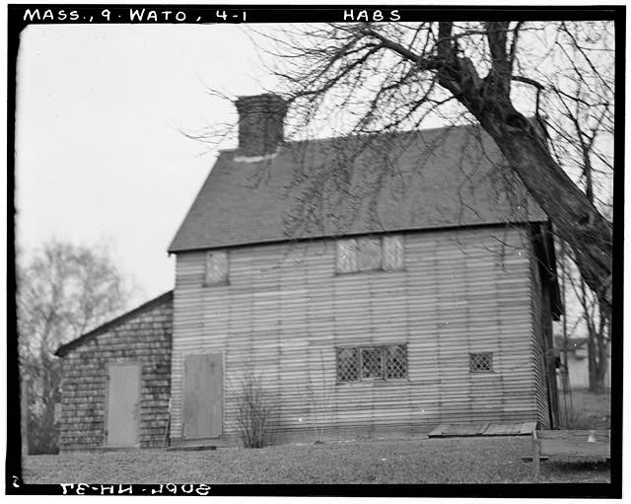
ABRAHAM BROWN HOUSE
Bookmark This Record: http://www.loc.gov/pictures/item/ma0816.photos.081252p

Slide 14
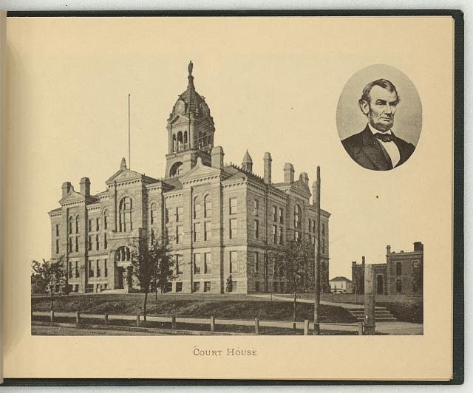
Court house
Date Created/Published: New York : The Albertype Co., c1897
Summary: Print showing exterior view of the courthouse in Lincoln, Nebraska; includes a bust portrait of Abraham Lincoln, facing right, in oval, in upper right corner
Bookmark This Record: http://www.loc.gov/pictures/item/2009630142

Slide 15
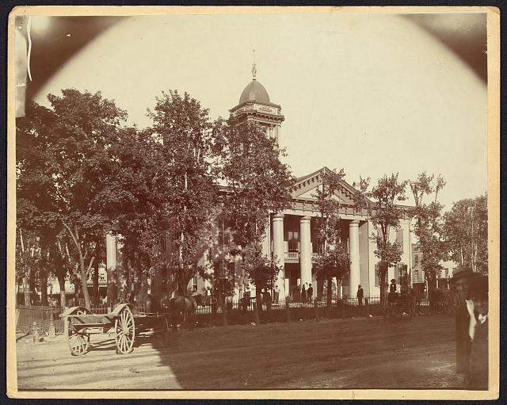
The Coles County Court House in Charleston
Date Created/Published: [between 1860 and 1898?]
Summary: Photograph showing courthouse with people and horse-drawn wagons in front
Bookmark This Record: http://www.loc.gov/pictures/item/2008680974

Slide 16
Wordle

