Slide 1
Abraham Lincoln
Nichlaus Schwartz

Slide 2
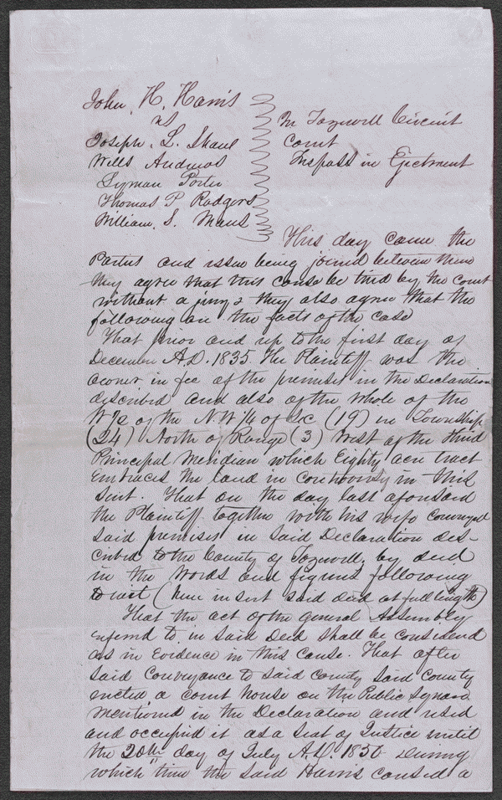

Slide 3
Harris Vs. Tazewell County
Summary: In 1835, Harris donated twenty acres of land in Tremont, Illinois, to Tazewell County for the erection of the county courthouse. In 1849, the legislature authorized the removal of the county seat to Pekin, Illinois, and specified that the Tremont courthouse be used for education. Harris retained Lincoln and sued to recover the property from the school trustees, but the circuit court ruled for the trustees. Harris appealed to the Illinois Supreme Court, and Lincoln argued that the land had been given on the condition that it be used as the county seat. The supreme court rejected Lincoln's argument and affirmed the judgment. Justice Trumbull ruled that Harris had given the land unconditionally, but had "the land been granted upon condition that it should be used for a particular purpose, it would unquestionably have reverted to the donor when it ceased to be thus used."
Date: September 16, 1851-Tazewell County, Illinois
Digital ID: lprbscsm scsm1525 http://hdl.loc.gov/loc.rbc/lprbscsm.scsm1525

Slide 4
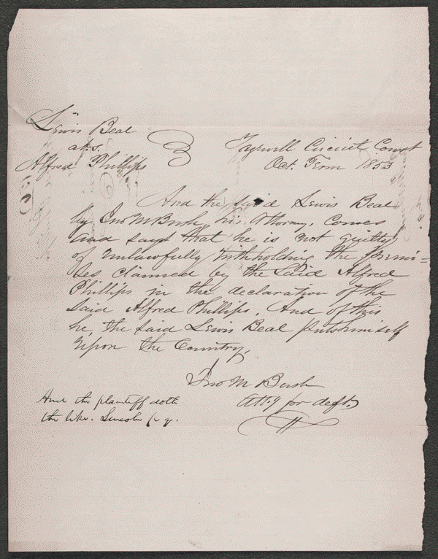

Slide 5
Phillips Vs. Beal
Summary: Phillips owned 160 acres of land in Tazewell County. Phillips retained Lincoln and sued Beal in an action of ejectment because Phillips claimed that Beal unlawfully withheld twenty acres from him. Beal pleaded not guilty, but a jury found for Phillips and awarded $0.01 in damages.
Date: July 01, 1853 Tazewell County, Illinois
Digital ID: http://hdl.loc.gov/loc.rbc/lprbscsm.scsm1556

Slide 6
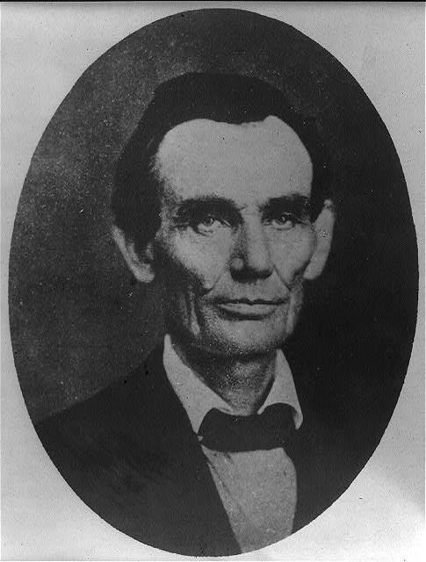

Slide 7
Abraham Lincoln while traveling lawyer, taken in Danville, Illinois
Creator(s): Amon T. Joslin (photographer)
Date: May 27th, 1857
Digital ID: http://hdl.loc.gov/loc.pnp/cph.3a18603

Slide 8
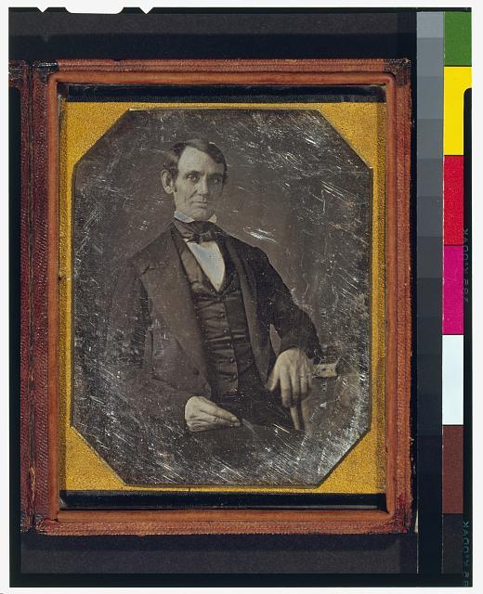

Slide 9
Lincoln, Congressman-elect from Illinois. Three-quarter length portrait, seated, facing front
Creator(s): Nicholas H. Shepherd
Date: 1846 or 1847 in Springfield, IL
Digital ID: digital file from color film copy transparency post-1992
http://hdl.loc.gov/loc.pnp/cph.3g02439

Slide 10
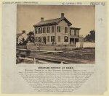

Slide 11
Abraham Lincoln at home
Creator(s): John Adams Whipple
Date: 1860
Summary: Photo shows the house where Abraham Lincoln lived in Springfield, Illinois, with presidential candidate Abraham Lincoln standing on the terrace, with his sons Willie and Tad.
Digital ID: digital file from original http://hdl.loc.gov/loc.pnp/ppmsca.23724

Slide 12
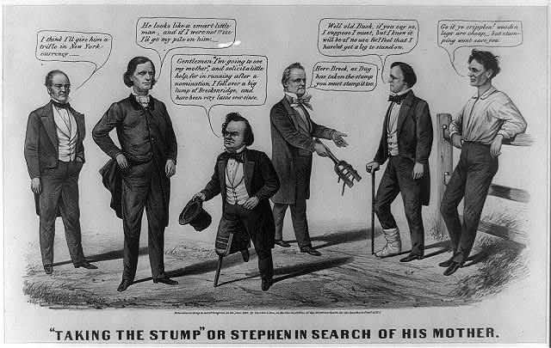

Slide 13
A satire on Douglas's July 1860 campaign tour of upstate New York and New England. (See also "Stephen Finding His Mother," no. 1860-35.) Here a double-entendre in the use of the word "stump," playing on its use as a colloquialism for both campaigning and a wooden leg. In the center Douglas, wearing a wooden leg, speaks with John Bell of Tennessee, Constitutional Union presidential candidate (far left), and influential Democrat Virginia governor Henry A. Wise. Douglas claims, "Gentlemen ps'm going to see my mother,' and solicit a little help, for in running after a nomination, I fell over a big lump of Breckenridge [i.e., rival Democratic candidate John C. Breckinridge], and have been very lame ever since." Bell remarks to Wise, "I think I'll give him a trifle in New York currency." Wise responds, "He looks like a smart little man, and if I were not Wise I'd go my pile on him." At right incumbent James Buchanan offers another stump to Breckinridge, his own favorite, saying, "Here Breck, as Dug has taken the stump you must stump it too." Breckinridge replies, "Well old Buck, if you say so, I suppose I must, but I know it will be of no use, for I feel that I haven't got a leg to stand on." His right foot is bandaged, possibly a souvenir of his defeat by Douglas at the May Democratic Convention in Baltimore. Abraham Lincoln, leaning against a rail fence at the far right, declares confidently, "Go it ye cripples! wooden legs are cheap, but stumping won't save you."
Creator(s): Currier & Ives
Date: July 1860
Digital ID: http://hdl.loc.gov/loc.pnp/cph.3a17242

Slide 14
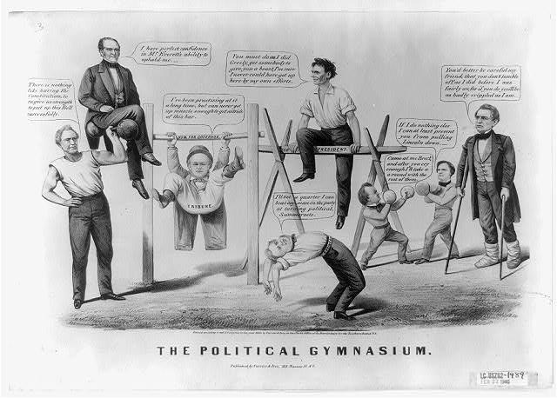

Slide 15
A general parody on the field of presidential candidates and their supporters in the 1860 campaign. At the far left stands Constitutional Union party vice presidential candidate Edward Everett, as a muscle man holding aloft a barbell on which rests running mate John Bell. Everett boasts, "There is nothing like having the Constitution, to give us strength to put up this Bell successfully." Bell states, "I have perfect confidence in Mr. Everett's ability to uphold me." Though holding second place on the ticket, the former senator from Massachusetts Everett was much more popular in the Northeast than Tennessean Bell. To the right of Bell and Everett is "Tribune" editor Horace Greeley. His political ambitions are mocked by the artist who shows him vainly attempting to climb up on a horizontal bar labeled "Nomination for Governor." Greeley complains, "I've been practising at it a long time, but can never get up muscle enough to get astride of this bar." Abraham Lincoln (center), who has successfully mounted a balance beam constructed of wooden rails, advises Greeley, "You must do as I did Greely, get somebody to give you a boost, I'm sure I never could have got up here by my own efforts." His cross bar, labeled "For President," represents the Republican nomination, which Lincoln won largely through Greeley's powerful support. Occupying the foreground is James Watson Webb of the New York "Courier," who tries a backward somersault. His wager here, "I'll bet a quarter I can beat any man in the party at turning political Summersets," is a swipe at Webb's mid-1850s conversion from Whig to Republican. At far right stands Lincoln's former competitor for the Republican nomination, William H. Seward, on crutches and with bandaged feet. He warns Lincoln, "You'd better be careful friend, that you don't tumble off; as I did before I was fairly on, for if you do you'll be as badly crippled as I am." (For a similar reference to political cripples in this campaign, see ""Taking the Stump" or Stephen in Search of His Mother," no. 1860-36.) Near Seward the two sectional Democratic candidates compete in a boxing match. Stephen A. Douglas, the regular Democratic nominee, faces southern Democrat John C. Breckinridge. Douglas taunts his opponent, "Come at me Breck, and after you cry enough, I'll take a round with the rest of them." In response Breckinridge asserts, "If I can do nothing else I can at least prevent you from pulling Lincoln down."
Creator(s): Currier & Ives
Date: circa 1860
Digital ID: http://hdl.loc.gov/loc.pnp/cph.3a05728

Slide 16
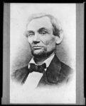

Slide 17
Abraham Lincoln, head-and-shoulders portrait, facing left.
Creator(s): Alschuler, Samuel G.,
Date: November 25, 1860
Digital ID: http://hdl.loc.gov/loc.pnp/cph.3a18217

Slide 18
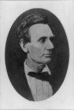

Slide 19
Lincoln Picture
Summary: Abraham Lincoln, head and shoulders portrait, facing right
Creator(s): Alexander Hesler
Date: June 3, 1860
Digital ID: http://hdl.loc.gov/loc.pnp/cph.3b41526

Slide 20
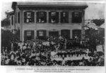

Slide 21
Lincoln Home
Summary: Abraham Lincoln at his home in Springfield, Illinois, with a large crowd of people gathered outside after a Republican rally, August 8, 1860
Creator(s):Shaw, William, photographer
Date: August 8, 1860
Digital ID: http://hdl.loc.gov/loc.pnp/cph.3a15971

