Slide 1
Lincoln law

Slide 2
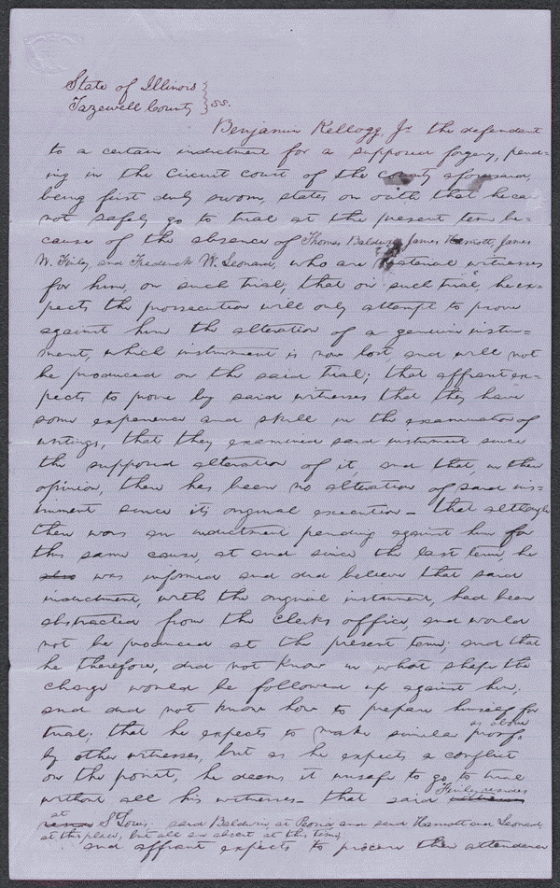
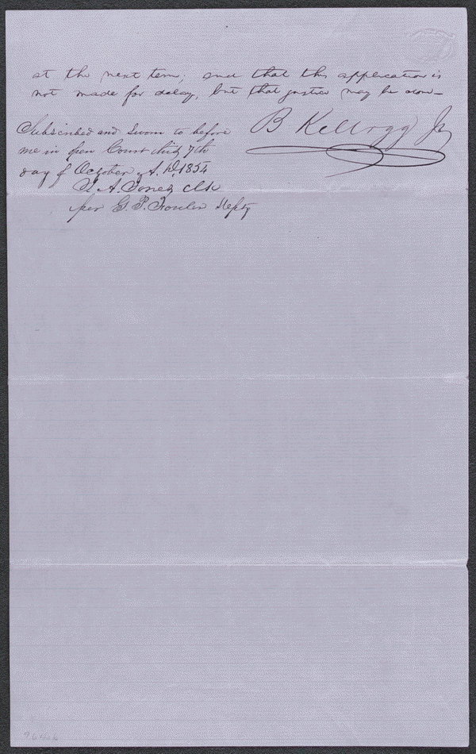
Notes
Autograph document. Appears to be in Lincoln's hand.
Summary: The state's attorney indicted Kellogg for forgery because he allegedly altered a document. Kellogg retained Lincoln and argued that he did not alter the document and produced many witnesses to testify to that effect. Lincoln motioned the court to quash the indictment; the court agreed and dismissed the case.
Digital ID:
lprbscsm scsm1578 http://hdl.loc.gov/loc.rbc/lprbscsm.scsm1578

Slide 3
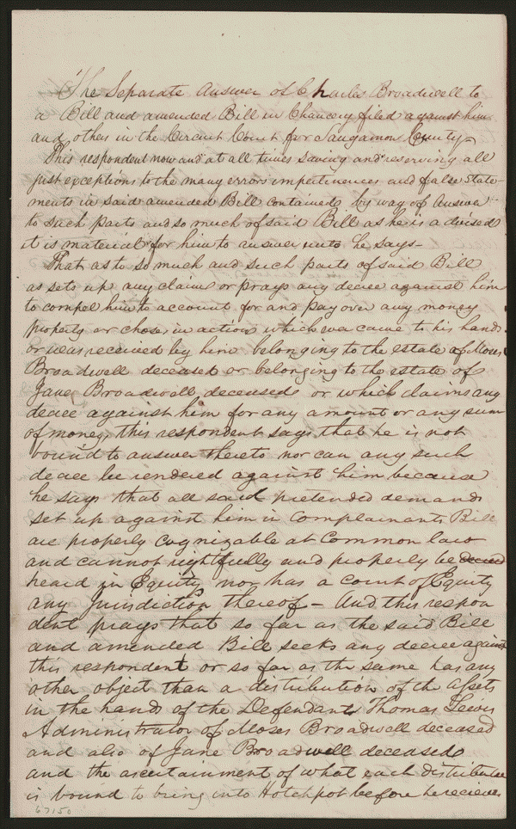
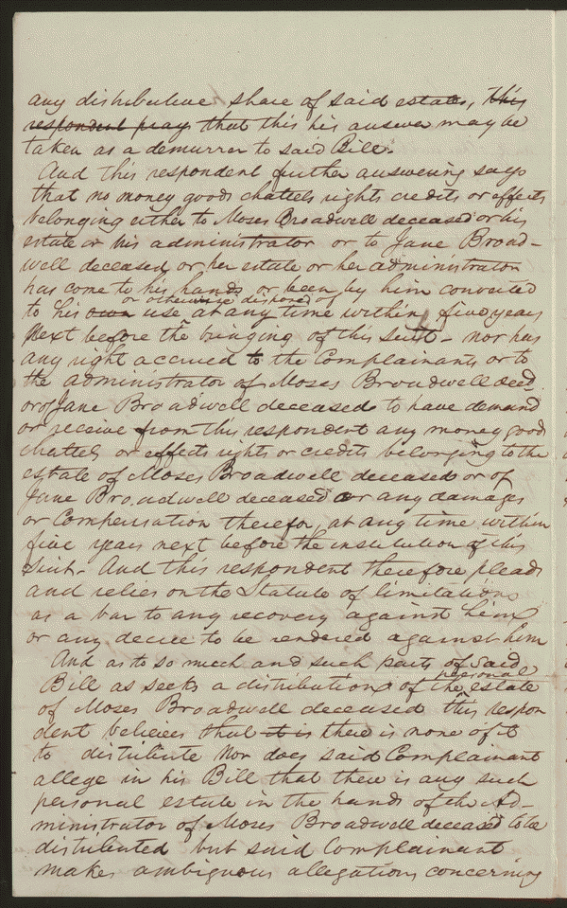
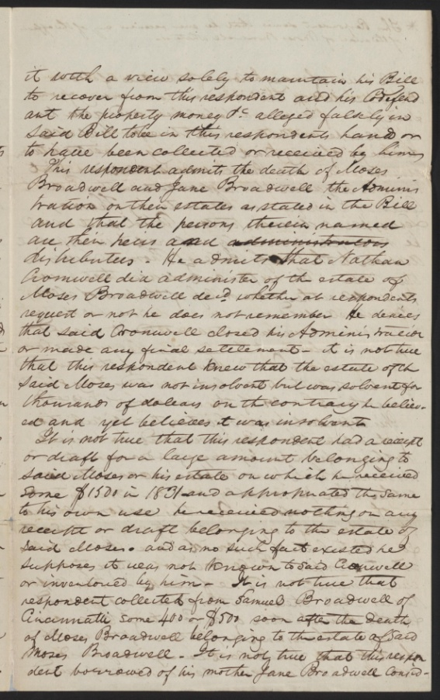
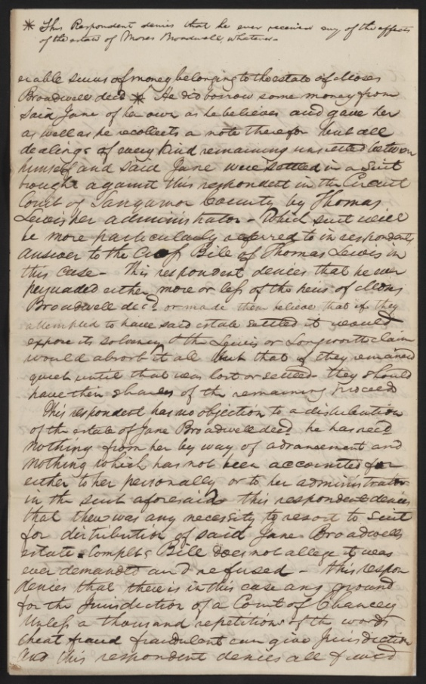
Digital ID
lprbscsm scsm1424 http://hdl.loc.gov/loc.rbc/lprbscsm.scsm1424
Summary: At the time of his death, Moses Broadwell possessed a sizable estate. Michael Thompson and his wife Mary Jane Thompson, who was a granddaughter of Moses Broadwell, claimed that Charles Broadwell, John Broadwell, and other heirs of Moses Broadwell embezzled large amounts of money from the estate and hid the money from the administrators. The Thompsons sued Broadwell and others for an accounting and a fair distribution of the estate. John Broadwell and Charles Broadwell retained Lincoln and Herndon, denied the allegations, and pleaded the statute of limitations. Lewis, the administrator of Moses Broadwell's estate, and William Broadwell filed separate cross-bills. Several defendants defaulted. The court continued the case for several years before striking the case from the docket. Lincoln and Herndon received $10 for their legal services.

Slide 4
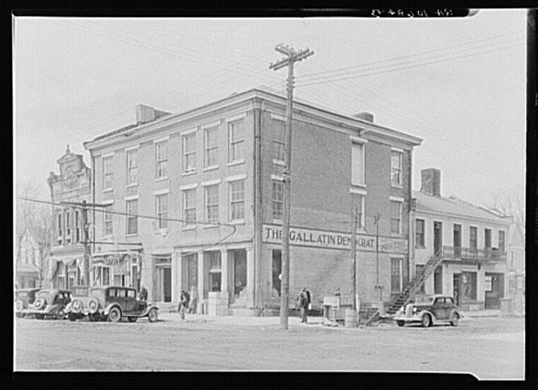
Date Created/Published: 1937 Apr.
Title: The Posey Building of Shawneetown, Illinois, in which Abraham Lincoln and Robert Ingersoll had law offices
Bookmark This Record: http://www.loc.gov/pictures/item/fsa1998022486/PP/

Slide 5
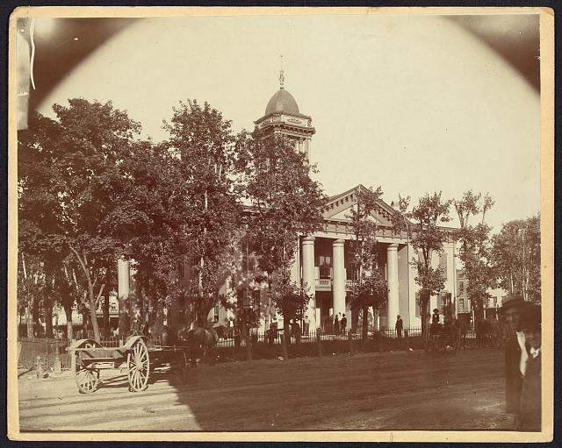
Title: The Coles County Court House in Charleston, Ills., in which Lincoln often practiced law and before which he made a short speech in the evening after his fourth joint debate with Douglas, Sept. 18, 1858
Date Created/Published: [between 1860 and 1898?]
Bookmark This Record: http://www.loc.gov/pictures/item/2008680974/

Slide 6
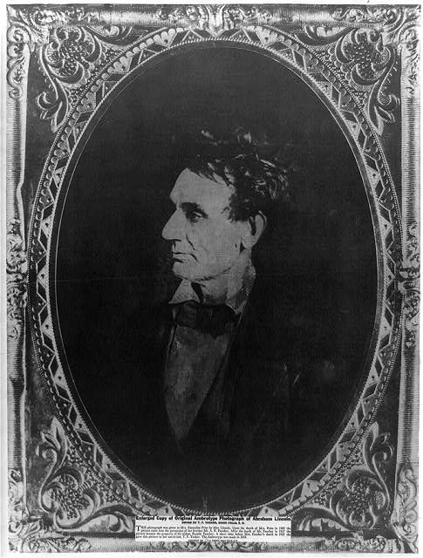
Title: [Abraham Lincoln, immediately prior to Senate nomination, Chicago, Illinois]
Creator(s): Hesler, Alexander, 1823-1895, photographer
Date Created/Published: [1857 February 28, printed later]
Bookmark This Record: http://www.loc.gov/pictures/item/2008678332/

Slide 7
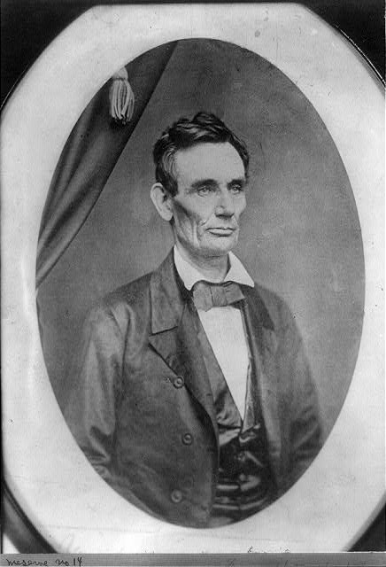
Digital ID: (digital file from b&w film copy neg.) cph 3a09457 http://hdl.loc.gov/loc.pnp/cph.3a09457

Slide 8
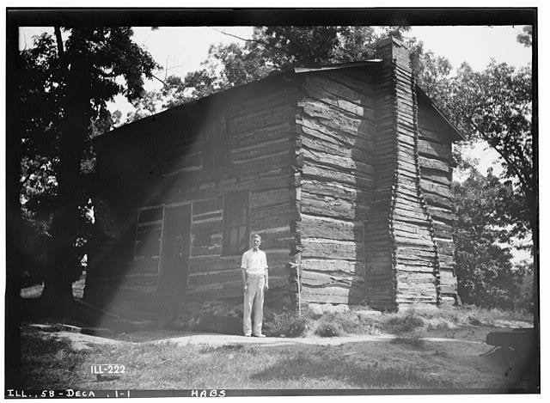
http://hdl.loc.gov/loc.pnp/hhh.il0366/photos.062906p
Title: First Macon County Courthouse, Fairview Park (moved from Main Street), Decatur, Macon County, IL
Related Names: Lincoln, Abraham
1832 Initial Construction

Slide 9
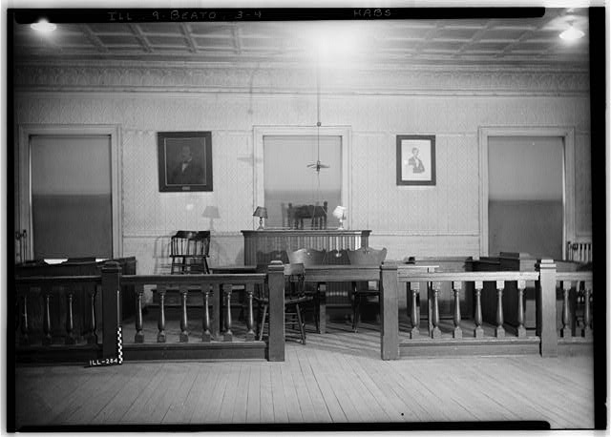
http://hdl.loc.gov/loc.pnp/hhh.il0264/photos.064145p
Title: Old Cass County Courthouse, Beardstown, Cass County, IL

Slide 10
Date Created/Published: c1938. Title: [Interior of Abraham Lincoln's home, showing fireplace, in Springfield, Illinois]
http://www.loc.gov/pictures/item/95501091/

Slide 11
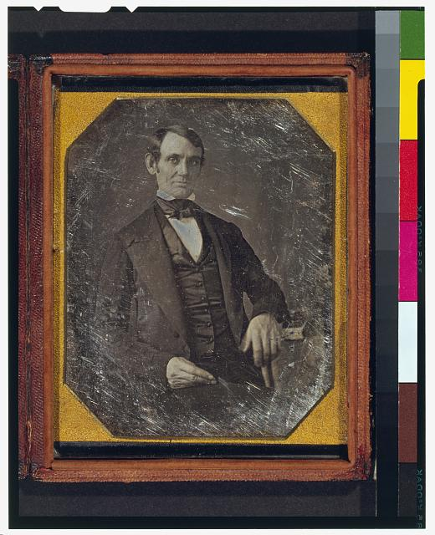
Date Created/Published: [Springfield, Ill., 1846 or 1847]
Summary: This daguerreotype is the earliest-known photograph of Abraham Lincoln, taken at age 37 when he was a frontier lawyer in Springfield and Congressman-elect from Illinois. (Source: Ostendorf, p. 4)
Title: [Abraham Lincoln, Congressman-elect from Illinois. Three-quarter length portrait, seated, facing front]
http://hdl.loc.gov/loc.pnp/cph.3g02439

Slide 12
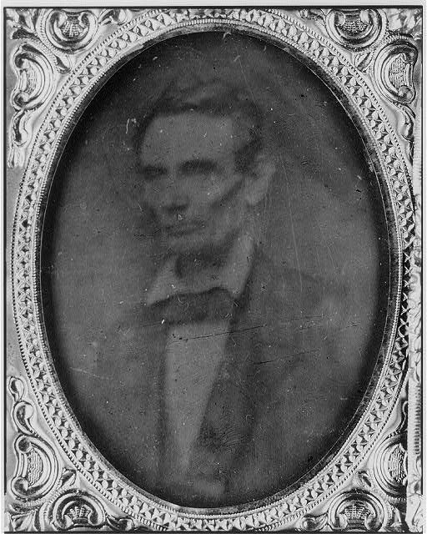
Title: [Abraham Lincoln, half-length portrait, facing left]
Date Created/Published: [probably 1858, copied later]
Summary: Photo shows Abraham Lincoln in an image that was widely reproduced on presidential campaign ribbons in 1860. Lincoln reportedly liked the photograph and often signed prints for admirers. (Source: Ostendorf, p. 29)
http://www.loc.gov/pictures/item/2009630654/

Slide 13
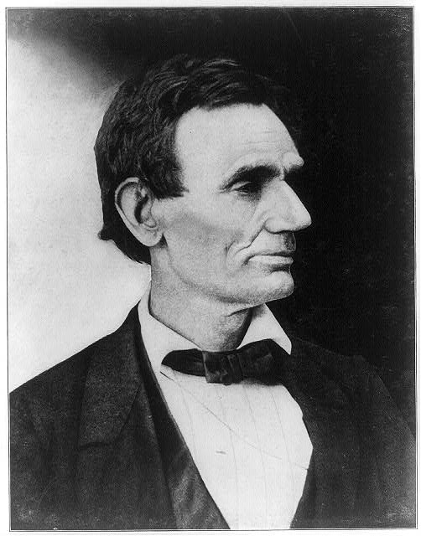
Title: [Abraham Lincoln, presidential candidate, half-length portrait, facing right]
Summary: Reproduction of photo of Lincoln made from a negative taken in Springfield, Illinois, by Alexander Hesler on June 3, 1860. One of several poses from that day. "Wrote Lincoln's law partner, William H. Herndon, 'There is the peculiar curve of the lower lip, the lone mole on the right cheek, and a pose of the head so essentially Lincolnian; no other artist has ever caught it.'" (Source: Ostendorf, p. 46)
http://www.loc.gov/pictures/item/2009630674/

Slide 14
wordle

