Slide 1
Megan Schweickert
Lincoln Cases

Slide 2
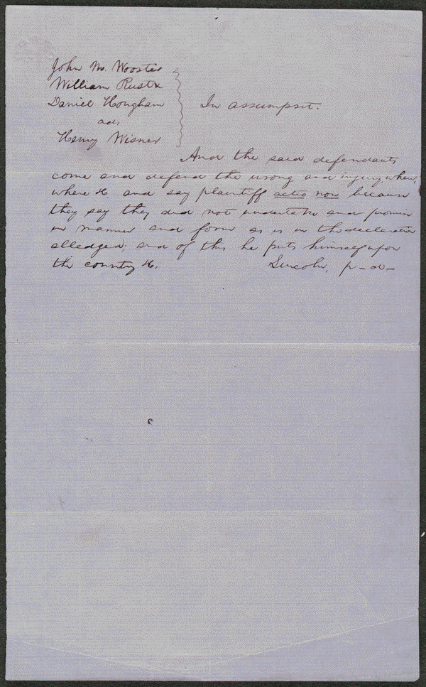
Summary: Wooster owed Wisner $3,000 for goods and merchandise. Wooster failed to pay, and Wisner sued in an action of assumpsit seeking $3,000. Wooster retained Lincoln and pleaded non-assumpsit. Apparently, the parties reached an agreement, and the court dismissed the case. http://hdl.loc.gov/loc.rbc/lprbscsm.scsm1512

Slide 3
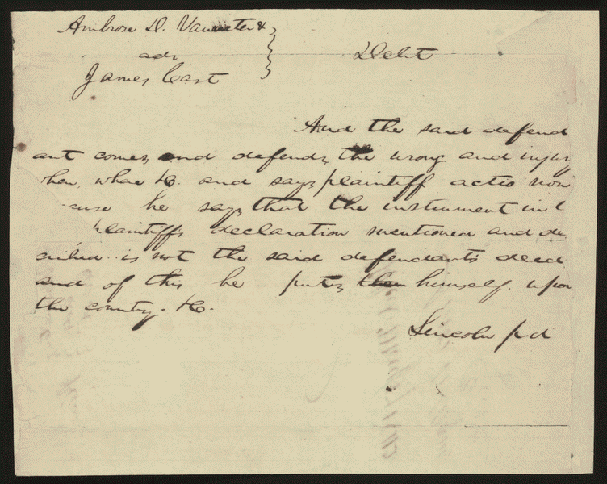
Summary: Cast sued Vanmeter in an action of debt. Vanmeter retained Lincoln but defaulted, and the court awarded Cast $891.10
http://hdl.loc.gov/loc.rbc/lprbscsm.scsm1397

Slide 4
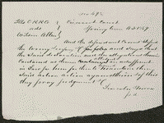
Summary: Allen sued the Illinois Central Railroad and requested $300 in damages. The railroad retained Lincoln, who demurred to Allen's declaration. The court sustained the demurrer and dismissed the case.
http://hdl.loc.gov/loc.rbc/lprbscsm.scsm1495

Slide 5
The Coles County Court House in Charleston, Ills., in which Lincoln often practiced law and before which he made a short speech in the evening after his fourth joint debate with Douglas, Sept. 18, 1858
http://www.loc.gov/pictures/item/2008680974/

Slide 6
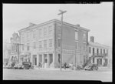
The Posey Building of Shawneetown, Illinois, in which Abraham Lincoln and Robert Ingersoll had law offices
http://www.loc.gov/pictures/item/fsa1998022486/PP/

Slide 7
An old grocery building and the Posey Building where Abraham Lincoln and Robert Ingersoll had law offices. Shawneetown, Illinois
http://www.loc.gov/pictures/item/fsa1998022487/PP/

Slide 8
Agreement in Gregory v. Leonard et al, [Law Papers].
http://memory.loc.gov/cgi-bin/query/D?scsmbib:8:./temp/~ammem_LZ75::

Slide 9
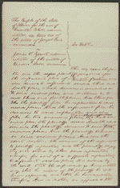
Summary: The people of Illinois, for the use of White, retained Lincoln and sued Yount to collect a $12,000 debt. White, the administrator de bonis non of Joseph Davis's estate, charged that Yount, as administrator of Marcus Snow's estate, was liable for the $12,000 due to the Davis estate from Snow, who had been administrator de bonis non of Davis's estate until his death. White stated that the $12,000 debt that Snow owed the estate came from Snow's selling real and personal property from the estate. The court ruled for Yount.

Slide 10
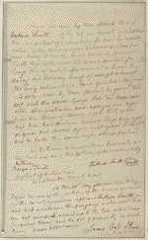
Verlinda Smith to George Poe, [Law papers].
http://hdl.loc.gov/loc.rbc/lprbscsm.scsm1601

Slide 11
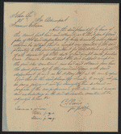
http://hdl.loc.gov/loc.rbc/lprbscsm.scsm1438
Summary: Lee sued Coburn to collect $600 for five years of labor as a servant. There was no written contract, guarantee, or promise between the parties, and Lee refused to prosecute the case further after the jury heard the evidence. Lincoln represented Coburn.

Slide 12
