Slide 1
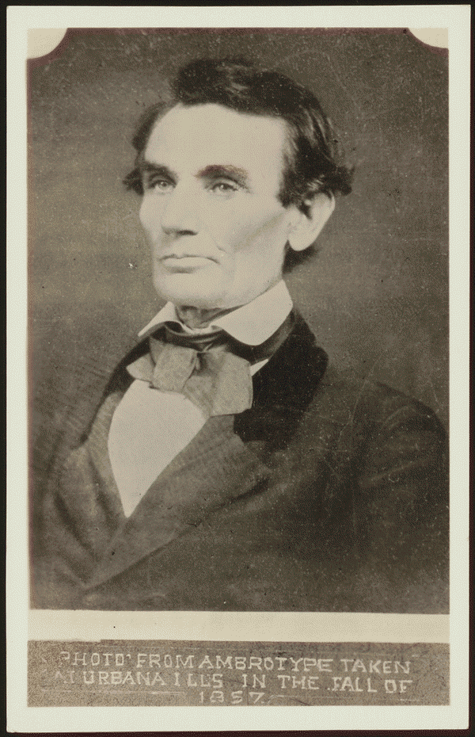
Lincoln as a Lawyer
By Maddie Henry

Slide 2
Yount vs. Illinois
The people of Illinois, for the use of White, retained Lincoln and sued Yount to collect a $12,000 debt. White, the administrator de bonis non of Joseph Davis's estate, charged that Yount, as administrator of Marcus Snow's estate, was liable for the $12,000 due to the Davis estate from Snow, who had been administrator de bonis non of Davis's estate until his death. White stated that the $12,000 debt that Snow owed the estate came from Snow's selling real and personal property from the estate. The court ruled for Yount.
http://hdl.loc.gov/loc.rbc/lprbscsm.scsm1510

Slide 3
Coles County Courthouse
The Coles County Court House in Charleston, Ills., in which Lincoln often practiced law and before which he made a short speech in the evening after his fourth joint debate with Douglas, 1858
http://www.loc.gov/pictures/item/2008680974/

Slide 4
Lincoln’s House
Photo shows the house where Abraham Lincoln lived in Springfield, Illinois, with presidential candidate Abraham Lincoln standing on the terrace, with his sons Willie and Tad.

Slide 5
Cast vs. Vanmeter
Cast sued Vanmeter in an action of debt. Vanmeter retained Lincoln but defaulted, and the court awarded Cast $891.10.
http://hdl.loc.gov/loc.rbc/lprbscsm.scsm139

Slide 6
Law Office
An old grocery building and the Posey Building where Abraham Lincoln and Robert Ingersoll had law offices. Shawneetown, Illinois
http://www.loc.gov/pictures/item/fsa1998022487/PP/

Slide 7
Allen vs. IL Central Railroad
Allen sued the Illinois Central Railroad and requested $300 in damages. The railroad retained Lincoln, who demurred to Allen's declaration. The court sustained the demurrer and dismissed the case.
http://hdl.loc.gov/loc.rbc/lprbscsm.scsm1495

Slide 8
Knight vs. Carter
Knight retained Lincoln and sued the heirs of Washington Carter to settle a partnership. Carter and Knight had been partners in selling land and livestock and in farming. The court appointed three commissioners to partition the estate's 615 acres. The commissioners assigned dower to Carter's widow, Susan Boardman; gave Knight one-half of the land; and partitioned the remaining land in equal shares for Carter's three minor heirs.
http://hdl.loc.gov/loc.rbc/lprbscsm.scsm1559

Slide 9
Lincoln House Today http://showcase.netins.net/web/creative/lincoln/sites/home.htm

Slide 10
Freer vs. Ashby
Freer sued Ashby in JP court to collect a $19.28 account. The JP ruled for Freer and awarded $0.14. Freer retained Lincoln and appealed to the circuit court, stating that the judgment was not acceptable. The parties reached a settlement in which Ashby agreed to pay Freer $7.50
http://hdl.loc.gov/loc.rbc/lprbscsm.scsm1545

Slide 11
Fullenwider vs. Shelton & Tharp
Shelton and Tharp gave Fullenwider a promissory note for $1,500, and Shelton secured the note with a mortgage on eighty acres of land in Sangamon County, Illinois. Fullenwider assigned the note and mortgage to Kingsbury. After Shelton and Tharp failed to pay, Kingsbury retained Lincoln and Herndon and sued Shelton to foreclose the mortgage. Shelton failed to appear, and the court ruled for Kingsbury and awarded $1,981.25 in damages. Shelton failed to pay the judgment, and the court sold the eighty acres to Kingsbury for $2,083.80. Kingsbury also recovered a judgment on the promissory note in a separate assumpsit case
http://hdl.loc.gov/loc.rbc/lprbscsm.scsm1467

