Slide 1
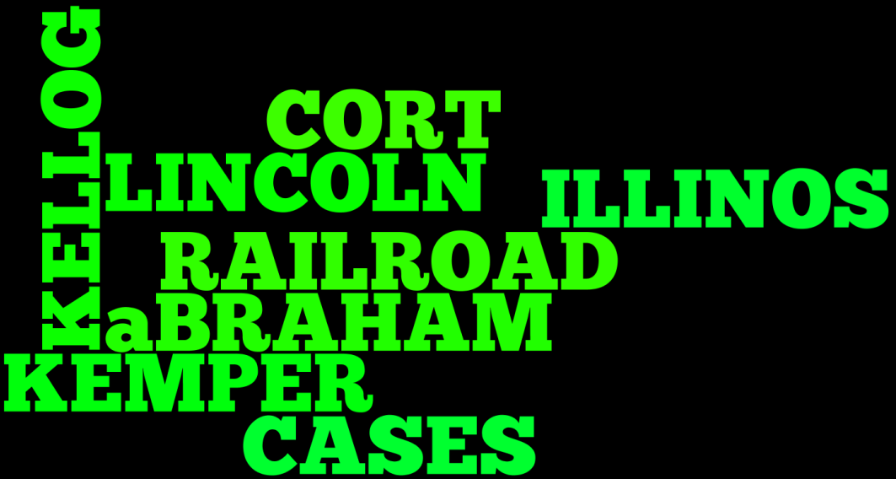
Lincoln
BY: LUCAS PITZER

Slide 2
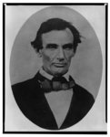
Lincoln as a small child
Abraham Lincoln, head-and-shoulders portrait, facing slightly left, taken in Pittsfield, Illinois, two weeks before the final Lincoln-Douglas debate in Lincoln's unsuccessful bid for the Senate, October 1, 1858
Item Title
Demurrer in Allen v. Illinois Central Railroad, [Law papers].
Spring, 1859
Summary: Allen sued the Illinois Central Railroad and requested $300 in damages. The railroad retained Lincoln, who demurred to Allen's declaration. The court sustained the demurrer and dismissed the case.
Digital ID
lprbscsm scsm1495 http://hdl.loc.gov/loc.rbc/lprbscsm.scsm1495
digital file from b&w film copy neg. http://hdl.loc.gov/loc.pnp/cph.3a18600

Slide 3
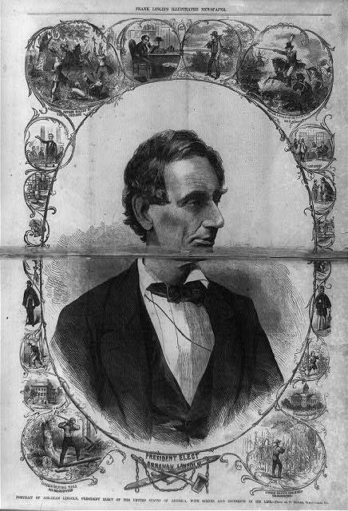
His creepy uncle joe
Amended Replication in Kellogg v. Crain, [Law papers].
Author/Creator
Author: Lincoln, Abraham
Created/Published
January 23, 1836
Summary: Kellogg and Lewis Crain dissolved their business partnership, but Crain owed Kellogg $16,000 to pay off the business's debts. Crain died before paying, and Kellogg sued James Crain, who served as surety for Lewis Crain, in an action of debt for $16,000. The court granted a change of venue to Peoria County, but the court there remanded the case back to Tazewell County. Kellogg retained Lincoln but failed to appear, and the court dismissed the case. Kellogg motioned to reinstate the case because he was ill and could not attend court. The court set aside the dismissal and ruled for Kellogg for $16,000.
Digital ID
lprbscsm scsm1374 http://hdl.loc.gov/loc.rbc/lprbscsm.scsm1374

Slide 4
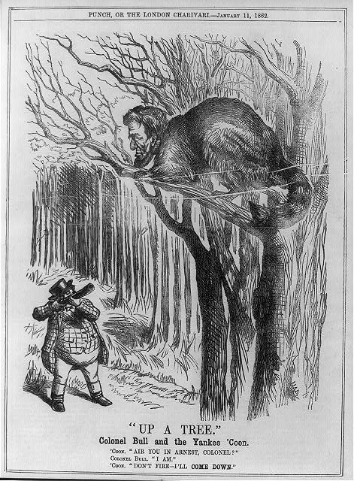
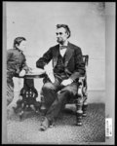
His sister, Aberta
Abraham Lincoln, seated and holding a book, with his son Tad (Thomas) leaning on a table
Item Title
Abraham Lincoln to Thomas J. Turner in Kemper v. Adams & Bovey, [Law papers].
Author/Creator
Author: Lincoln, Abraham
Created/Published
February 08, 1850 Springfield, Illinois
Notes
Provenance Note: October 3, 1961 note on transcription: This is the last letter I sold to Mr. Stern. I sold it the day he died. King Hostick.
Provenance Note: This letter is listed in the Collected Works of Abraham Lincoln. In the Collected Works they identify it as a case in the United States District Court in which Lincoln was involved.
Digital ID
lprbscsm scsm1602 http://hdl.loc.gov/loc.rbc/lprbscsm.scsm1602

Slide 5
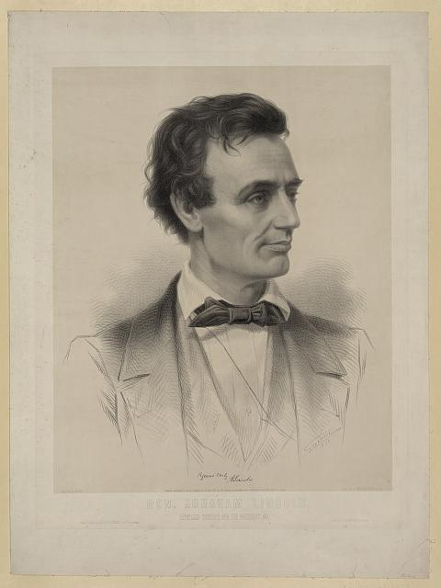
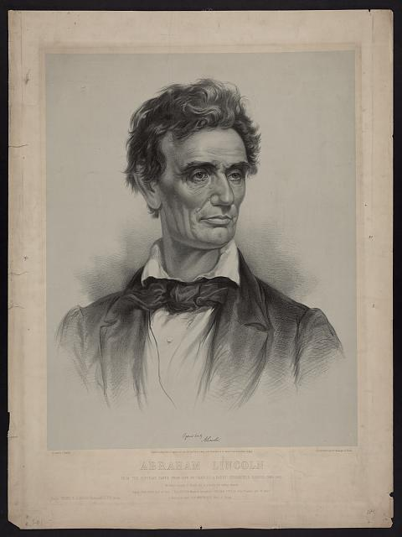
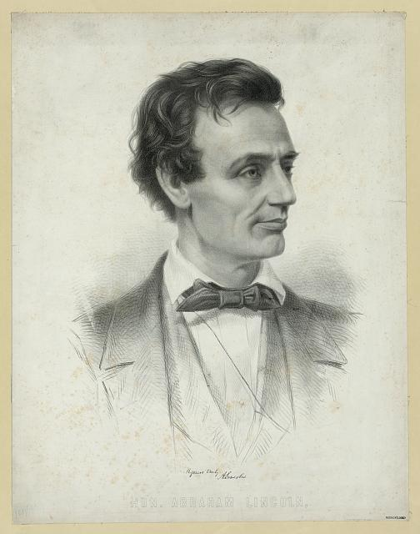
Digital ID: (digital file from original print) pga 00380 http://hdl.loc.gov/loc.pnp/pga.00380
Digital ID: (digital file from original print) pga 03472 http://hdl.loc.gov/loc.pnp/pga.03472
Digital ID: (digital file from original print) pga 03411 http://hdl.loc.gov/loc.pnp/pga.03411

