Slide 1
Abraham Lincoln as Lawyer
By: Kyle Look

Slide 3
Created/Published
September 16, 1851 Tazewell County, Illinois
lprbscsm scsm1525 http://hdl.loc.gov/loc.rbc/lprbscsm.scsm1525
Summary: In 1835, Harris donated twenty acres of land in Tremont, Illinois, to Tazewell County for the erection of the county courthouse. In 1849, the legislature authorized the removal of the county seat to Pekin, Illinois, and specified that the Tremont courthouse be used for education. Harris retained Lincoln and sued to recover the property from the school trustees, but the circuit court ruled for the trustees. Harris appealed to the Illinois Supreme Court, and Lincoln argued that the land had been given on the condition that it be used as the county seat. The supreme court rejected Lincoln's argument and affirmed the judgment. Justice Trumbull ruled that Harris had given the land unconditionally, but had "the land been granted upon condition that it should be used for a particular purpose, it would unquestionably have reverted to the donor when it ceased to be thus used."

Slide 4
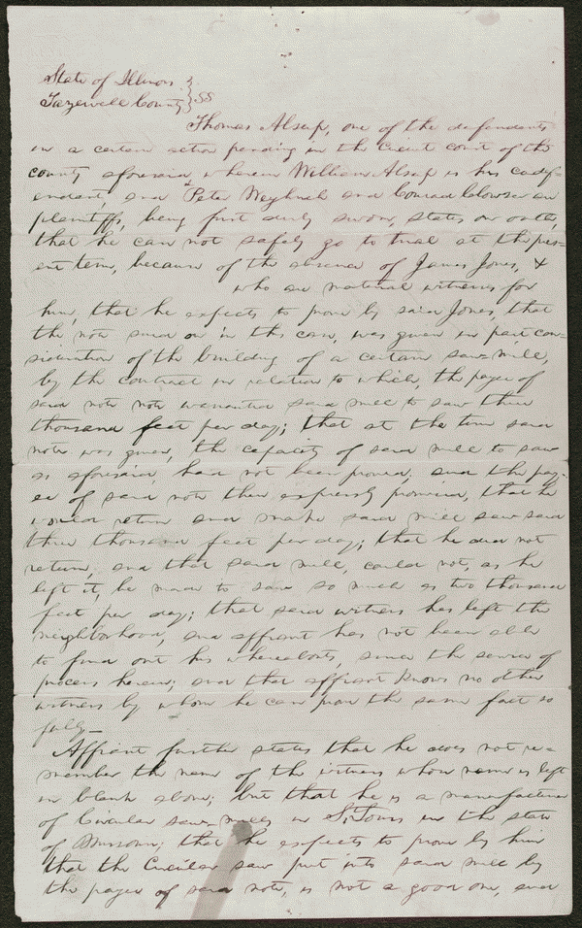

Slide 5
Created/Published
April 28, 1856 Tazewell County, Illinois
Summary: Thomas Allsup and William Allsup gave Springer a promissory note for $336.39. Springer assigned the note to P. Weyrich and Company, who sued in an action of assumpsit after Allsup and Allsup failed to pay. Allsup and Allsup retained Lincoln and argued that the note was for the last payment for a saw mill but that the mill had not been completed on time. Springer had said that the mill could saw three thousand feet per day, but once finished, it could not saw even two thousand feet per day. Allsup and Allsup argued that the consideration of the note had failed. The jury found for Weyrich and Co. and awarded $356.
lprbscsm scsm1465 http://hdl.loc.gov/loc.rbc/lprbscsm.scsm1465

Slide 7
Summary: Saltonstall allegedly took a piece of iron and assaulted Selak. Selak was incapacitated for five weeks and was unable to transact any business. He also spent a great deal of money to restore his health. Selak sued Saltonstall in an action of trespass seeking $500. Saltonstall retained Lincoln and pleaded not guilty. A jury found for Selak and awarded $15 in damages.
Digital ID
lprbscsm scsm1442 http://hdl.loc.gov/loc.rbc/lprbscsm.scsm1442

Slide 8
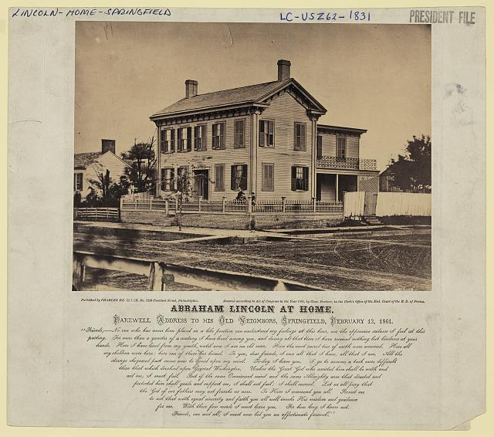
Summary: Photo shows the house where Abraham Lincoln lived in Springfield, Illinois, with presidential candidate Abraham Lincoln standing on the terrace, with his sons Willie and Tad.
digital file from original http://hdl.loc.gov/loc.pnp/ppmsca.23724

Slide 9
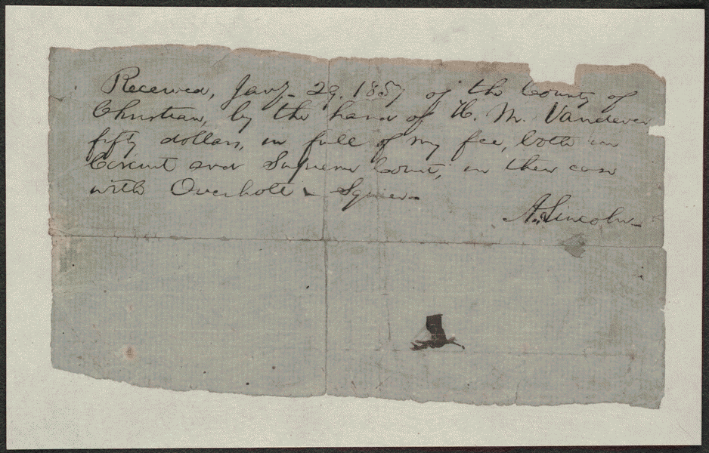

Slide 10
Autograph document. Lawyer Lincoln issues a receipt for "fifty dollars, in full of my fee, both in Circuit and Supreme Court, in the case with Overhold & Squier.
Summary: Overholt and Squier contracted with three judges from Christian County, Illinois, to construct a courthouse. The $15,000 contract was to be paid in installments upon completion of specific projects. Overholt completed the foundation, but Judge Vandeveer refused to pay because the job failed to meet agreed specifications. Overholt and Squier halted construction and sued in the Christian County Circuit Court to recover the anticipated profits. The court granted a change of venue to the Macon County Circuit Court. The jury found for Overholt and Squier and awarded $657.87. The Christian County officials, who had retained Lincoln, appealed to the Illinois Supreme Court, which reversed and remanded the appeal. The court ruled that Overholt and Squier could not sue for anticipated profits unless they were prevented from completing construction, which did not happen. Lincoln received a $50 fee for his work in the trial and the appeal.
Digital ID
lprbscsm scsm1473 http://hdl.loc.gov/loc.rbc/lprbscsm.scsm1473

Slide 11
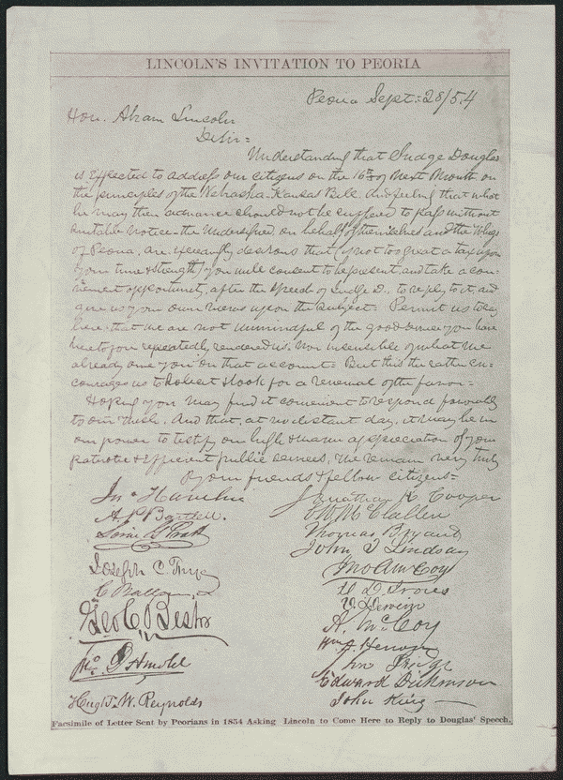
Facsimile of letter sent by Peorians in 1854 asking Lincoln to come here to reply to Douglas's speech.
Digital ID
lprbscsm scsm0361 http://hdl.loc.gov/loc.rbc/lprbscsm.scsm0361

Slide 12
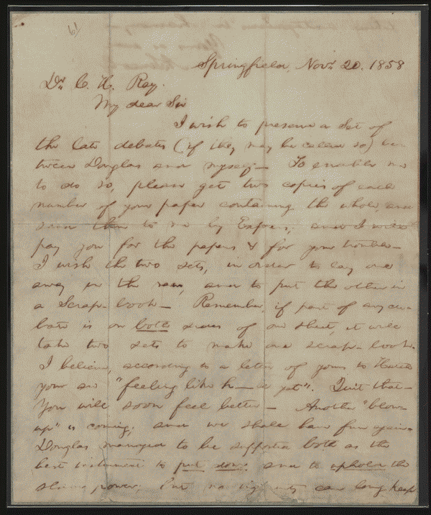
Letter to C. H. Ray from Abraham Lincoln, November 20, 1858. Requests newspaper reports of the debates with Douglas.
Digital ID
lprbscsm scsm0862 http://hdl.loc.gov/loc.rbc/lprbscsm.scsm0862

Slide 13
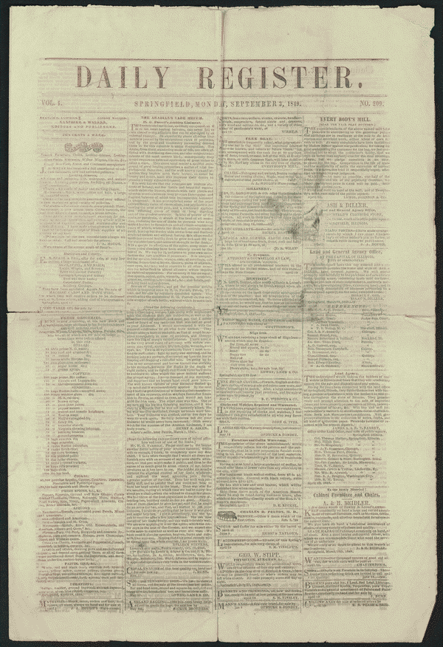
Lincoln cited as reference by law firm, p. [4].
Digital ID
lprbscsm scsm0221 http://hdl.loc.gov/loc.rbc/lprbscsm.scsm0221

Slide 14
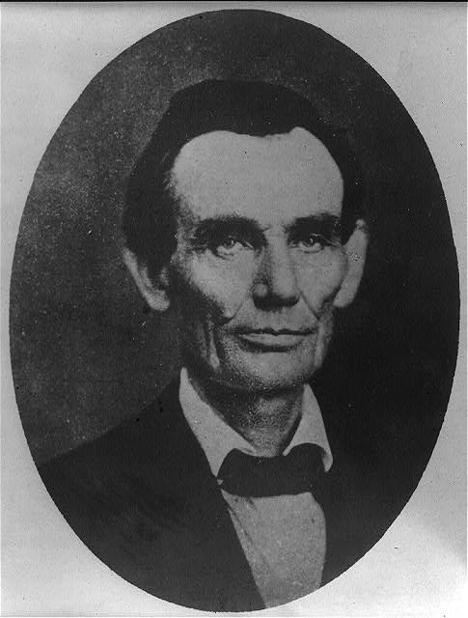
Abraham Lincoln while a traveling lawyer, taken in Danville, Illinois
digital file from b&w film copy neg. http://hdl.loc.gov/loc.pnp/cph.3a18603

Slide 15
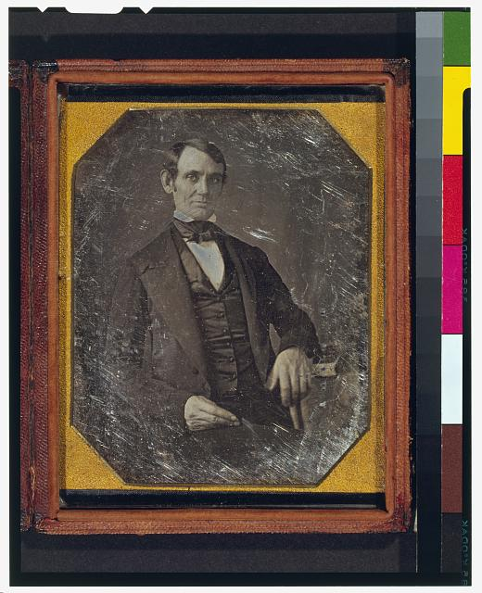
This daguerreotype is the earliest-known photograph of Abraham Lincoln, taken at age 37 when he was a frontier lawyer in Springfield and Congressman-elect from Illinois. (Source: Ostendorf, p. 4)
Creator(s): Shepherd, Nicholas H., photographer
Date Created/Published: [Springfield, Ill., 1846 or 1847]
digital file from color film copy transparency post-1992 http://hdl.loc.gov/loc.pnp/cph.3g02439

Slide 16
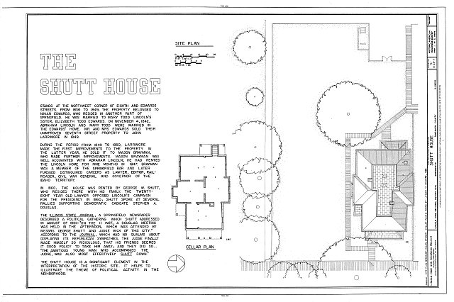
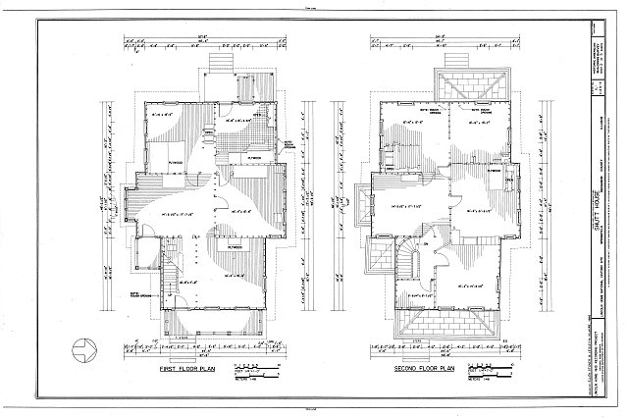
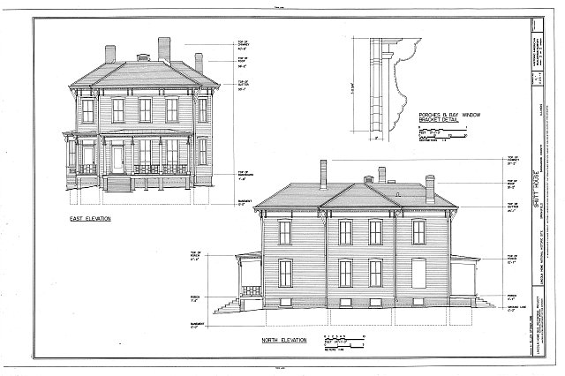
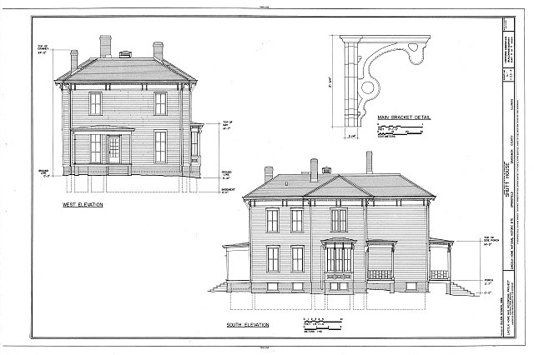

Slide 17
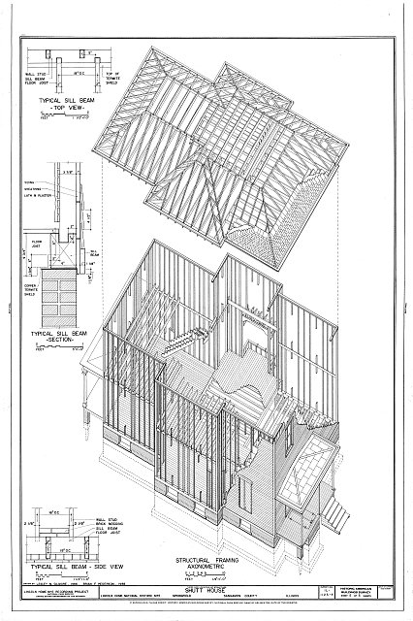

Slide 18
Lincoln Home Site, Shutt House, Edwards & Eighth Streets, Springfield, Sangamon County, IL
http://hdl.loc.gov/loc.pnp/hhh.il0570/sheet.00001a
http://hdl.loc.gov/loc.pnp/hhh.il0570/sheet.00002a
http://hdl.loc.gov/loc.pnp/hhh.il0570/sheet.00003a
http://hdl.loc.gov/loc.pnp/hhh.il0570/sheet.00004a
http://hdl.loc.gov/loc.pnp/hhh.il0570/sheet.00005a

Slide 19
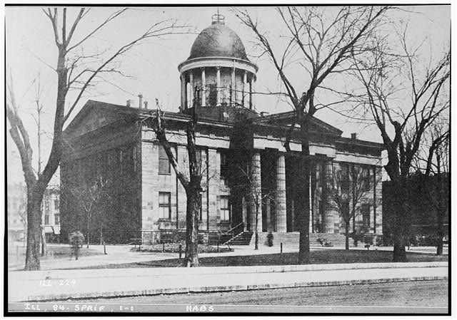
HISTORIC AMERICAN BUILDINGS SURVEY PHOTOGRAPHER UNKNOWN, ABOUT 1898, VIEW FROM SOUTH-WEST - Old State House, Springfield, Sangamon County, IL
http://hdl.loc.gov/loc.pnp/hhh.il0202/photos.064076p

Slide 20
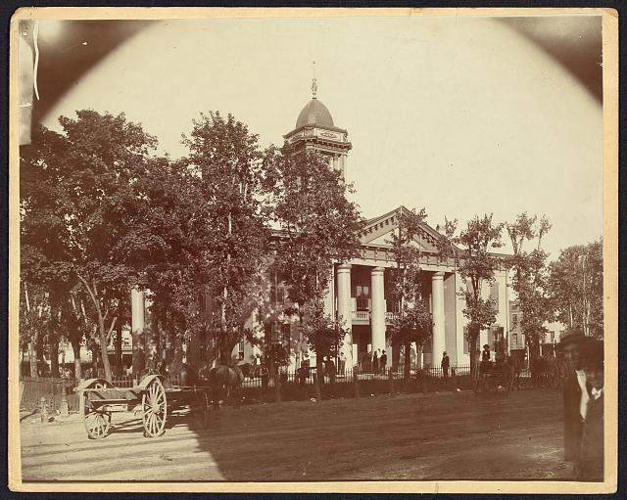

Slide 21
Title: The Coles County Court House in Charleston, Ills., in which Lincoln often practiced law and before which he made a short speech in the evening after his fourth joint debate with Douglas, Sept. 18, 1858
Summary: Photograph showing courthouse with people and horse-drawn wagons in front.
http://hdl.loc.gov/loc.pnp/ppmsca.19197

