Slide 1
Lincoln & The Law
by: Jona Hall

Slide 2
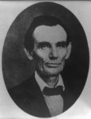
Shot taken by Amon Joslin, of Lincoln as he was traveling as a lawyer in Danville, Illinois, 1856

Slide 3
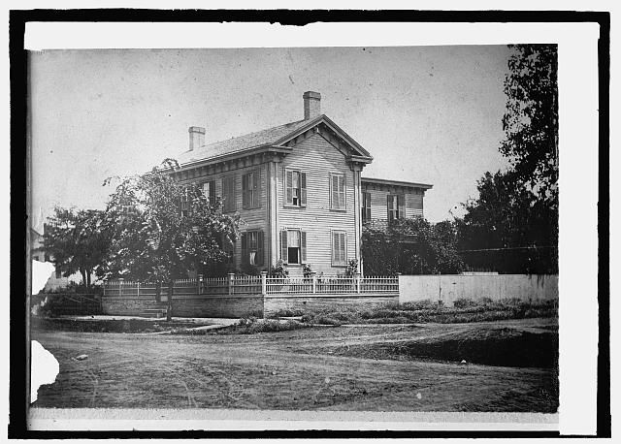
Lincoln House in Springfield, Il., 1861. The elm in front was planted by President Lincoln himself

Slide 4
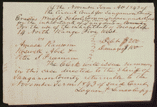
Ransom and others gave Wright(school commissioner for Sangamon County, Illinois) a note for $100, but failed to pay. The commissioner hired Lincoln and sued Ransom for his debt. The commissioner dismissed the case.

Slide 5
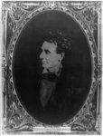
Lincoln, right before his Senate nomination in Chicago, Illinois.

Slide 6
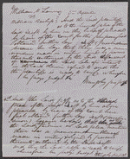
Lamm vs. Bachop. Created and Published on October 29, 1853. Lamm and Bachop were settling an argument through arbitration. Lamm was to relinquish a deed on 360 acres of land for $125 from Bachop. Lamm sued after he was not paid by Bachop. Bachop then hired Lincoln as his lawyer and pleaded that it's fair, because he made no written agreement with Lamm. The court ruled for Bachop.

Slide 7
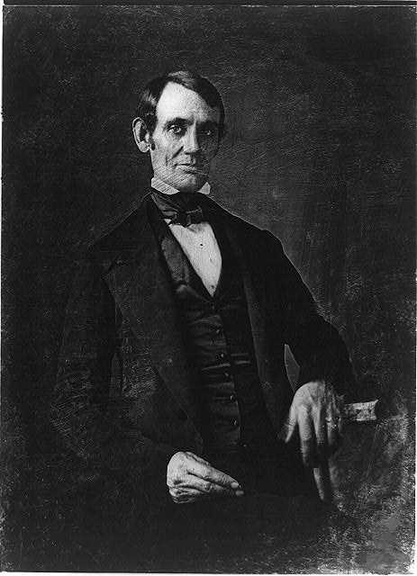
Abraham Lincoln is elected as Congressman for the state of Illinois.

Slide 8
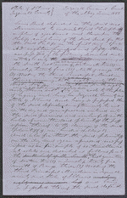
Phillips owned 160 acres in Tazewell County. He hired Lincoln and sued Beal for unlawfully with holding 20 acres from him. Beal pleaded not guilty, but the jury awarded Phillips $0.01 in damages.

