Slide 1
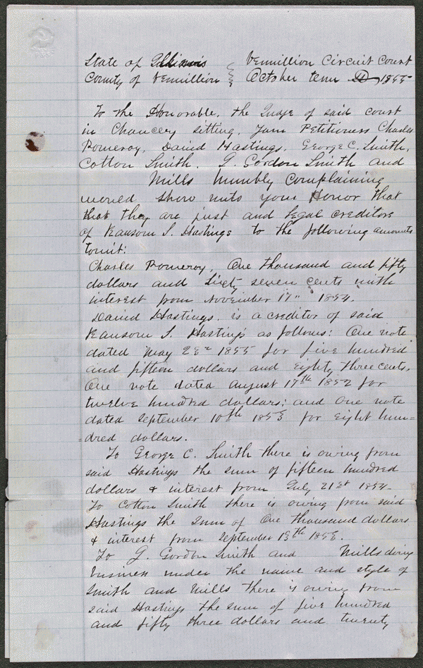
Freeman & Bright v. Hastings Hastings owed the firm of Freeman and Bright $3,701.59, but failed to pay. Hastings owned 1,600 acres of land in Vermilion and Iroquois Counties and gave Greenlee a trust deed to sell the land to pay three debts totaling $1,500, not including Freeman and Bright's. Freeman and Bright sued Hastings and others to set aside the trust deed and petitioned the court to sell the land to pay all of Hastings's creditors. Pomeroy and other creditors retained Lincoln and filed a cross-bill and claimed that Greenlee had sold the land for $7,000, and pro-rated the money to Hastings's creditors, including Freeman and Bright. Pomeroy and others had been left out of the distribution and wanted to be paid. Freeman and Bright later dismissed the case.
http://hdl.loc.gov/loc.rbc/lprbscsm.scsm1458

Slide 2
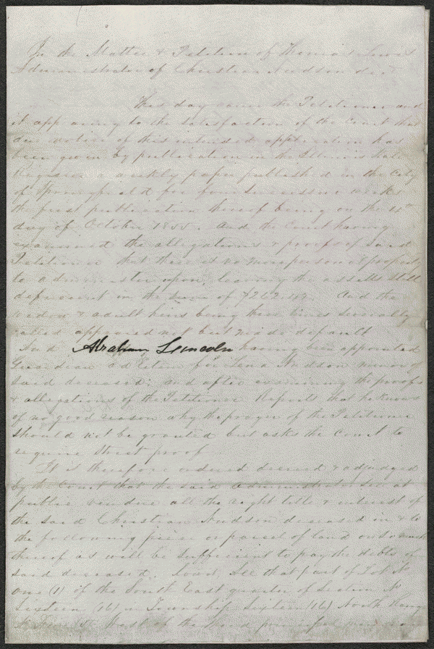
Decree in Ex parte Lewis
At the time of his death in 1855, Christian Nudson owed debts totaling $262.42. Lewis, the administrator of Nudson's estate, petitioned the court to allow him to sell fifteen acres of the estate's land in Sangamon County, Illinois, to pay the debts of the estate. The court appointed Lincoln as guardian ad litem for Nudson's minor heir. The court granted the petition and ordered Lewis to sell the fifteen acres. Lewis sold the land to Canedy for $435.
http://hdl.loc.gov/loc.rbc/lprbscsm.scsm1461

Slide 3
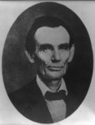
Traveling lawyer, in Danville, Illinois.

Slide 4
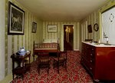
Petersen House across from the Ford’s Theatre
Room Abe died in
Same layout as it was

Slide 5
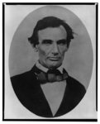
Portrait taken in Pittsfield Illinois
Two weeks before final Lincoln Douglas debate.

Slide 6
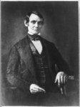
Frontier lawyer in Springfield

