Slide 1
Lincoln And The Law
Hannah Kirby

Slide 2
http://hdl.loc.gov/loc.rbc/lprbscsm.scsm1510
Summary: The people of Illinois, for the use of White, retained Lincoln and sued Yount to collect a $12,000 debt. White, the administrator de bonis non of Joseph Davis's estate, charged that Yount, as administrator of Marcus Snow's estate, was liable for the $12,000 due to the Davis estate from Snow, who had been administrator de bonis non of Davis's estate until his death. White stated that the $12,000 debt that Snow owed the estate came from Snow's selling real and personal property from the estate. The court ruled for Yount

Slide 3
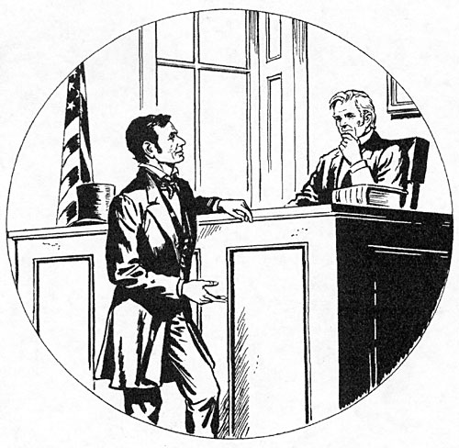

Slide 4
http://hdl.loc.gov/loc.rbc/lprbscsm.scsm1457
Summary: Gatling, Martin, and Prather retained Lincoln and sued the Great Western Railroad for unlawful detention of five acres of their land. The railroad's depot, built on the property, had burned, and Gatling requested $500 in damages. Gatling dismissed the suit. Gatling later invented the rapid fire "Gatling gun." October 1880

Slide 5
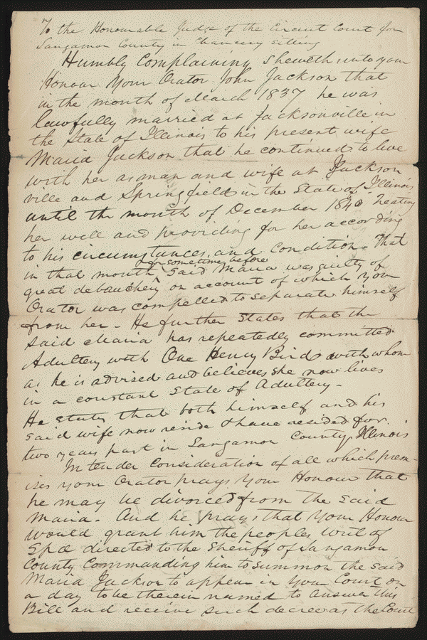
http://hdl.loc.gov/loc.rbc/lprbscsm.scsm1406
Summary: John Jackson retained Logan and Lincoln and sued Maria Jackson for divorce on the grounds of adultery. The court ruled for John Jackson and granted the divorce.
November 05, 1842 Sangamon county, Illinois

Slide 6
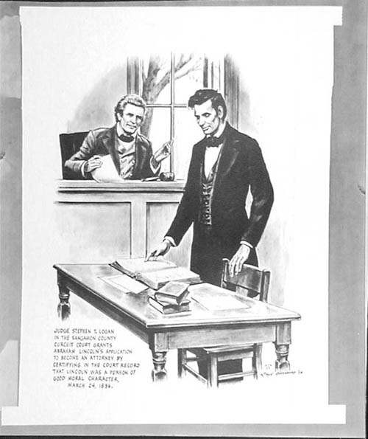

Slide 7
http://hdl.loc.gov/loc.rbc/lprbscsm.scsm1444
Summary: Joseph Gundy and John Gundy entered into the business of selling hogs and cattle in the fall of 1847, and decided to dissolve the partnership in December 1848. Joseph Gundy sued John Gundy in a chancery action to settle the partnership. Joseph Gundy also sued John Gundy in a separate common law action (Gundy v. Gundy). In this case, Joseph Gundy claimed that John Gundy owed him $200 for 1,000 bushels of corn; $200 for 110 hogs sold; and an additional amount for twenty-four steers. John Gundy retained Lincoln and answered that Joseph Gundy owed him money from the partnership and filed a cross-bill to obtain the sum. The parties reached a settlement in which the court ruled for Joseph Gundy and awarded $415.
10/24/18

Slide 8
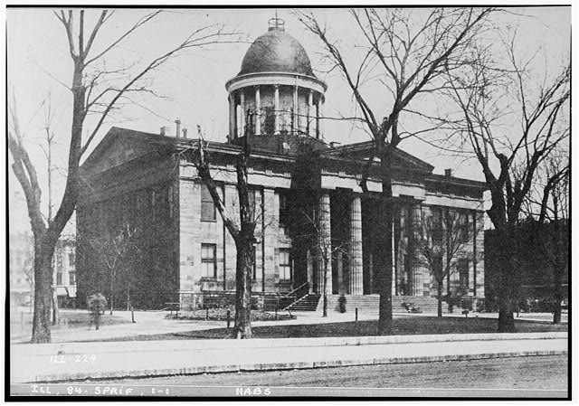
Old State House, Springfield, Sangamon County, IL
hhh il0202.photos.064076p http://hdl.loc.gov/loc.pnp/hhh.il0202/photos.064076p

Slide 9
Danville, IL
http://www.loc.gov/pictures/item/2008678328/

Slide 10
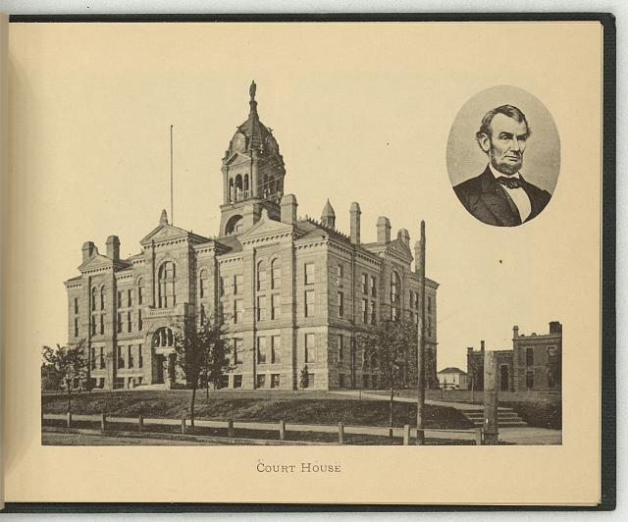
http://www.loc.gov/pictures/item/2009630142/

Slide 11
http://www.loc.gov/pictures/item/98517810/
Summary: Abraham Lincoln, head-and-shoulders portrait, facing right.

Slide 12
Wordle

