Slide 1
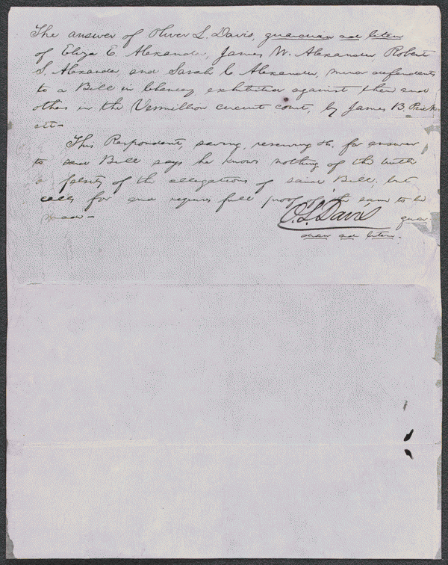
http://hdl.loc.gov/loc.rbc/lprbscsm.scsm1560
Summary: Prickett retained Lincoln and sued the administrator and heirs of William Alexander to correct a deed. Prickett had purchased part of lot seven in block nine in Danville, but the deed described a lot in block four. The court appointed a commissioner to correct the deed.

Slide 2
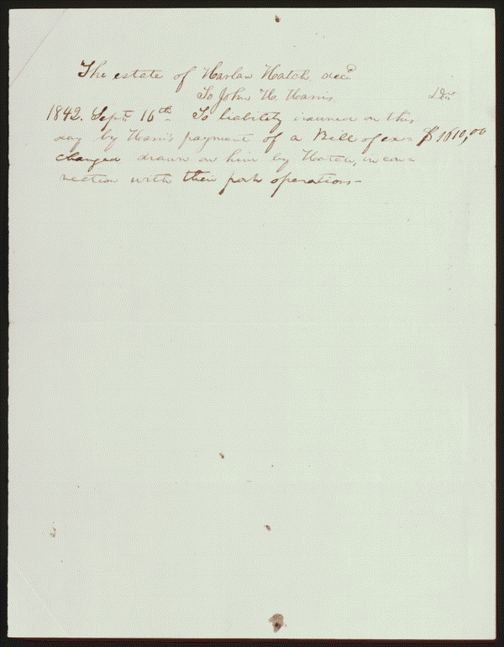
http://hdl.loc.gov/loc.rbc/lprbscsm.scsm1411
Summary: Harris and Hatch were partners in a pork business. Hatch owed Harris $1,610, but died before paying the debt. Lincoln wrote an account for Harris as a claim against Hatch's estate.

Slide 3
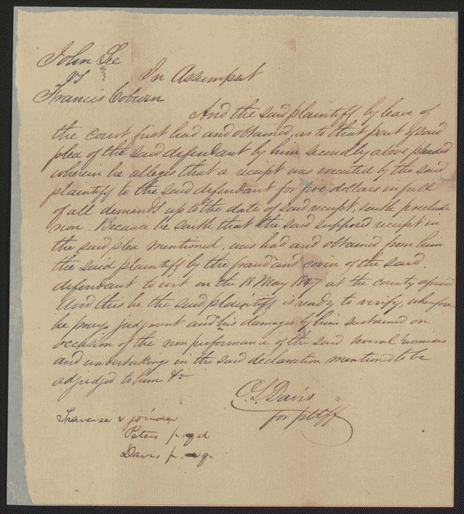
http://hdl.loc.gov/loc.rbc/lprbscsm.scsm1438
Summary: Lee sued Coburn to collect $600 for five years of labor as a servant. There was no written contract, guarantee, or promise between the parties, and Lee refused to prosecute the case further after the jury heard the evidence. Lincoln represented Coburn.

