Slide 1
LINCOLN AND THE LAW
A COMMUNITY HISTORY PROJECT

Slide 2
Thorpe .v. Thorpe
The case of adultery! Eliza Thorpe hires Lincoln and Herndon to sue her husband, Moses for his acts of infidelity. She stated that he committed adultery with Emily Cox, and Eliza used her as evidence. Moses denied the charge, claiming that Eliza verbally abused him and drove him into divorce. He presented witnesses, including his son(from previous marriage), but the case was later dismissed.

Slide 3
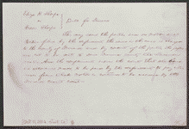
Thorpe .vs. Thorpe cont.
Location: Platt County, Il
Date: October 11 1852
http://hdl.loc.gov/loc.rbc/lprbscsm.scsm1539

Slide 4
Young .v. Littler
Young sued Littler for $1,000 for assault and battery. The fight took place on Young's property after Littler alleged that a hog was his. Littler, represented by Lincoln, pleaded self-defense and claimed that Young had attempted to assault him with a gun and a club. Young later died, and his attorney abated the case.
http://hdl.loc.gov/loc.rbc/lprbscsm.scsm1440

Slide 5
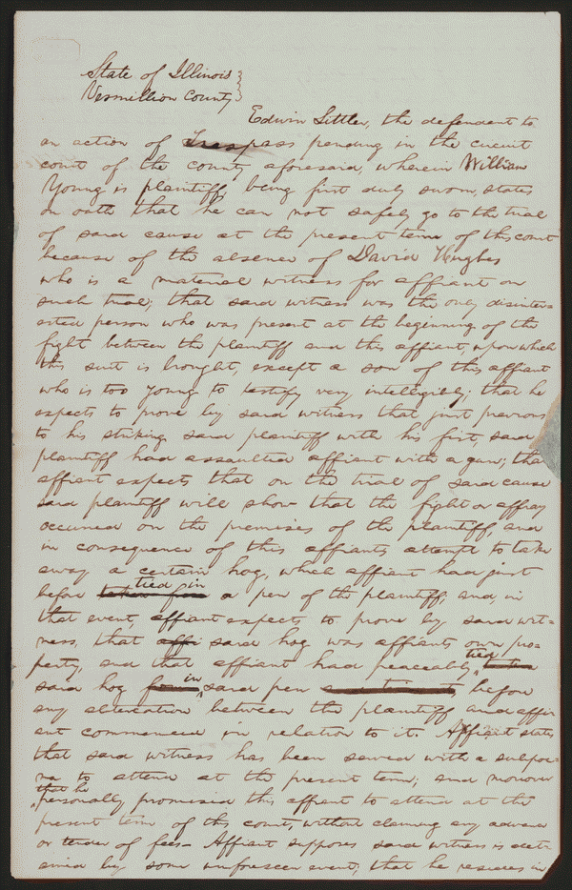
Young .v. Littler
Location: Vermilion County, Illinois
Date: May 1850
Author: Abraham Lincoln
Signed by: Edwin Littler
http://hdl.loc.gov/loc.rbc/lprbscsm.scsm1440

Slide 6
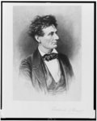
Lincoln the Lawyer
Author: Frederick T. Stuart(1837-1913)
Date: 1865-1910(?)
http://hdl.loc.gov/loc.pnp/hhh.il0202/photos.064076p

Slide 7
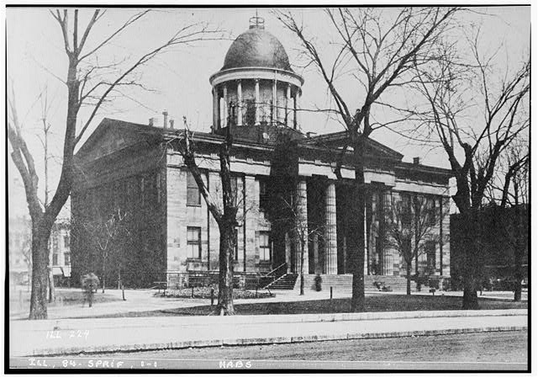
Old State House
Location: Springfield, Sangamon, County, IL
Creator(s): Historic American Buildings Survey
Date: After 1933
http://hdl.loc.gov/loc.pnp/hhh.il0202/photos.064076p

Slide 8
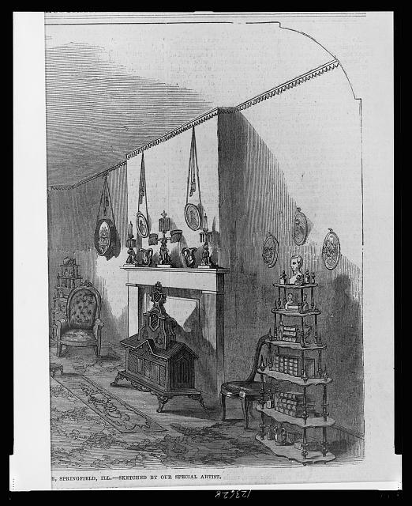
Front Parlor in Abraham Lincoln’s house
Location: Springfield, IL
Author: Sketched by a “special” artist
Date: 1861
http://hdl.loc.gov/loc.pnp/cph.3c23628

Slide 9
House where Abraham Lincoln’s father lived.
Location: Coles Co, IL (9 miles south of Charleston)
Date Created: ?
http://www.loc.gov/pictures/item/2004677374/

Slide 10
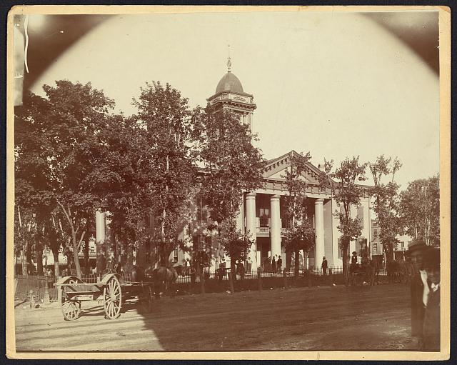
The Coles Co County Courthouse
Location: Charleston, IL
Date: 1860-1898(?)
http://hdl.loc.gov/loc.pnp/ppmsca.19197

Slide 11
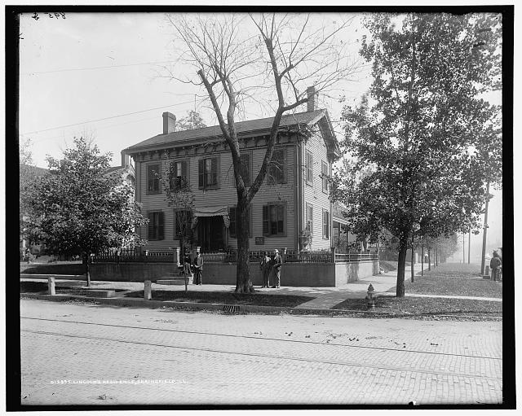
Lincoln’s Residence
Location: Springfield, IL
Date: 1900

Slide 12
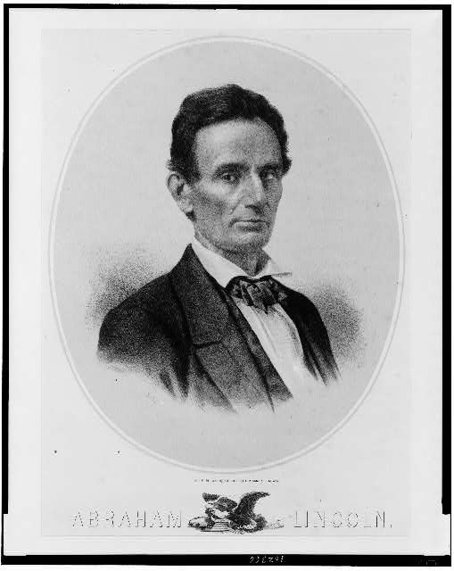
Abraham Lincoln/lith
Creators: Mendel, Ed
Location: Chicago, IL
Date: 1850-1900(?)
http://hdl.loc.gov/loc.pnp/cph.3c02366

Slide 13
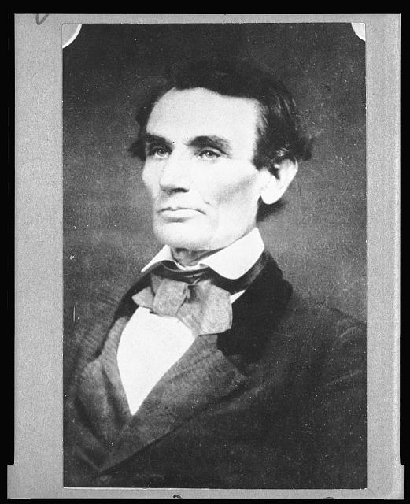
Abraham Lincoln in a borowed coat
Creators: Alschueler, Samuel G
Date: April 25, 1858
Location: Urbana, IL
http://www.loc.gov/pictures/item/2008678329/

Slide 14
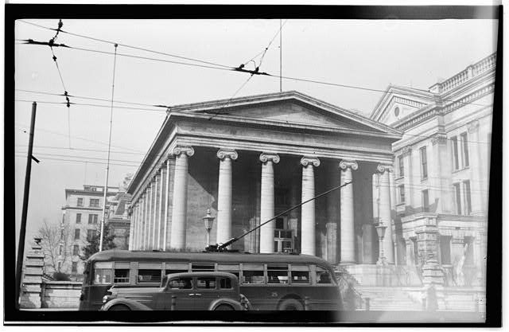
Old Montgomery County Courthouse
Creators: Historic American Buildings Survey
Date: After 1933
http://hdl.loc.gov/loc.pnp/hhh.oh0045/photos.128196p

Slide 15
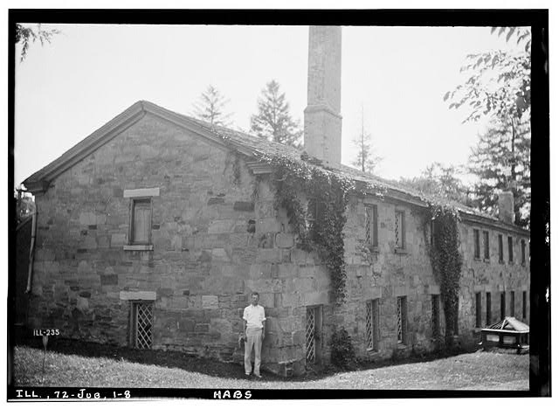
Historic American Buildings Survey
Location: Jubilee College, Brimfield, Peoria, IL
Date: July 1935
http://hdl.loc.gov/loc.pnp/hhh.il0372/photos.063398p

