Slide 1
Law Cases

Slide 2
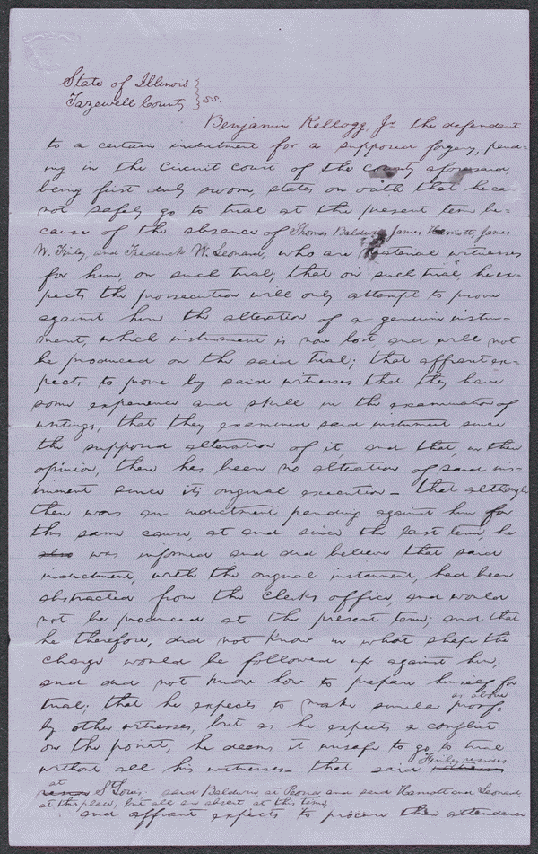
Affidavit in People v. Kellogg
Summary: The state's attorney indicted Kellogg for forgery because he allegedly altered a document. Kellogg retained Lincoln and argued that he did not alter the document and produced many witnesses to testify to that effect. Lincoln motioned the court to quash the indictment; the court agreed and dismissed the case.
http://hdl.loc.gov/loc.rbc/lprbscsm.scsm1578

Slide 3
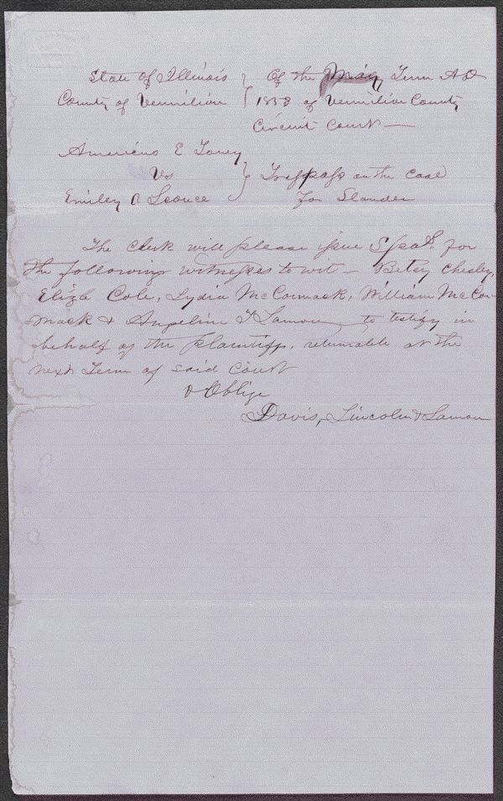
Order for Subpoena in Toney v. Sconce, [Law papers].
Date: 1853 Location: Vermilion County, Illinois
Summary: Toney retained Lincoln and sued Sconce in an action of slander, seeking $5,000 in damages. Toney charged that Sconce publicly stated that she had committed fornication with Whitcomb, after hearing the bed "rattling and jiggling," and seeing a disheveled Toney, red-faced and in an excited state, emerge from her room at 3:00 a.m. Sconce consented to a $5,000 judgment, of which Toney remitted all but $50.
http://hdl.loc.gov/loc.rbc/lprbscsm.scsm1547

Slide 4
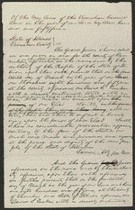
Indictment in People v. Tucker, [Law papers].
Date: May 26, 1856 Location: Vermilion County, Illinois
Summary: The state's attorney indicted Tucker for assaulting Smith with a four-pound axe. Tucker pleaded guilty, and the court fined him $75. Lincoln wrote the indictment for state's attorney Lamon.
http://hdl.loc.gov/loc.rbc/lprbscsm.scsm1468

Slide 5
Pictures

Slide 6
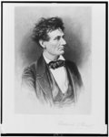
: Lincoln the lawyer / Frederick T. Stuart.
Creator(s): Stuart, Fredrick T., 1837-1913, etcher
Date Created/Published: Between 1865-1910?
Summary: Abraham Lincoln, head-and-shoulders portrait, facing right.
http://www.loc.gov/pictures/item/98517810/

Slide 7
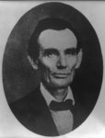
Abraham Lincoln while a traveling lawyer, taken in Danville, Illinois
Creator(s): Joslin, Amon T photographer
Date Created/Published: 1857 May 27 [printed later]
http://www.loc.gov/pictures/item/2008678328/

Slide 8
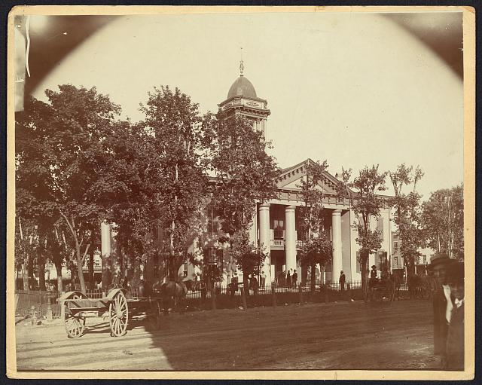
The Coles County Court House in Charleston, Ills
Date Created/Published: [between 1860 and 1898?]
Summary: Lincoln often practiced law and before which he made a short speech in the evening after his fourth joint debate with Douglas, Sept. 18, 1858
Digital ID: http://hdl.loc.gov/loc.pnp/ppmsca.19197

Slide 9
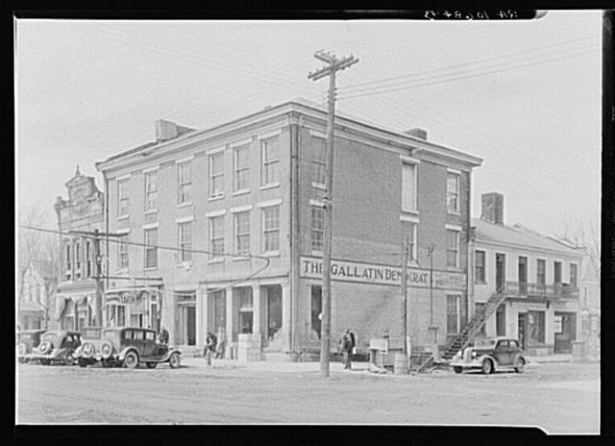
The Posey Building of Shawneetown, Illinois, in which Abraham Lincoln and Robert Ingersoll had law offices
Creator(s): Lee, Russell, 1903-1986, photographer
Date Created/Published: 1937 Apr.
http://www.loc.gov/pictures/item/fsa1998022486/PP/

Slide 10
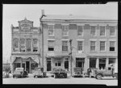
Posey Building where Abraham Lincoln and had law offices. Shawneetown, Illinois
Creator(s): Lee, Russell, 1903-1986, photographer
Date Created/Published: 1937 Apr.
http://www.loc.gov/pictures/item/fsa1998022487/PP/

Slide 11
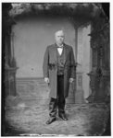
Ingersoll, Robert (The Infidel)
http://www.loc.gov/pictures/item/brh2003002102/PP/

Slide 12
Wordle

