Slide 1
Abraham Lincoln
By daniel

Slide 2
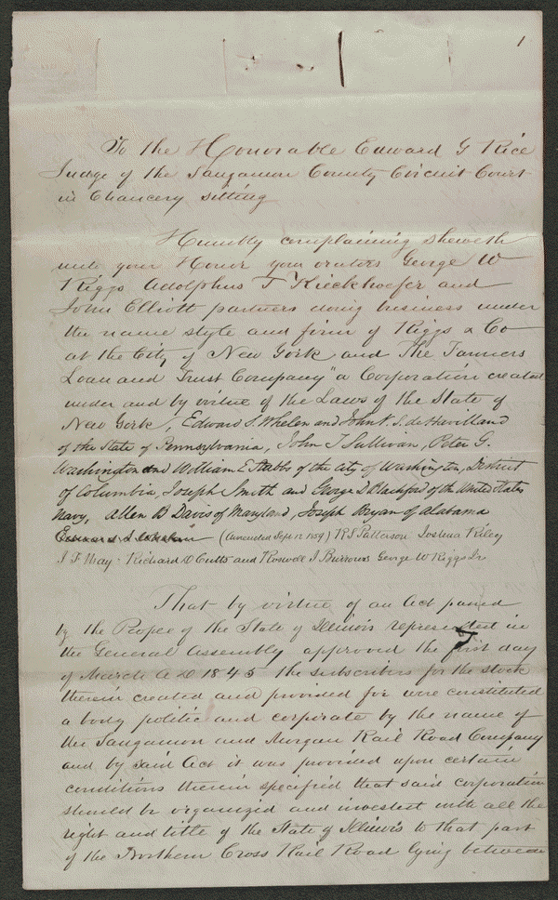

Slide 3
Summary: In 1853, the Great Western Railroad Company borrowed $1,000,000 and issued bonds in various denominations to pay back the loan. To secure these bonds, the Great Western Railroad issued a deed trust transferring a portion of the railroad line to the Farmers' Loan and Trust Company. The railroad failed to pay the first series of bonds and interest. The Farmers' Loan and Trust Co. retained Lincoln and sued the railroad. The Farmers' Loan and Trust Co. asked the court to obtain an accounting of the railroad's records, to appoint a receiver to take control of the railroad, and to issue an injunction to stop the railroad from paying any other debts before repaying the bank. The Farmers' Loan and Trust Co. added other defendants upon discovering that the railroad had mortgaged some of its land to others. Lamb, one of the defendants, motioned the court to dismiss the case because of a lack of proper parties. The Farmers' Loan and Trust Co. later dismissed the case
http://hdl.loc.gov/loc.rbc/lprbscsm.scsm1592
February 01, 1859 Sangamon County, Illinois

Slide 4
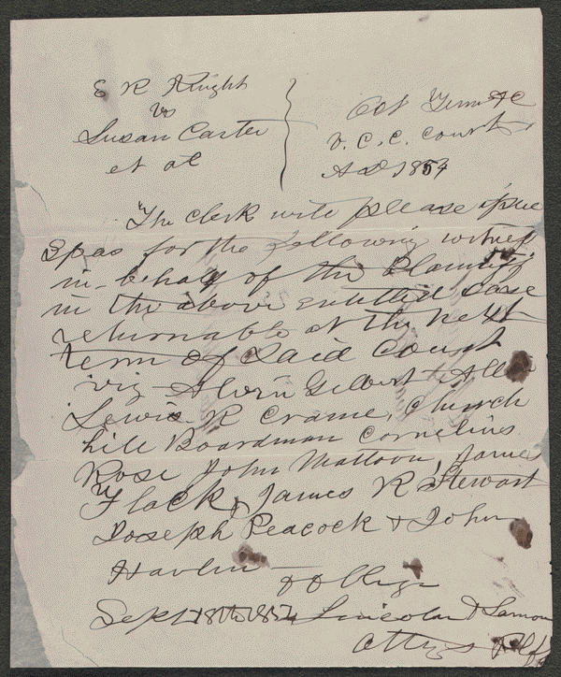

Slide 5
Summary: Knight retained Lincoln and sued the heirs of Washington Carter to settle a partnership. Carter and Knight had been partners in selling land and livestock and in farming. The court appointed three commissioners to partition the estate's 615 acres. The commissioners assigned dower to Carter's widow, Susan Boardman; gave Knight one-half of the land; and partitioned the remaining land in equal shares for Carter's three minor heirs.
http://hdl.loc.gov/loc.rbc/lprbscsm.scsm1577
September 18, 1854

Slide 6
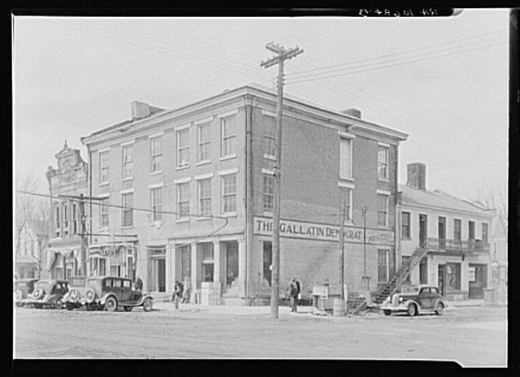

Slide 7
title: The Posey Building of Shawneetown, Illinois, in which Abraham Lincoln and Robert Ingersoll had law offices
Creator(s): Lee, Russell, 1903-1986, photographer
Date Created/Published: 1937 Apr.
Medium: 1 negative : safety ; 5 x 7 inches or smaller.
Reproduction Number: LC-USF341-T01-010684-B (b&w film dup neg.)
Rights Advisory: No known restrictions on images made by the U.S. government; images copied from other sources may be restricted. For information, see U.S. Farm Security Administration/Office of War Information Black & White Photographs(http://www.loc.gov/rr/print/res/071_fsab.html)
Call Number: LC-USF341- 010684-B [P&P]
Other Number: F 256
Repository: Library of Congress Prints and Photographs Division Washington, DC 20540 USA http://hdl.loc.gov/loc.pnp/pp.print
Notes:
Title and other information from caption card.
LOT 1088 (Location of corresponding print).
Transfer; United States. Office of War Information. Overseas Picture Division. Washington Division; 1944.
More information about the FSA/OWI Collection is available at http://hdl.loc.gov/loc.pnp/pp.fsaowi

Slide 8
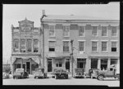

Slide 9
Title: An old grocery building and the Posey Building where Abraham Lincoln and Robert Ingersoll had law offices. Shawneetown, Illinois
http://www.loc.gov/pictures/item/fsa1998022487/PP/

Slide 10
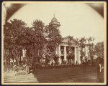

Slide 11
Title: The Coles County Court House in Charleston, Ills., in which Lincoln often practiced law and before which he made a short speech in the evening after his fourth joint debate with Douglas, Sept. 18, 1858
http://www.loc.gov/pictures/item/2008680974/

Slide 12
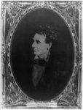

Slide 13
Title: [Abraham Lincoln, immediately prior to Senate nomination, Chicago, Illinois]
http://www.loc.gov/pictures/item/2008678332/

Slide 14
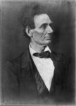

Slide 15
[Abraham Lincoln, presidential candidate, half-length portrait, facing right]
http://www.loc.gov/pictures/item/2009630665/

Slide 16
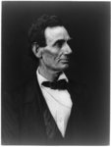

Slide 17
Title: [Abraham Lincoln, presidential candidate, half-length portrait, facing right
http://www.loc.gov/pictures/item/2009630667/

Slide 18
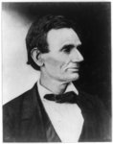

Slide 19
: [Abraham Lincoln, presidential candidate, half-length portrait, facing right
http://www.loc.gov/pictures/item/2009630674/

Slide 20
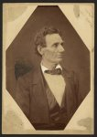

Slide 21
: [Abraham Lincoln, presidential candidate, half-length portrait, facing right]
http://www.loc.gov/pictures/item/2008680971/

Slide 22
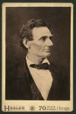

Slide 23
: [Abraham Lincoln, presidential candidate, half-length portrait, facing right]
http://www.loc.gov/pictures/item/2009630673/

Slide 24
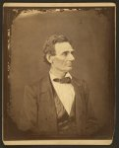

Slide 25
[Abraham Lincoln, presidential candidate, half-length portrait, facing right
http://www.loc.gov/pictures/item/2010645957/

Slide 26
