Slide 1
Abraham Lincoln life as a lawyer
By DaJhae Weeks

Slide 2
Case #1
Summary: Knight retained Lincoln and sued the heirs of Washington Carter to settle a partnership. Carter and Knight had been partners in selling land and livestock and in farming.
The court appointed three commissioners to partition the estate's 615 acres.
The commissioners assigned dower to Carter's widow, Susan Boardman; gave Knight one-half of the land; and partitioned the remaining land in equal shares for Carter's three minor
http://hdl.loc.gov/loc.rbc/lprbscsm.scsm1577

Slide 3
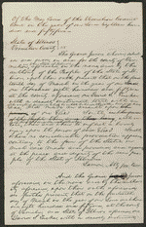
Case #2
Summary: The state's attorney indicted Tucker for assaulting Smith with a four-pound axe.
Tucker pleaded guilty, and the court fined him $75. Lincoln wrote the indictment for state's attorney Lamon.
http://hdl.loc.gov/loc.rbc/lprbscsm.scsm1533

Slide 4
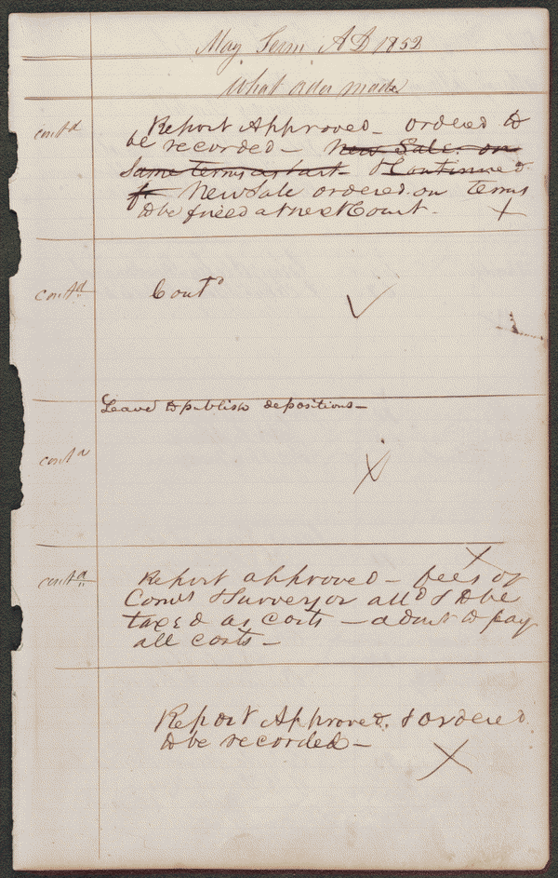
Case#3
Summary: Joseph Gundy and John Gundy entered into the business of selling hogs and cattle in the fall of 1847, and decided to dissolve the partnership in December 1848.
Joseph Gundy sued John Gundy in a chancery action to settle the partnership. Joseph Gundy also sued John Gundy in a separate common law action (Gundy v. Gundy).
In this case, Joseph Gundy claimed that John Gundy owed him $200 for 1,000 bushels of corn; $200 for 110 hogs sold; and an additional amount for twenty-four steers.
John Gundy retained Lincoln and answered that Joseph Gundy owed him money from the partnership and filed a cross-bill to obtain the sum. The parties reached a settlement in which the court ruled for Joseph Gundy and awarded $415.
http://hdl.loc.gov/loc.rbc/lprbscsm.scsm1468

Slide 5
Pictures of Abraham Lincoln

Slide 6
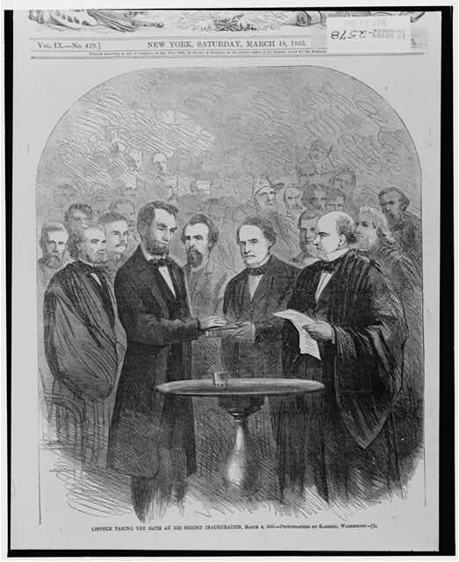
Summary: Knight retained Lincoln and sued the heirs of Washington Carter to settle a partnership. Carter and Knight had been partners in selling land and livestock and in farming. The court appointed three commissioners to partition the estate's 615 acres. The commissioners assigned dower to Carter's widow, Susan Boardman; gave Knight one-half of the land; and partitioned the remaining land in equal shares for Carters three minor
http://hdl.loc.gov/loc.rbc/lprbscsm.scsm1468

Slide 7
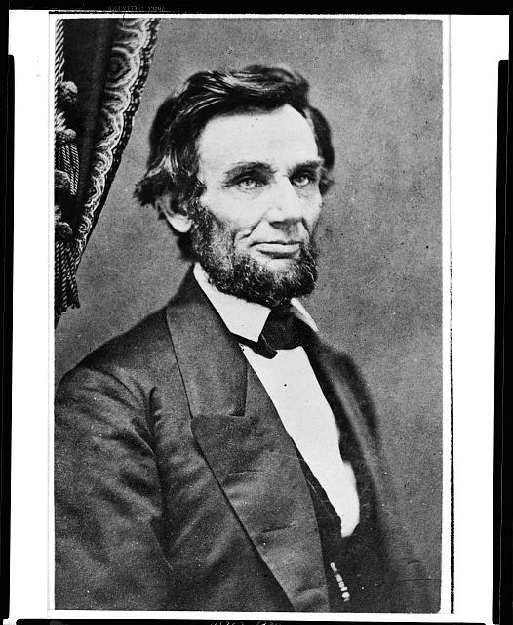
Summary: Abraham Lincoln, last portrait sitting in Springfield, Illinois, before leaving for Washington, D.C., to assume the presidency.
http://hdl.loc.gov/loc.pnp/cph.3a09984

Slide 8
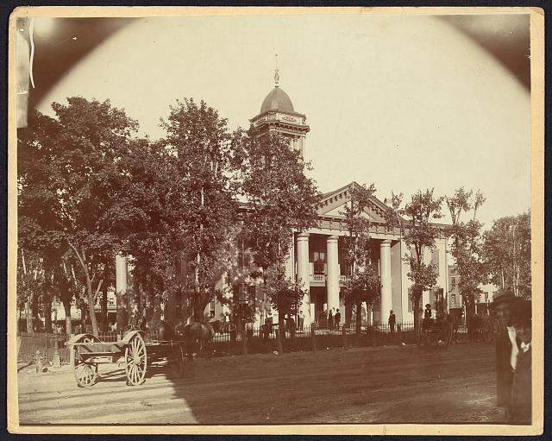
The Coles County Court House in Charleston, Ills., in which Lincoln often practiced law and before which he made a short speech in the evening after his fourth joint debate with Douglas, Sept. 18, 1858

Slide 9
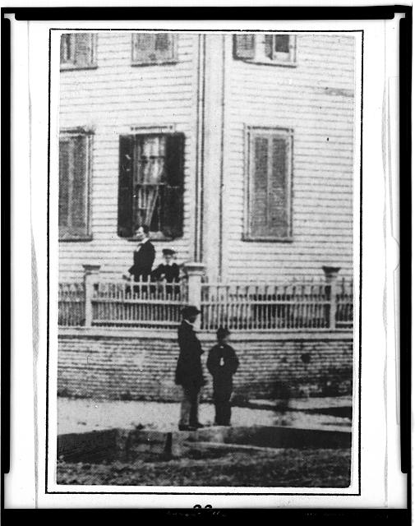
Abraham Lincoln at home in Springfield, Illinois, standing inside the fence with his son Willie and Tad (looking out from behind the corner post), summer, 1860].
http://hdl.loc.gov/loc.pnp/cph.3a52061

Slide 10
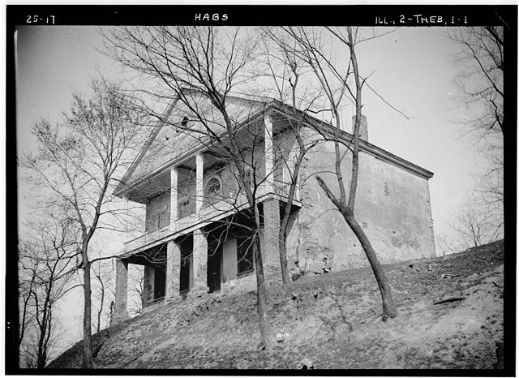
1. HISTORIC AMERICAN BUILDINGS SURVEY CHAUNCEY BUCK - PHOTOGRAPHER - MARCH 17, 1934. VIEW FROM SOUTH-WEST - Thebes Courthouse, Thebes, Alexander County, IL
http://hdl.loc.gov/loc.pnp/hhh.il0139/photos.061823p

Slide 11
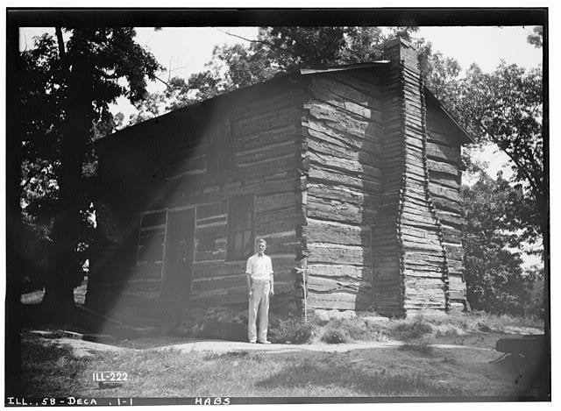
. HISTORIC AMERICAN BUILDINGS SURVEY E.E. LUNDEEN, PHOTOGRAPHER JULY 10, 1935. VIEW FROM SOUTHWEST - First Macon County Courthouse, Fairview Park (moved from Main Street), Decatur, Macon County, IL
http://hdl.loc.gov/loc.pnp/hhh.il0366/photos.062906p

Slide 12
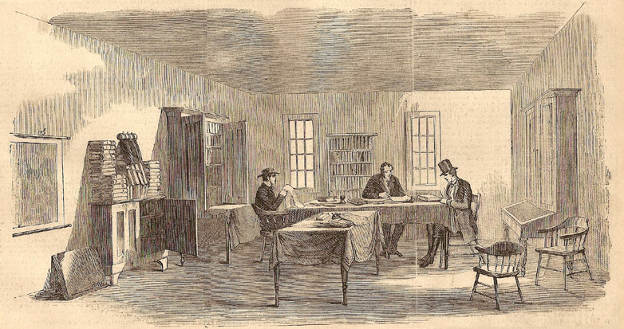
"The First Law Office Rented in 1837 by Abraham Lincoln, in Hoffman's Row, Third Division, Upstairs, Springfield, Ill.," engraving made in 1860, when the artist visited the office.
"When Abraham Lincoln first went to Springfield, nearly thirty years ago, he ran for the Legislature, was elected, and served several terms.
In 1837 he opened a law office under the firm of Stuart & Lincoln, in Hoffman's Row."

Slide 13
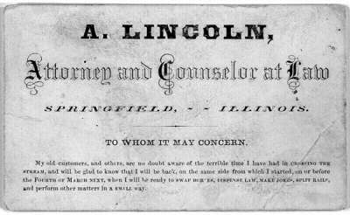
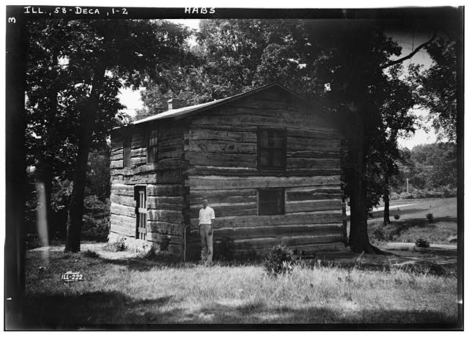
. HISTORIC AMERICAN BUILDINGS SURVEY E.E. LUNDEEN, PHOTOGRAPHER JULY 10, 1935. VIEW FROM NORTHEAST - First Macon County Courthouse, Fairview Park (moved from Main Street), Decatur, Macon County, IL
http://hdl.loc.gov/loc.pnp/hhh.il0366/photos.062907p

Slide 14
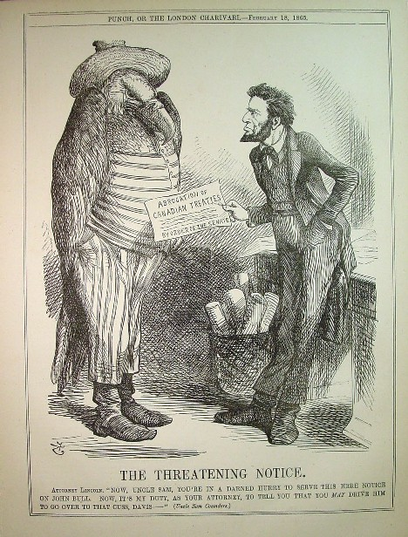
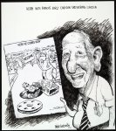
This interesting cartoon picturing Lincoln as a lawyer counseling his client the American Eagle in Uncle Sam garb to be prudent in his service of legal process lest it backfire.
It was the last caricature of Lincoln in Punch while he was alive.
http://hdl.loc.gov/loc.pnp/ppmsc.03491

Slide 15
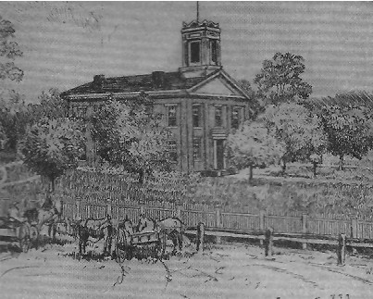
Courthouses where Abraham Lincoln pleaded cases included Macon County's First Courthouse (left), the Menard County Courthouse (center) and the Metamora Courthouse (right). Source of illustrations: Bernhardt Wall's Following Abraham Lincoln 1809-1865.
http://hdl.loc.gov/loc.pnp/ppmsca.19197

Slide 16
Wordle

