Slide 1
Lincoln And The Law
By Christopher Foley 7th

Slide 2
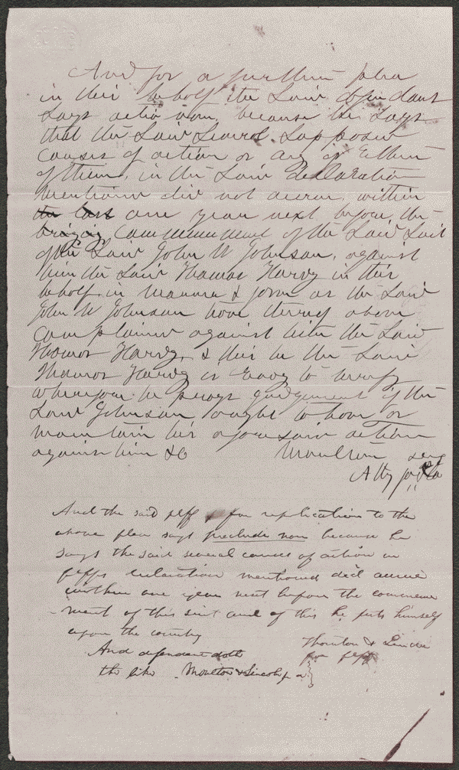
Plea, Replication in Johnson v. Hardy
Summary: Hardy accused Johnson of stealing $215 while they were on a ship in the harbor at San Francisco, California. Johnson sued Hardy in an action of slander and requested $500 in damages. Hardy retained Lincoln and pleaded not guilty. The jury found for Johnson and awarded $50 in damages. Guardian ad litem's Answer in Martin et al. v. Allen et al Plea, Replication in Johnson v. Hardy
Digital ID http://hdl.loc.gov/loc.rbc/lprbscsm.scsm1534

Slide 3
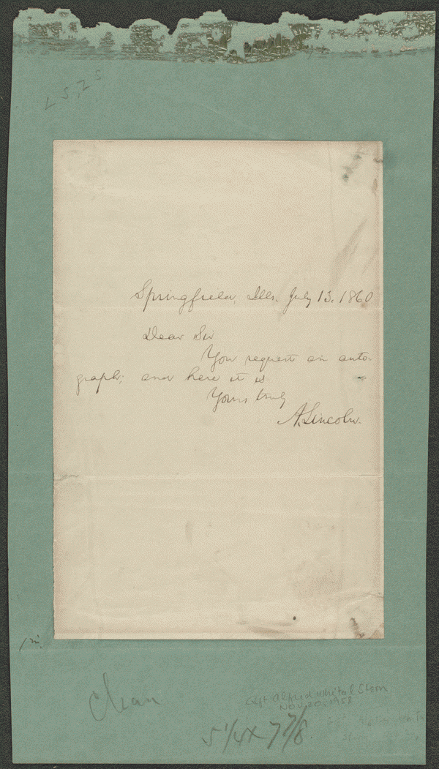
Lincoln the lawyer
Created/Published: July 13, 1860 Springfield, Illinois
http://hdl.loc.gov/loc.rbc/lprbscsm.scsm0868

Slide 4
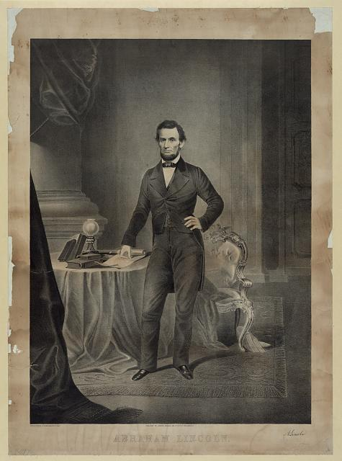
Lincoln pose’s for a picture
Created/Published May 18th , 1861
http://hdl.loc.gov/loc.pnp/pga.03364

Slide 5
The Lincoln memorial tablets in Springfield, Illinois
Created September 21, 1921 Illinois State Register
http://hdl.loc.gov/loc.rbc/lprbscsm.scsm0470

Slide 6
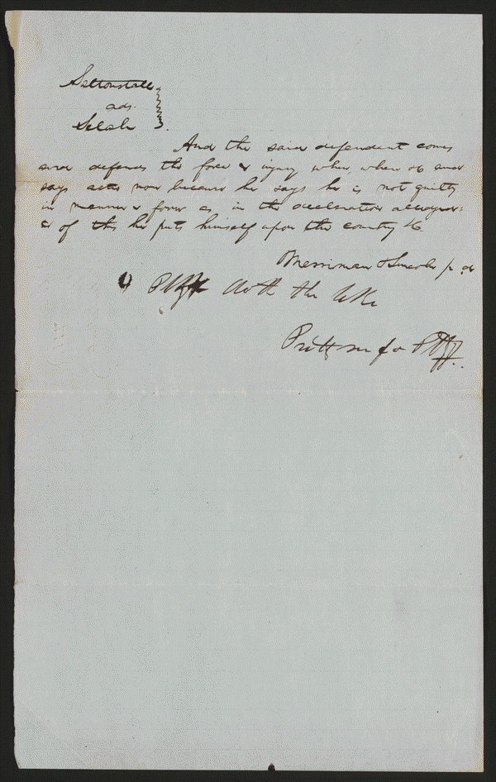
Plea in Selak v. Saltonstall
Summary: Saltonstall allegedly took a piece of iron and assaulted Selak. Selak was incapacitated for five weeks and was unable to transact any business. He also spent a great deal of money to restore his health. Selak sued Saltonstall in an action of trespass seeking $500. Saltonstall retained Lincoln and pleaded not guilty. A jury found for Selak and awarded $15 in damages.
Digital ID: http://hdl.loc.gov/loc.rbc/lprbscsm.scsm1442

Slide 7
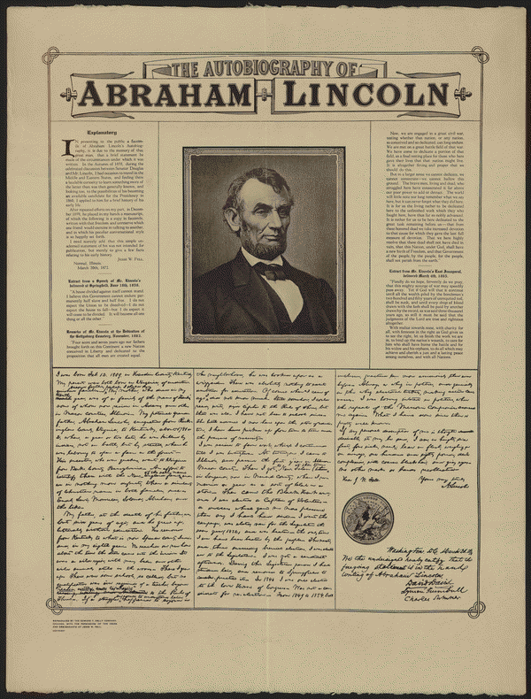
The autobiography of Abraham Lincoln
Created/Published Chicago, Illinois Edward T. Kelly Company
http://hdl.loc.gov/loc.rbc/lprbscsm.scsm0674

Slide 8
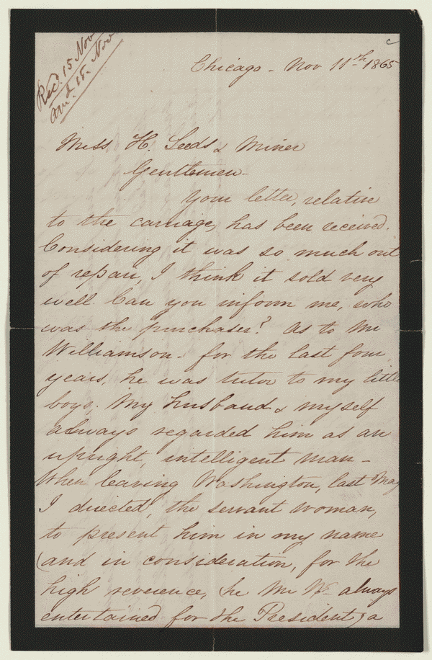
Letter to Leads and Miner from Mary Todd Lincoln, November 11, 1865.
November 22, 1865 Chicago, Illinois http://hdl.loc.gov/loc.rbc/lprbscsm.scsm1080

Slide 9
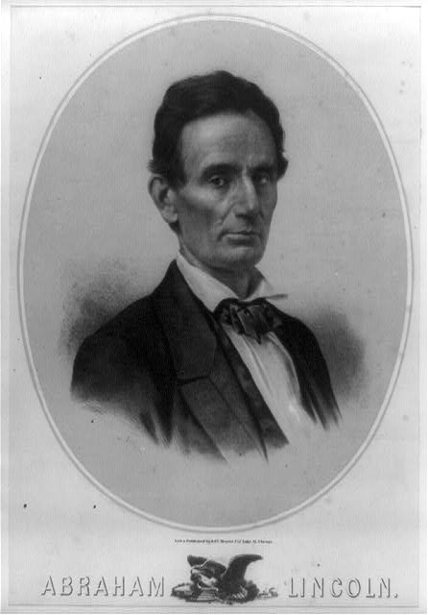
Lincoln lawyer
Library of Congress 1858 http://hdl.loc.gov/loc.pnp/cph.3b38591

