Slide 1
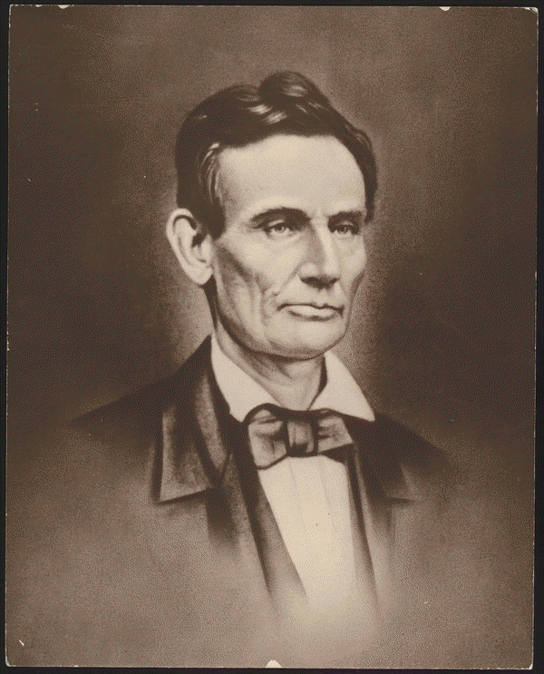
Abraham Lincoln
Digital ID
lprbscsm scsm0987 http://hdl.loc.gov/loc.rbc/lprbscsm.scsm0987
Pictures and Court Cases

Slide 2
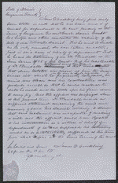
Case #1
Digital id: http://hdl.loc.gov/loc.rbc/lprbscsm.scsm1462
Created/Published
December 13, 1855 Sangamon County, Illinois
Summary: Sarah Correll, Mary Ann Herrin, and Martha McIntyre, the three married daughters of William McDaniel, and their husbands, sued their brothers, James McDaniel and Joseph McDaniel, and the other heirs of William McDaniel in a chancery action to set aside William McDaniel's will. William McDaniel dictated his will to the attending physician, Dr. Randall, to dispose his real and personal property, valued at $15,000 to $20,000. McDaniel died eleven days later. William McDaniel bequeathed the land to his sons, James McDaniel and Joseph McDaniel, and to his grandsons, William Sutcliff, Rufus McDaniel, and Robert McDaniel. The daughters and the remaining grandchildren were to receive equal shares of the personal property. Correll and others charged that William McDaniel was not mentally competent to dispose of his property, and that his two sons took advantage of their infirm father, plied him with wine, and dictated a will favorable to their interests. The daughters also stated that McDaniel's widow had renounced the will's provisions and had received her dower at an earlier term of court. They claimed that, if competent, their father would have divided the estate equally among his heirs. James McDaniel and others retained Lincoln and Herndon. The jury found for the Correll and others and declared the will void on the grounds of William McDaniel's mental incompetency. McDaniel and others continued to employ Lincoln and Herndon and appealed to the Illinois Supreme Court on the grounds that the non-resident minor defendants were neither properly summoned nor represented in the proceedings. The supreme court reversed and remanded the case. Chief Justice Caton ruled that the lower court had failed to bring all the defendants within its jurisdiction and must serve the non-residents with a summons. The supreme court refused to rule on the will's legality, choosing to leave that issue to another jury. At the trial of the remanded case, the jury found for James McDaniel and others and validated the will.

Slide 3
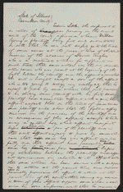
Case #2
lprbscsm scsm1440 http://hdl.loc.gov/loc.rbc/lprbscsm.scsm1440
Created/Published
May, 1850 Vermilion County, Illinois
Summary: Young sued Littler for $1,000 for assault and battery. The fight occurred on Young's property after Littler claimed that a hog belonged to him. Littler, represented by Lincoln, pleaded self-defense and claimed that Young had tried to assault him with a gun and a club. Young died, and his attorney abated the case.
*Appears to be in Lincolns hand

Slide 4
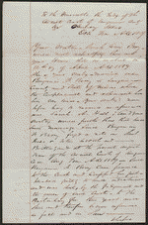
Case #3
Digital ID
lprbscsm scsm1499 http://hdl.loc.gov/loc.rbc/lprbscsm.scsm1499
Created/Published
September 06, 1859 Sangamon county, Illinois
Summary: Benjamin Berry pleaded guilty in a forgery case, and the court sentenced him to three years in the penitentiary. Sarah Berry retained Lincoln and Herndon and sued Benjamin Berry for divorce on the grounds that he was a convicted felon. Benjamin Berry failed to appear, and the court granted the divorce.
Bill for Divorce
in Berry v. Berry, [Law papers].

Slide 5
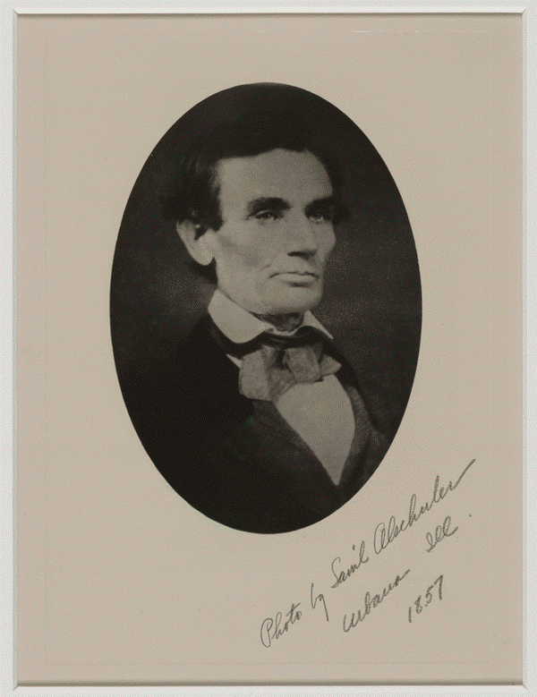
Pictures
Item Title
[Framed photograph of Lincoln by Samuel Alschuler.]
Author/Creator
Photographer: Alschuler, Samuel
Created/Published
1857 Urbana, Illinois
Digital ID
lprbscsm scsm1050 http://hdl.loc.gov/loc.rbc/lprbscsm.scsm1050

Slide 6
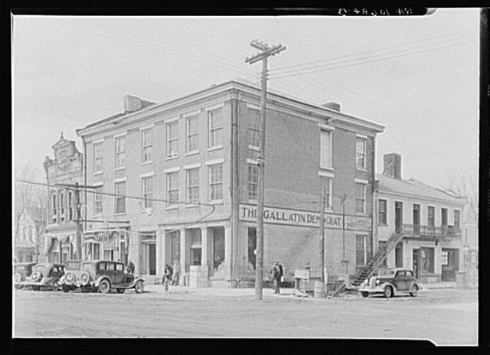
The Posey Building of Shawneetown, Illinois, in which Abraham Lincoln and Robert Ingersoll had law offices.
Lee, Russell, 1903-1986, photographer.
DIGITAL ID (intermediary roll film) fsa 8c51242 http://hdl.loc.gov/loc.pnp/fsa.8c51242

Slide 7
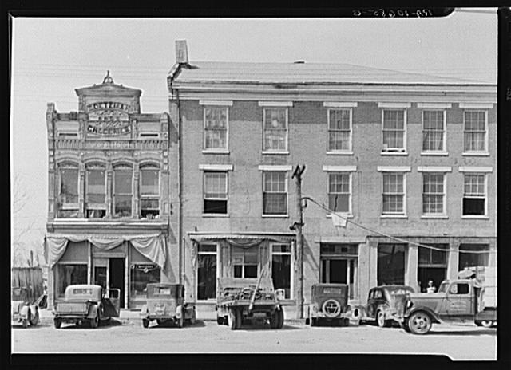
CREATED/PUBLISHED 1937 Apr.
An old grocery building and the Posey Building where Abraham Lincoln and Robert Ingersoll had law offices. Shawneetown, Illinois.
Lee, Russell, 1903-1986, photographer.
DIGITAL ID (intermediary roll film) fsa 8c51243 http://hdl.loc.gov/loc.pnp/fsa.8c51243

Slide 8
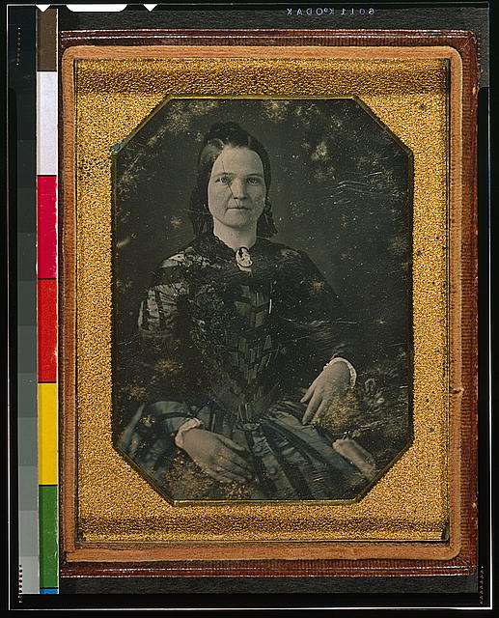
CREATED/PUBLISHED [1846 or 1847]
[Mary Todd Lincoln, wife of Abraham Lincoln. Three-quarter length portrait, seated, facing front].
Shepherd, Nicolas H., photographer.
DIGITAL ID (digital file from color film copy transparency) cph 3g06189 http://hdl.loc.gov/loc.pnp/cph.3g06189

Slide 9
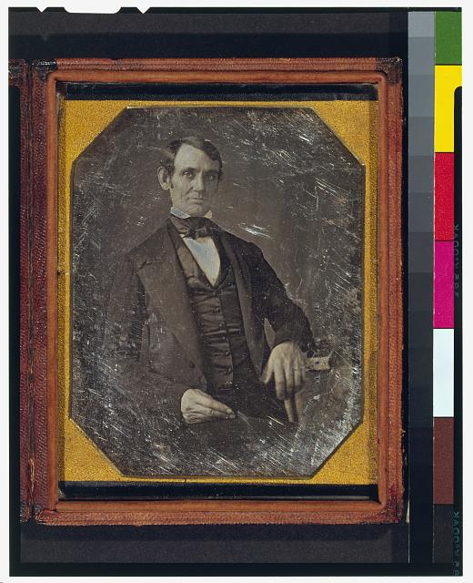
SUMMARY This daguerreotype is the earliest-known photograph of Abraham Lincoln, taken at age 37 when he was a frontier lawyer in Springfield and Congressman-elect from Illinois. (Source: Ostendorf, p. 4)
DIGITAL ID (digital file from color film copy transparency post-1992) cph 3g02439 http://hdl.loc.gov/loc.pnp/cph.3g02439
CREATED/PUBLISHED [Springfield, Ill., 1846 or 1847]

Slide 10
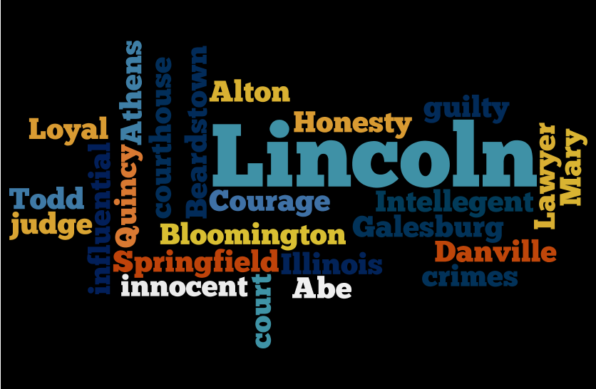
WORDLE

