Slide 1
Lincoln in the Law
TPS
Alexander Carpenter

Slide 2
Photos

Slide 3
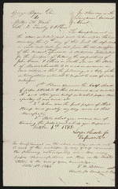
Notice to Take Deposition in Bryan & Bryan v. Wash et al, [Law papers].
http://hdl.loc.gov/loc.rbc/lprbscsm.scsm1405

Slide 4
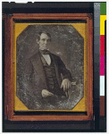
This daguerreotype is the earliest-known photograph of Abraham Lincoln, taken at age 37 when he was a frontier lawyer in Springfield and Congressman-elect from Illinois. (Source: Ostendorf, p. 4)
http://hdl.loc.gov/loc.pnp/cph.3g02439

Slide 5
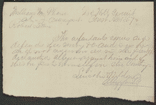
Plea in Lewis v. Phares, [Law papers].
http://hdl.loc.gov/loc.rbc/lprbscsm.scsm1474

Slide 6
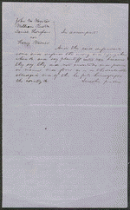
Plea in Wisner v. Wooster, Rust, & Hougham, [Law papers].

Slide 7
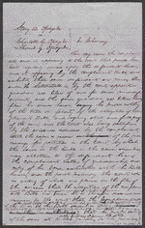
Decree in Opdycke v. Opdycke & Opdycke, [Law papers].
http://hdl.loc.gov/loc.rbc/lprbscsm.scsm1526

Slide 8
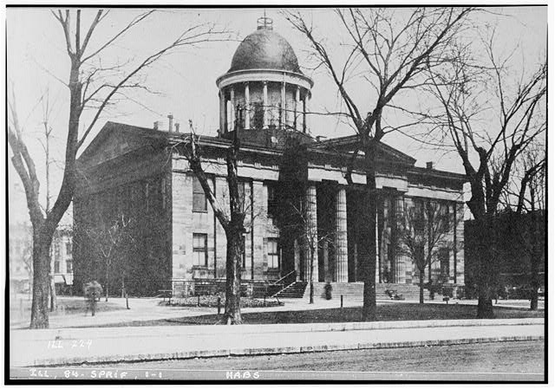
Old State House, Springfield, Sangamon County, IL
Historic American Buildings Survey:Creators
http://www.loc.gov/pictures/item/il022
/

Slide 9
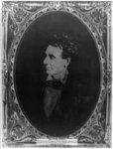
Abraham Lincoln, immediately prior to Senate nomination, Chicago, Illinois
http://www.loc.gov/pictures/item/2008678332/

Slide 10
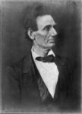
Abraham Lincoln, presidential candidate, half-length portrait, facing right

Slide 11
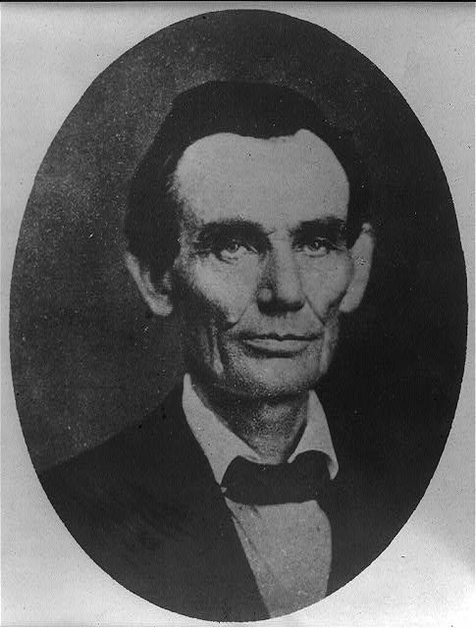
[Abraham Lincoln while a traveling lawyer, taken in Danville, Illinois
http://www.loc.gov/pictures/item/2008678328/

Slide 12
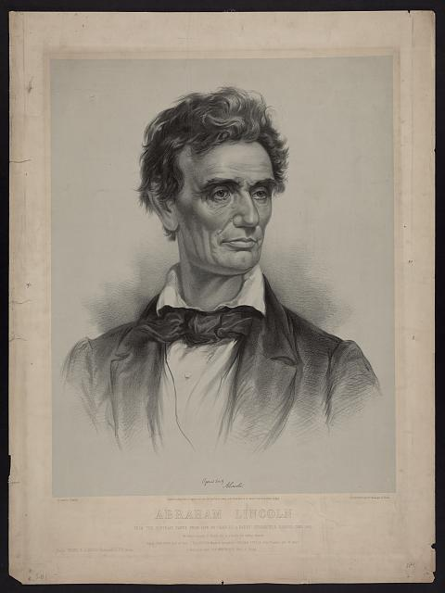
Abraham Lincoln from a portrait taken from life by Charles A. Barry, Springfield, Illinois, June 1860 / on stone by J.E. Baker ; J.H. Bufford's Lith. 313 Washington St. Boston.
http://www.loc.gov/pictures/item/2006680102/

Slide 13
Court Cases

Slide 14
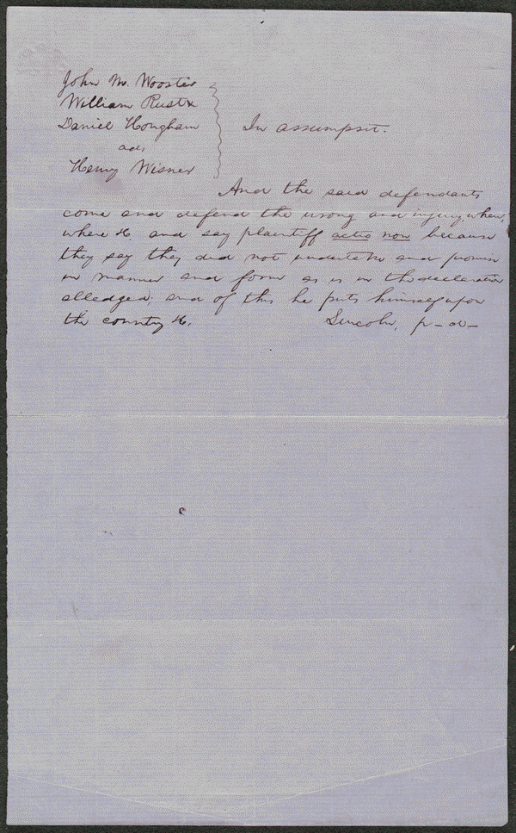
http://hdl.loc.gov/loc.rbc/lprbscsm.scsm1512
Summary: Wooster owed Wisner $3,000 for goods and merchandise.
Wooster failed to pay, and Wisner sued in an action of assumpsit seeking $3,000.
Wooster retained Lincoln and pleaded non-assumpsit. Apparently,
the parties reached an agreement, and the court dismissed the case.

Slide 15
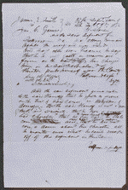
http://hdl.loc.gov/loc.rbc/lprbscsm.scsm1512
Summary: Gaines claimed that Smith stole some of his corn. Smith retained Lincoln and sued Gaines in an action of trespass on the case for slander seeking $1,000 in damages. Gaines pleaded not guilty, but a jury found for Smith and awarded $100.

Slide 16
Wordle

